Slide 1
The Work Ready Club
Bringing the world of work to life
The first ever virtual monthly networking opportunity for young people aged 16-19 in Slough.
Thanks to the generosity of the SEGRO Centenary Fund we are delighted to offer this ground-breaking activity.
FREE for young people aged 16-19 across the Slough area.
The Work Ready Club is a great way to meet a new network of business people and peers who can share their experience with you and help you develop the skills and the confidence to make your first steps in the workplace.
All you need to join is access to the internet.
https://www.learningtowork.org.uk/the-work-ready-club/

Slide 2
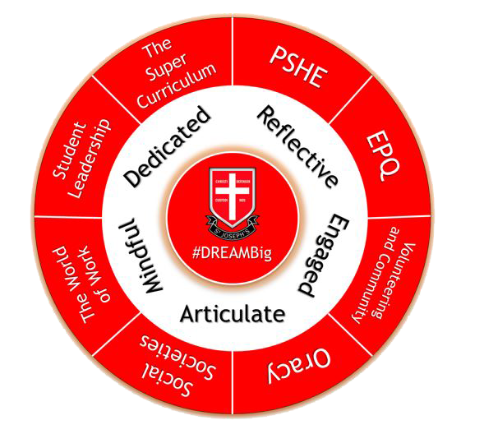
Welcome to the Super Curriculum
#DREAMBig
Notes:
How to analyse a text
Create a super curricular plan

Slide 3
Think, Pair & Share:
What does the term ‘extracurricular’ mean?
Give 3 examples of ‘extracurricular’ activities in which you have taken part throughout your life. How have they helped to develop your knowledge or skills?
Using your knowledge of the term extracurricular, what do you think ‘supercurricular’ could refer to?

Slide 4
Learning Objectives:
LO1 – to understand how the super curriculum improves student opportunities.
LO2 – to explore the various super curriculum opportunities that are on offer at St Joseph’s and beyond.
LO3 – to create a super curricular plan to improve holistic development.

Slide 5
Key Vocabulary:
Influencer - a person or thing that influences another.
Critically engage – to think about and reflect upon the content that you have read and how it impacts and shapes your existing knowledge.
Curated - (regarding online content, merchandise, information, etc.) selected, organized, and presented using professional or expert knowledge.
Holistic – the development of the whole student, not just the subject specific knowledge and skills.

Slide 6
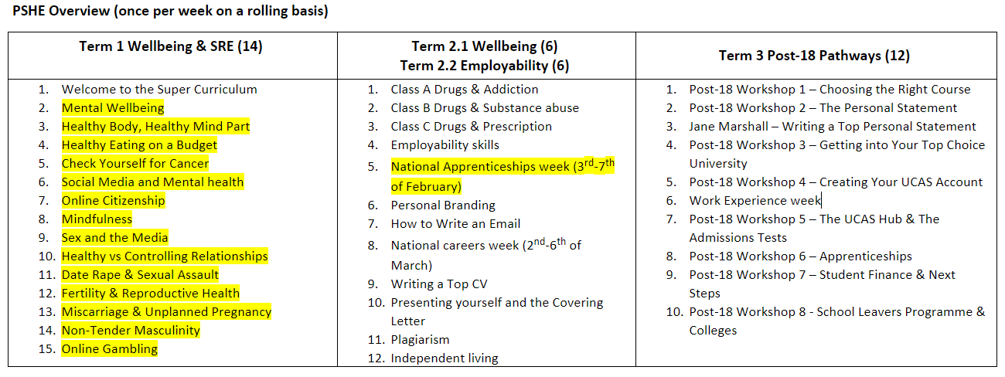
The Year 12 PSHE Learning Journey

Slide 7
What is the Super Curriculum?
LO1 – to understand how the super curriculum improves student opportunities.
LO2 – to explore the various super curriculum opportunities that are on offer at St Joseph’s and beyond.
LO3 – to create a super curricular plan to improve holistic development.
https://www.youtube.com/watch?v=C776-AX5WIY
Watch this video by Ray Amjad, a second-year student studying Physics at St John's College, University of Cambridge.
Ray has become an influencer, helping young people to improve their chances of applying to the top universities.
He has a plethora of advice and guidance for anyone apply to Higher Education, as well as study tips, on his channel.
Watch the video and consider the following questions; be ready to answer them.
What is the super curriculum?
Why is this important?
Give an example of a super curricular activity.
What were Anjam’s 6 tips?

Slide 8
Quiz:
LO1 – to understand how the super curriculum improves student opportunities.
LO2 – to explore the various super curriculum opportunities that are on offer at St Joseph’s and beyond.
LO3 – to create a super curricular plan to improve holistic development.
What is the super curriculum?
Why is this important?
Give an example of a super curricular activity.
What were Anjam’s 6 tips?
An student-led academic activity, independent of the classroom that contributes to your subject specific learning.
The super curriculum helps students to achieve ‘mastery’ of a given topic as well as helping your UCAS application being highly competitive.
Debate club, reading subject specific magazines, reading lists of books, competitions, documentaries, podcasts and much more!
1. Start early, 2. Start small, 3. Keep a record (how does what you have learnt impact your existing understanding?), 4. Follow a story (show a methodical and logical path of learning rather than darting around to different articles/sources, 5. What are you getting out of it? Go into detail, 6. Do something you enjoy!

Slide 9
The Super Curriculum at St Joe’s
LO1 – to understand how the super curriculum improves student opportunities.
LO2 – to explore the various super curriculum opportunities that are on offer at St Joseph’s and beyond.
LO3 – to create a super curricular plan to improve holistic development.
#DREAMBig
We call our super curriculum at St Joseph’s ‘Dream Big’. The vision behind this is that we provide the education, opportunities and fostering the ambition for all of our students in order to achieve the very best life opportunities available.

Slide 10
The Super Curriculum at St Joe’s
LO1 – to understand how the super curriculum improves student opportunities.
LO2 – to explore the various super curriculum opportunities that are on offer at St Joseph’s and beyond.
LO3 – to create a super curricular plan to improve holistic development.
#DREAMBig
Our super curriculum includes all of the things that you see in the wheel on the left and have been carefully designed to provide holistic development.
This means, making you competitive in applying to the top universities/jobs, having a well-rounded knowledge of the world as well as top achievers in your subject.

Slide 11
The Super Curriculum at St Joe’s
LO1 – to understand how the super curriculum improves student opportunities.
LO2 – to explore the various super curriculum opportunities that are on offer at St Joseph’s and beyond.
LO3 – to create a super curricular plan to improve holistic development.
PSHE – we have chosen topics that help prepare you for life beyond sixth form (e.g. finance, accountability) as well as providing learning about law and thinking skills such as how to form an argument and how to spot logical flaws in the arguments of others.
The Great Conversation – this is a course of videos that introduces you to a wide range of concepts and facts that form the basis of many of the subjects that you study. It is a study of general knowledge that will help you to understand the greater context of the world in which we live
VESPA – this is a course that develops your study skills to make you a more effective learner.

Slide 12
The Super Curriculum at St Joe’s
LO1 – to understand how the super curriculum improves student opportunities.
LO2 – to explore the various super curriculum opportunities that are on offer at St Joseph’s and beyond.
LO3 – to create a super curricular plan to improve holistic development.
EPQ – this provides you with skills of academic literacy that you will use at university, such as essay writing, forming an effective argument and research methods.
The World of Work – the information and guidance that we provide via the PSHE unit, trips (National College and Leavers Show), speakers (NAW), Friday form time, the interactive book, external workshops and the access to eClips and Start Profile. This will prepare you well for being competitive in the labour market.
The Social Society – sixth form students that develop their leadership skills by planning events for the sixth form.

Slide 13
The Super Curriculum at St Joe’s
LO1 – to understand how the super curriculum improves student opportunities.
LO2 – to explore the various super curriculum opportunities that are on offer at St Joseph’s and beyond.
LO3 – to create a super curricular plan to improve holistic development.
Student Leadership – the various roles within the school, along with the Leadership Unit in PSHE, help students to develop their leadership skills.
The Super Curriculum – whilst is includes all of the initiatives that we have just looked at, on the following pages are more super curricular activities that we suggest.

Slide 14
The Super Curriculum at St Joe’s
LO1 – to understand how the super curriculum improves student opportunities.
LO2 – to explore the various super curriculum opportunities that are on offer at St Joseph’s and beyond.
LO3 – to create a super curricular plan to improve holistic development.
Student Leadership – the various roles within the school, along with the Leadership Unit in PSHE, help students to develop their leadership skills.
The Super Curriculum – whilst is includes all of the initiatives that we have just looked at, on the following pages are more super curricular activities that we suggest.

Slide 15
A range of resources and opportunities.
LO1 – to understand how the super curriculum improves student opportunities.
LO2 – to explore the various super curriculum opportunities that are on offer at St Joseph’s and beyond.
LO3 – to create a super curricular plan to improve holistic development.

Slide 16
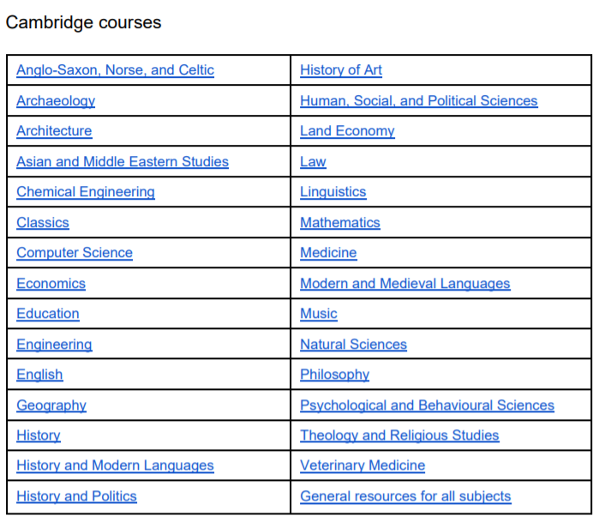
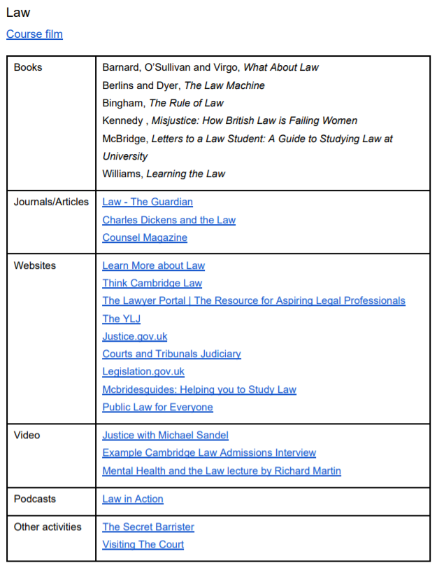
Here is what Cambridge Suggest:
Strong applicants to Cambridge and other competitive universities tend to have explored their chosen subject through wider reading outside the classroom, as well as doing very well in their GCSEs and A-levels. We call this sort of exploration ‘super-curricular’, as it builds on and enhances what you are studying in school. It is important to read critically by thinking carefully about the arguments, assumptions and evidence presented by the author. Reading is a great way to explore subjects that you find interesting
https://www.undergraduate.study.cam.ac.uk/files/publications/super-curricular_suggestions.pdf

Slide 17
Events and Courses
LO1 – to understand how the super curriculum improves student opportunities.
LO2 – to explore the various super curriculum opportunities that are on offer at St Joseph’s and beyond.
LO3 – to create a super curricular plan to improve holistic development.
Sutton Trust Pathways
Sutton Trust UK University Summer School
Sutton Trust US University Summer School
Sutton Trust UK Apprenticeship Summer School
Oxford Mentoring Scheme
Eton Oxbridge Preparation Day
Joe Organ – Brasenose College
UNIQ
PiXL Conferences ("Getting in to a Top University" and "Why Should We Make You an Offer?")
Meet the Russell Group
The Social Mobility Aspiring Professionals Programme
Exhibitions and Open Days (https://www.opendays.com/)

Slide 18
Exhibitions and Open Days
Exhibitions/Lectures
Eton Societies (sent via email)
Thames Valley Learning Partnership (sent via email)
Free Video Lectures (https://freevideolectures.com/)
Open Days - https://www.opendays.com/
LO1 – to understand how the super curriculum improves student opportunities.
LO2 – to explore the various super curriculum opportunities that are on offer at St Joseph’s and beyond.
LO3 – to create a super curricular plan to improve holistic development.

Slide 19
Massive Open Online Lectures
LO1 – to understand how the super curriculum improves student opportunities.
LO2 – to explore the various super curriculum opportunities that are on offer at St Joseph’s and beyond.
LO3 – to create a super curricular plan to improve holistic development.
https://www.futurelearn.com/

Slide 20
The Reading List 2.0
New and improved!
A list of things to read, things to go see and careers guidance; compiled by your subject leaders.
LO1 – to understand how the super curriculum improves student opportunities.
LO2 – to explore the various super curriculum opportunities that are on offer at St Joseph’s and beyond.
LO3 – to create a super curricular plan to improve holistic development.

Slide 21
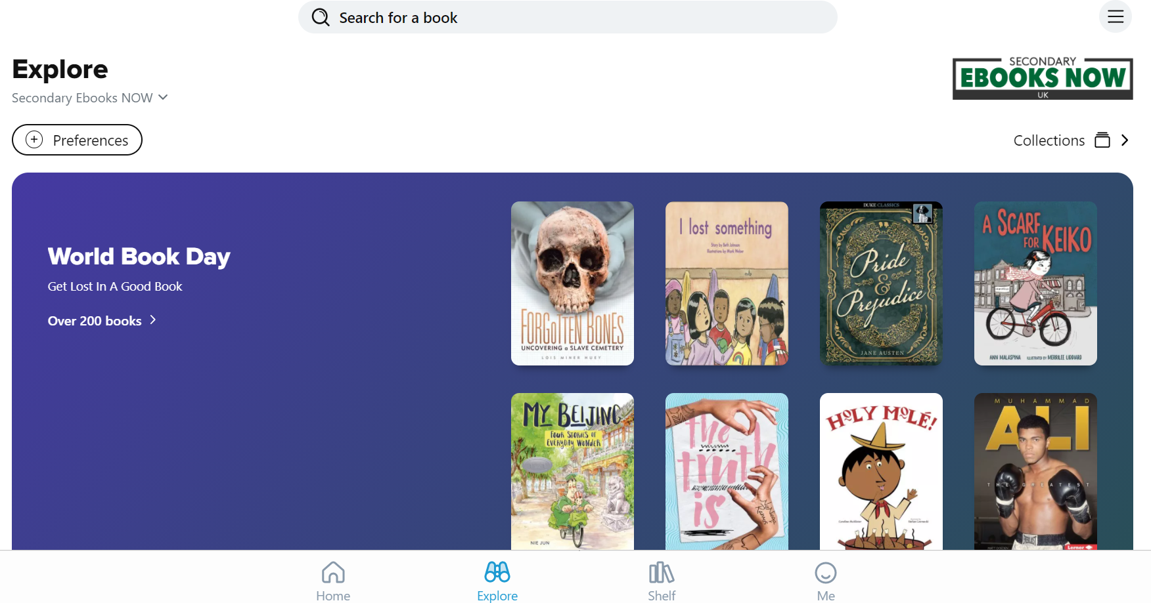
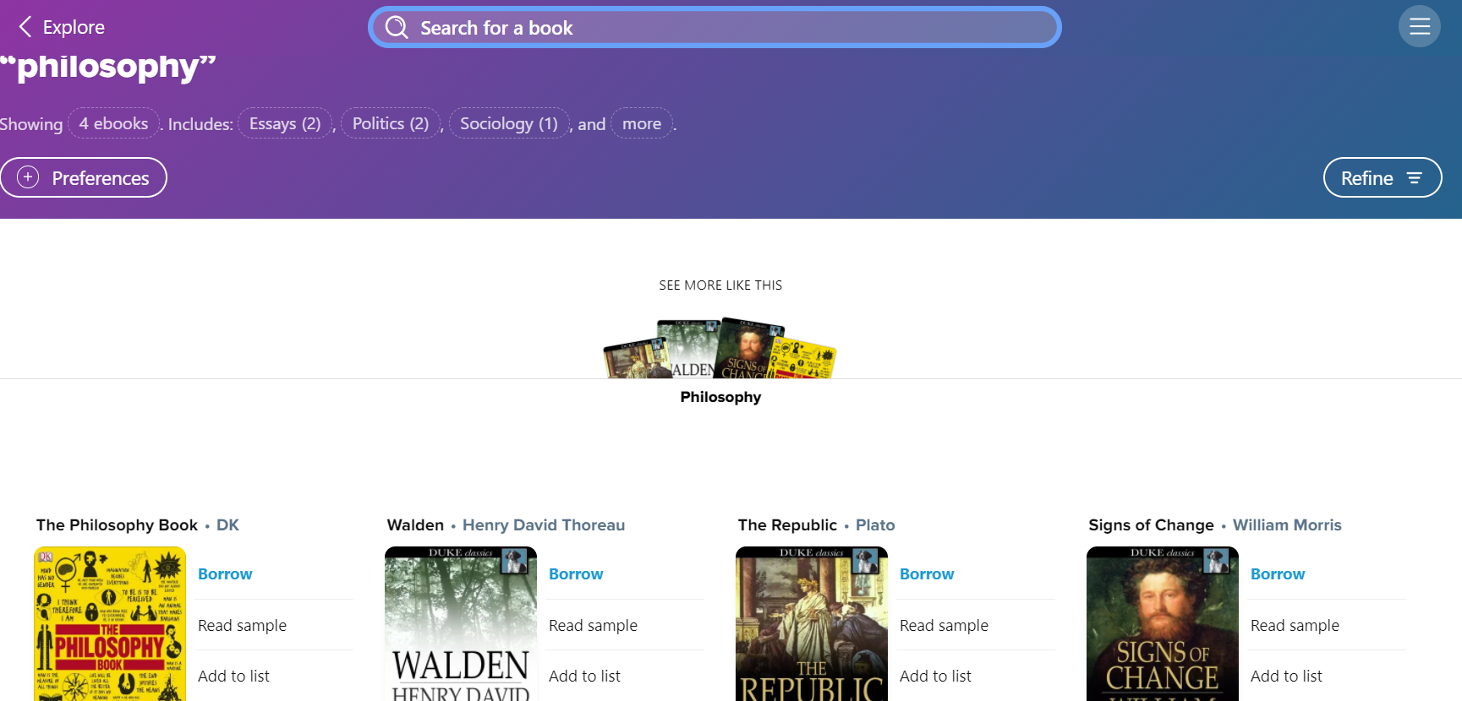
Sora App
LO1 – to understand how the super curriculum improves student opportunities.
LO2 – to explore the various super curriculum opportunities that are on offer at St Joseph’s and beyond.
LO3 – to create a super curricular plan to improve holistic development.

Slide 22
Electronic Library
We have recently purchased an online library for both the staff and students to use. The library is home to over 2000 books that you can take out for free.
To access the library please download the Sora app: www.soraapp.com
You will be brought to the following page:
You will then be brought to a log-in page that looks like this:
Please note that your user name and password is the same at your computer log in. For example:
m.banks (first initial . surname)
Your password is your St. Joseph’s password
Click on the green box. You will be re-directed to another page where you will need to type in our school: St. Joseph’s Catholic High School

Slide 23
Form Book Boxes
Title and Author | For students of
Film Form – Sergei Eisentstein | Media Studies
Republic – Plato | Philosophy and Ethics, Politics & Law
Why Do Buses Come in Threes? | Maths
The Puzzle of Ethics – Peter Vardy | Philosophy & Ethics
Introducing Psychology: A Graphic Guide to Your Mind and Behaviour – Nigel Benson | Psychology
Natives: Race and Class in the Ruins of Empire – Akala | History, Politics and Sociology
The Madness of Crowds: Gender, Race and Identity – Douglas Murray | Sociology
Powerdown: Options and Actions for a Post-Carbon World – Richard Heinberg | Geography & Economics
Sapiens – Yuval Noah Harari | Sociology, Biology and History
Adam Smith: What He Thought, and Why it Matters – Jesse Norman | Business Studies, Politics & Economics
Eats, Shoots and Leaves – Lynne Truss | English Language
On Liberty – JS Mill | Philosophy & ethics and Politics)
The Interpretation of Dreams – Sigmund Freud | Psychology
Homage to Catalonia – George Orwell | Spanish, Politics, History
On the Road – Jack Kerouac | English Literature and Sociology
LO1 – to understand how the super curriculum improves student opportunities.
LO2 – to explore the various super curriculum opportunities that are on offer at St Joseph’s and beyond.
LO3 – to create a super curricular plan to improve holistic development.

Slide 24
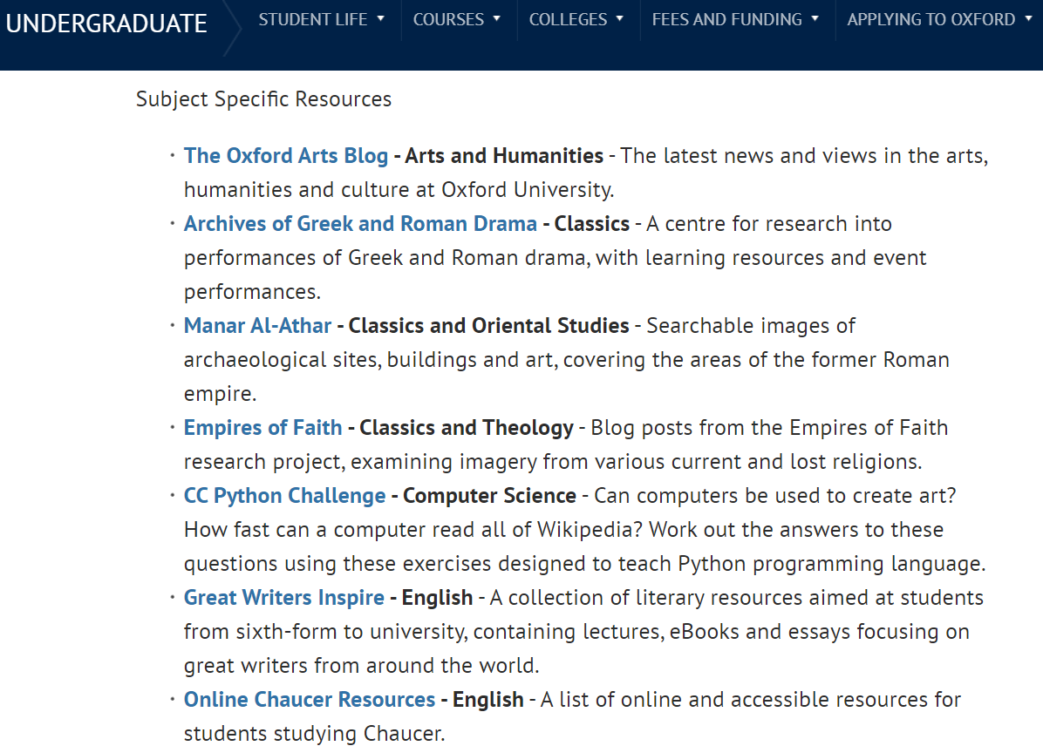
Oxford’s Digital Resources
https://www.ox.ac.uk/admissions/undergraduate/increasing-access/ug-digital-resources/students-over-16
What’s available?
Resources from Oxford
Oxplore
Subject Specific (see right – in uni)
General Resources
Applying to Oxford (for all top unis)
Recommended External Resources
General Resources
Museums and Galleries
Subject Specific (external)
LO1 – to understand how the super curriculum improves student opportunities.
LO2 – to explore the various super curriculum opportunities that are on offer at St Joseph’s and beyond.
LO3 – to create a super curricular plan to improve holistic development.

Slide 25
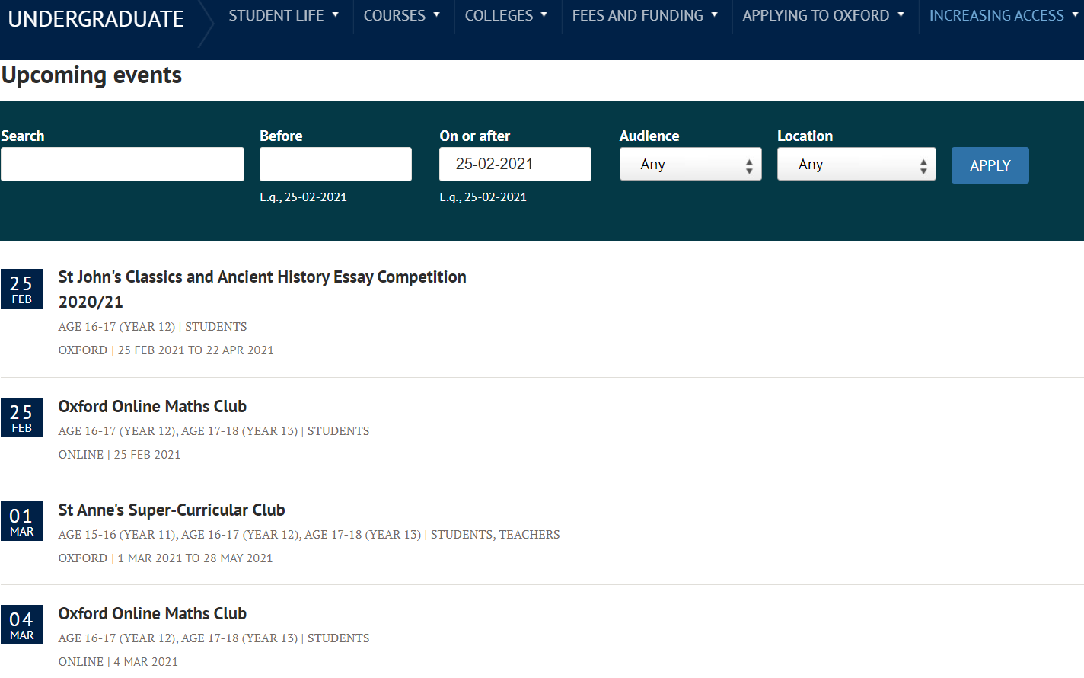
Oxford’s Events
https://www.ox.ac.uk/admissions/undergraduate/increasing-access/events-calendar
LO1 – to understand how the super curriculum improves student opportunities.
LO2 – to explore the various super curriculum opportunities that are on offer at St Joseph’s and beyond.
LO3 – to create a super curricular plan to improve holistic development.

Slide 26
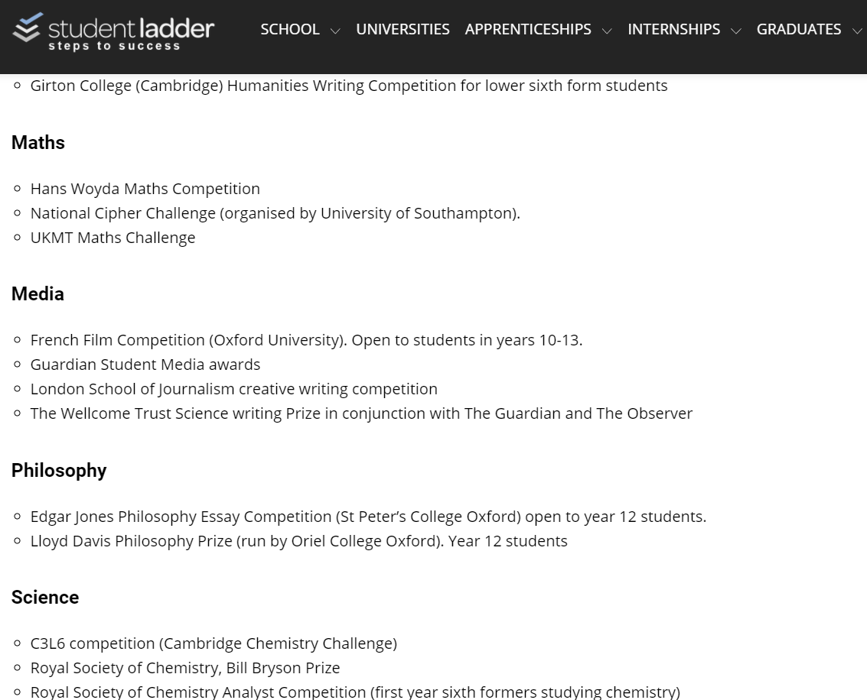
Student Ladder Bank of Competitions
https://www.studentladder.co.uk/year-12/entering-competitions/
Why take part in competitions?
Show your competitive edge.
Show your qualities and skills.
Show the creative talent you have in your discipline.
Develop the highest of thinking skills with composition.
Practice makes perfect.
LO1 – to understand how the super curriculum improves student opportunities.
LO2 – to explore the various super curriculum opportunities that are on offer at St Joseph’s and beyond.
LO3 – to create a super curricular plan to improve holistic development.

Slide 27
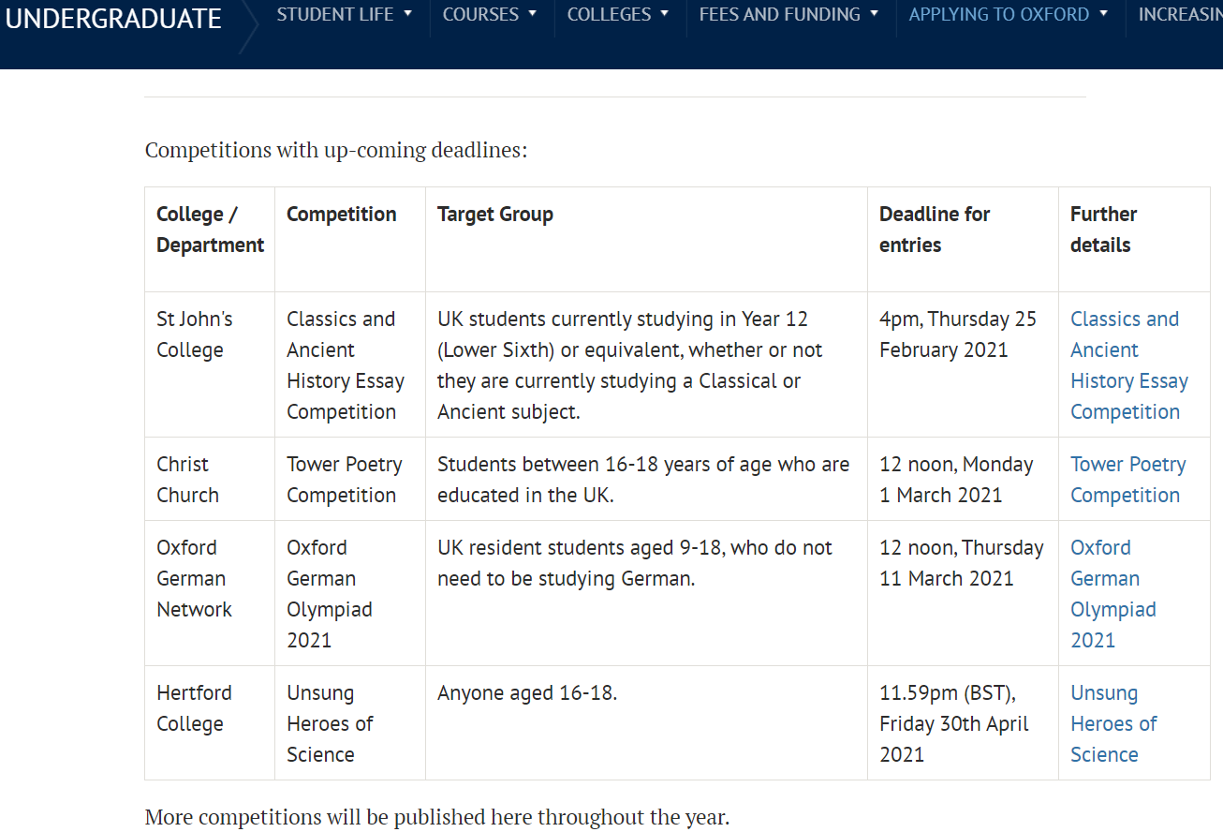
Oxford’s Competitions
https://www.ox.ac.uk/admissions/undergraduate/applying-to-oxford/teachers/academic-competitions-schools-and-colleges
LO1 – to understand how the super curriculum improves student opportunities.
LO2 – to explore the various super curriculum opportunities that are on offer at St Joseph’s and beyond.
LO3 – to create a super curricular plan to improve holistic development.

Slide 28
Oxplore
LO1 – to understand how the super curriculum improves student opportunities.
LO2 – to explore the various super curriculum opportunities that are on offer at St Joseph’s and beyond.
LO3 – to create a super curricular plan to improve holistic development.
Use the template on the next page to make notes.
https://oxplore.org/
https://youtu.be/oFdh7xk3FgE How does it work?
Choose a question, select an answer and delve into the curated information that Oxplore have provided to support arguments from both sides.

Slide 29
Critical Thinking
Thursday – 8am – A5 with Mr Clark
“The study of ‘logic’ in order to seek truth”.
Essential for the Oxbridge, LNAT, BMAT, UCAT and achieving A*-B.
LO1 – to understand how the super curriculum improves student opportunities.
LO2 – to explore the various super curriculum opportunities that are on offer at St Joseph’s and beyond.
LO3 – to create a super curricular plan to improve holistic development.

Slide 30
LO1 – to understand how the super curriculum improves student opportunities.
LO2 – to explore the various super curriculum opportunities that are on offer at St Joseph’s and beyond.
LO3 – to create a super curricular plan to improve holistic development.
Crash Course Subject Playlists:
Anatomy - https://thecrashcourse.com/courses/anatomy
Astronomy - https://thecrashcourse.com/courses/astronomy
Scientific History 1 - https://thecrashcourse.com/courses/bighistory
Scientific History 2 - https://thecrashcourse.com/courses/historyofscience
Biology - https://thecrashcourse.com/courses/biology
Entrepreneurship - https://thecrashcourse.com/courses/businessentrepreneurship
Employability - https://thecrashcourse.com/courses/businesssoftskills
Chemistry - https://thecrashcourse.com/courses/chemistry
Computer Science - https://thecrashcourse.com/courses/computerscience
Geography - https://thecrashcourse.com/courses/ecology
Engineering - https://thecrashcourse.com/courses/engineering
European History - https://thecrashcourse.com/courses/europeanhistory
Film Studies - https://thecrashcourse.com/courses/film
Media Literacy - https://thecrashcourse.com/courses/medialiteracy
Literature - https://thecrashcourse.com/courses/literature
Critical Consumer of Online Information - https://thecrashcourse.com/courses/navigatingdigitalinfo
Philosophy & Ethics - https://thecrashcourse.com/courses/philosophy
Physics - https://thecrashcourse.com/courses/physics
Psychology - https://thecrashcourse.com/courses/psycholog y
Sociology - https://thecrashcourse.com/courses/sociology
Statistics - https://thecrashcourse.com/courses/statistics
Performing Arts - https://thecrashcourse.com/courses/theaterdrama
US History - https://thecrashcourse.com/courses/ushistory
World History - https://thecrashcourse.com/courses/worldhistory1
World History 2 - https://thecrashcourse.com/courses/worldhistory2

Slide 31
Ted Talks
LO1 – to understand how the super curriculum improves student opportunities.
LO2 – to explore the various super curriculum opportunities that are on offer at St Joseph’s and beyond.
LO3 – to create a super curricular plan to improve holistic development.
https://www.ted.com/talks
Select a video that is related to your subject area or even for general interest. Remember to make notes and reflect on how it impacts your existing learning.

Slide 32
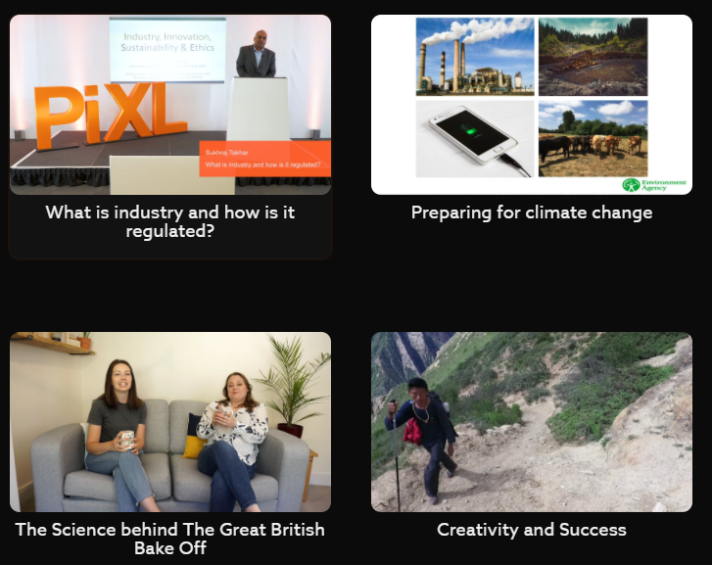
PiXL Stretch
PiXL Stretch is a library of Ted Talk style videos to help you to be “stretched” intellectually and to experience/learn about new innovations, ideas, research and people.
Each video has accompanying resources on a PowerPoint.
Follow the link to the video and download the activities to complete alongside it to help you engage critically with the content.

Slide 34
How to Critically Engage with the Content.
LO1 – to understand how the super curriculum improves student opportunities.
LO2 – to explore the various super curriculum opportunities that are on offer at St Joseph’s and beyond.
LO3 – to create a super curricular plan to improve holistic development.

Slide 35
Title:
________________________________________________________________________________________________________________________________________________________________________________________________________________________________________________________________________________________________________________________________________________________________________________________________________________________________________________________________________________________________________________________________________________________________________________________________________________________________________________________________________________________________________________________________________________________________________________________________________________________________________________________________________________________________________________________________________________________________________________________________
Key ideas
Most interesting points made are…

Slide 36
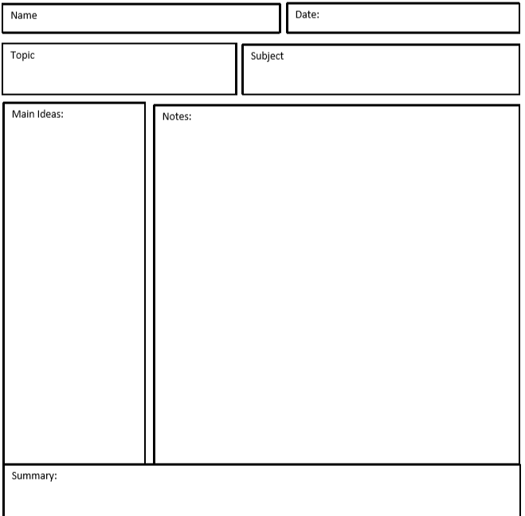
LO1 – to understand how the super curriculum improves student opportunities.
LO2 – to explore the various super curriculum opportunities that are on offer at St Joseph’s and beyond.
LO3 – to create a super curricular plan to improve holistic development.
Taking Notes (Cornell and Outline method):
https://youtu.be/E7CwqNHn_Ns - the first step in honing your new study skills is to take better notes. This week Thomas will tell you everything you need to know to come to class prepared and find a note-taking system that will help you retain and review like a champ.

Slide 37
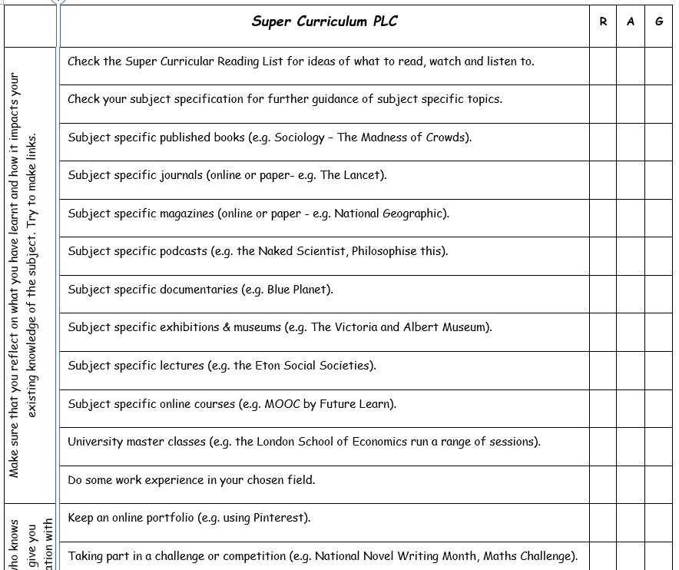

Slide 38
Create a Super Curricular Plan.
LO1 – to understand how the super curriculum improves student opportunities.
LO2 – to explore the various super curriculum opportunities that are on offer at St Joseph’s and beyond.
LO3 – to create a super curricular plan to improve holistic development.

Slide 39
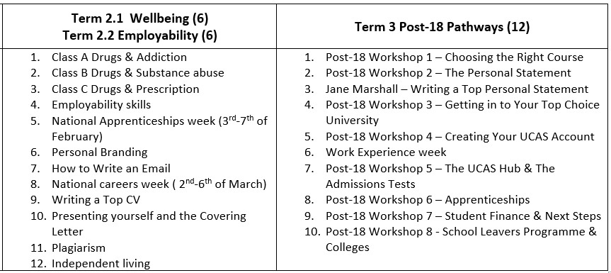
Futures Survey Part 1
In the next term you will complete a Futures survey, which will gauge your Career Pathway, your progress made towards Super Curricular learning and provide you with an opportunity for reflection on skills and qualities needed for life beyond sixth form.
LO1 – to understand how the super curriculum improves student opportunities.
LO2 – to explore the various super curriculum opportunities that are on offer at St Joseph’s and beyond.
LO3 – to create a super curricular plan to improve holistic development.

Slide 40
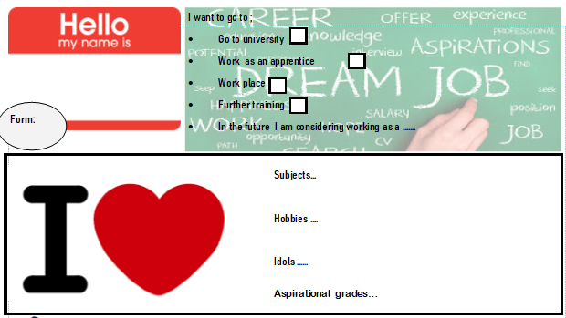
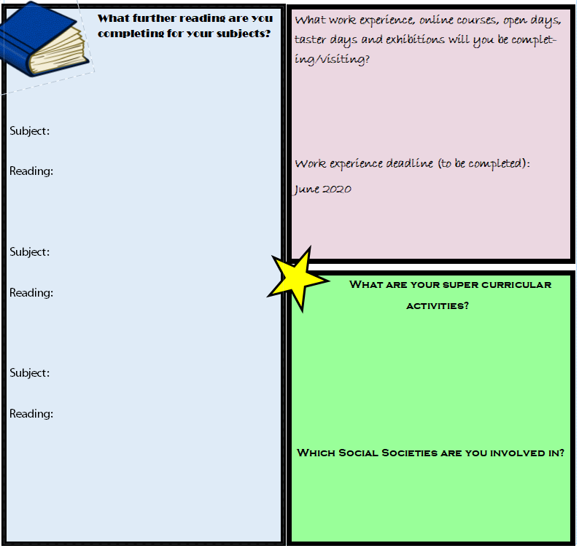
Task) you are going to create a super curricular plan.
Review your pupil profile from the first term.
Fill out a second profile and update it with specific content and resources you are going to read. Send to your PSHE teacher.
LO1 – to understand how the super curriculum improves student opportunities.
LO2 – to explore the various super curriculum opportunities that are on offer at St Joseph’s and beyond.
LO3 – to create a super curricular plan to improve holistic development.

Slide 41
Learning Objectives:
LO1 – to understand how the super curriculum improves student opportunities.
LO2 – to explore the various super curriculum opportunities that are on offer at St Joseph’s and beyond.
LO3 – to create a super curricular plan to improve holistic development.
Think, Pair & Share
With your partner, discuss the following questions:
What was one thing that you learnt today?
What did you not understand and need clarifying. Can you partner help you?

