Slide 1
Reflection:
When is your UCAS application deadline?
How many choices do you make?
What metric have we told you to use to judge what sort of choices you should make (regarding entry requirements).
What happens next after you get all of your offers?
Tell me 3 things that make a good personal statement.

Slide 2
Notices:
Sixth Form Parents Evening 26th November for Yr 12 and 13.

Slide 3
I talk about this in today’s session

Slide 5
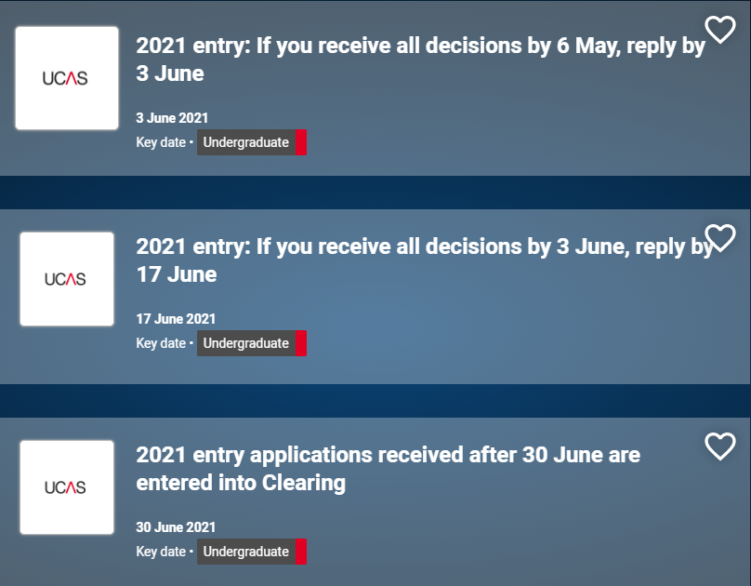
I talk about this in today’s session

Slide 7
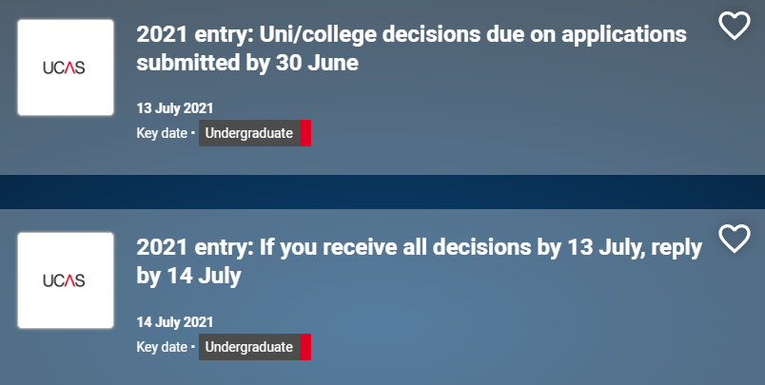
I talk about this in today’s session

Slide 8
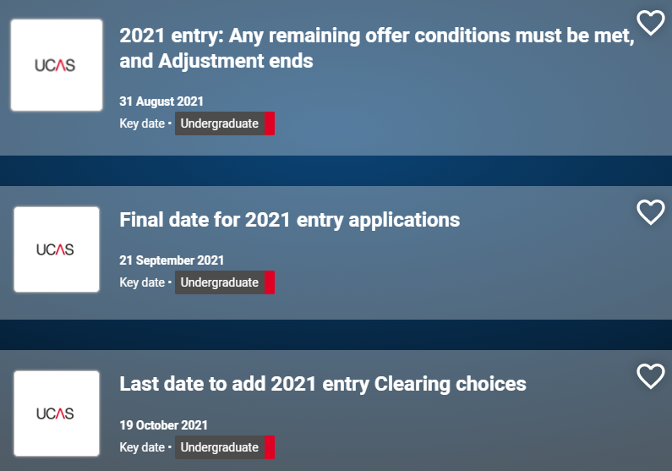

Slide 9
So what is UCAS Extra?
If you've used all five choices on your application, and you're not holding any offers, you could still find a place using Extra between 25th February and 5th July – it's free!

Slide 10
So what is UCAS Adjustment?
The potential to swap to a different course if you meet and exceed your offer.
Adjustment is available from A level results day (13 August 2020), until 31 August and is optional. No harm in looking?

Slide 11
So what is Clearing?
From 6 July to 20 October, you can apply for a course using Clearing if you’re not already holding an offer from a university or college, and the course still has places.
You can use Clearing if:
you’re applying after 30 June
you didn’t receive any offers (or none you wanted to accept)
you didn’t meet the conditions of your offers
you’ve declined your firm place using the ‘decline my place’ button in Track

Slide 12
So what is Clearing?
You'll know you're in Clearing if your Track status says 'You are in Clearing‘.
Get in touch with the universities/colleges if it's taking a while – they might still be considering you, even if your results are a bit lower than required.
If you originally only applied for one course for the reduced fee of £20, you'll have to pay an additional £5 to apply through Clearing.

Slide 13
The Clearing Process
Typically, you will go through clearing on results day.
Ask for clearing advice (laptops set up at school, careers advisor and teachers).
See what courses are available on the UCAS Clearing Search Tool.
Give the Universities a ring – you are in a strong position. Sound out their offers but do not verbally agree to anything until you are sure!
Add your Clearing choice in track.

Slide 14
So what is Clearing?
From 6 July to 20 October, you can apply for a course using Clearing if you’re not already holding an offer from a university or college, and the course still has places.
You can use Clearing if:
you’re applying after 30 June
you didn’t receive any offers (or none you wanted to accept)
you didn’t meet the conditions of your offers
you’ve declined your firm place using the ‘decline my place’ button in Track

Slide 15
So what is Clearing?
From 6 July to 20 October, you can apply for a course using Clearing if you’re not already holding an offer from a university or college, and the course still has places.
You can use Clearing if:
you’re applying after 30 June
you didn’t receive any offers (or none you wanted to accept)
you didn’t meet the conditions of your offers
you’ve declined your firm place using the ‘decline my place’ button in Track

Slide 16
Unconditional Offers
Unconditional offers mean that students are offered a placed regardless of results:
Greatly impacts motivation.
Research shows that it impacts performance.
More likely to miss targets by 1 or 2 grades.
Importance of A Level grades in future CVs.
It is a journey – your A Level skills and knowledge will form the basis of your degree level study.

Slide 17
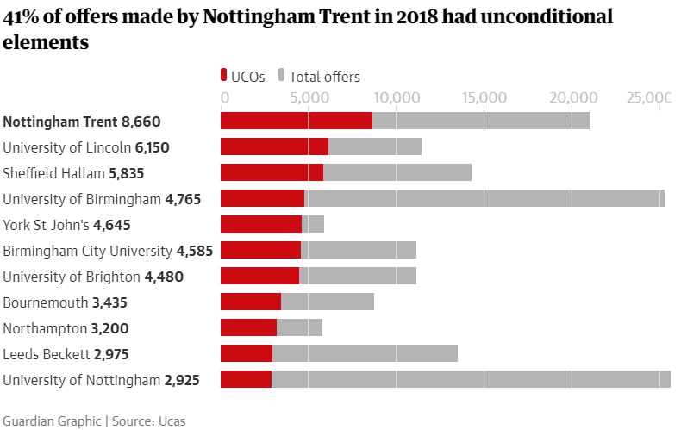
Earnings for those graduating from universities that offer the most = £21,890 on average
Those universities who offer the fewest = £30,180 on average
After the first sixth months of graduation.

Slide 18
It may well work for you, just be aware of the potential outcomes.
We want to make sure you have all of the information for any choice that you make ☺

Slide 19
Finance

Slide 20
Student Finance Explained
On the YouTube playlist below, you will find the following six videos for your guidance on Student Finance:
When and how to apply? 2020/21
Eligibility 2020/21
What can I get? 2020/21
Student Finance Explained 2019/20
Student Finance Application Journey 2019/20
Student finance for EU students 2019/20
How and when to apply for student finance 2019/20
Evidence to support your student finance application 2019/20
Repaying student loans 2019/20
Updating your student finance application
https://www.youtube.com/watch?v=Qtv4Wm02C2A&list=PL9uCQbM0tQyu1gQjpJr6wLjWWqJV2p148

Slide 21
https://www.gov.uk/apply-for-student-finance
New students from England – PN1 form.
New EU students – EU19N form.
The deadline is 9 months after the first day of the course’s academic year. Academic years begin on 1 September, 1 January, 1 April and 1 July.
If you begin on the 1st of September, you can apply for finance for that academic year all the way up to the June of that year.

Slide 22
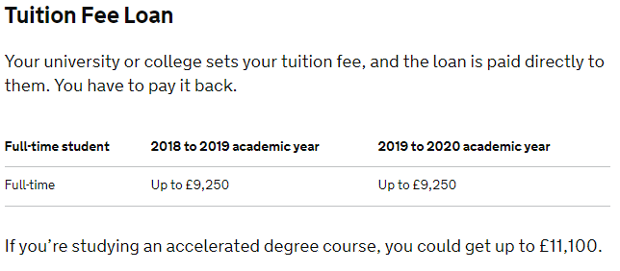
Home students

Slide 23
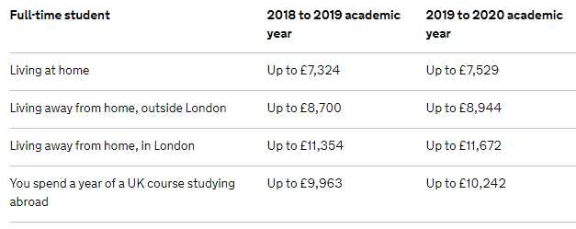
Home students

Slide 24
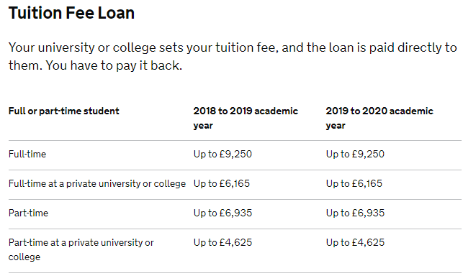
EU students

Slide 25
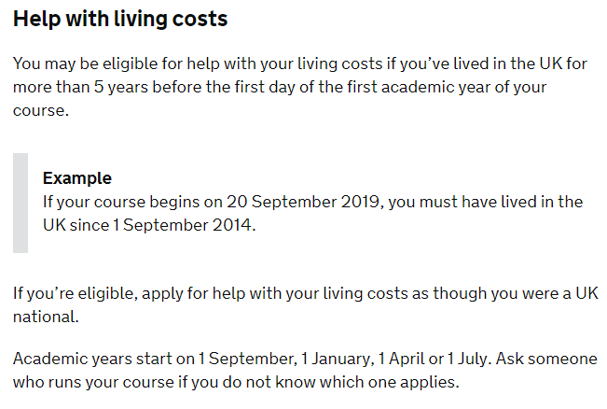
EU students

Slide 26
Need a little extra help?

Slide 27
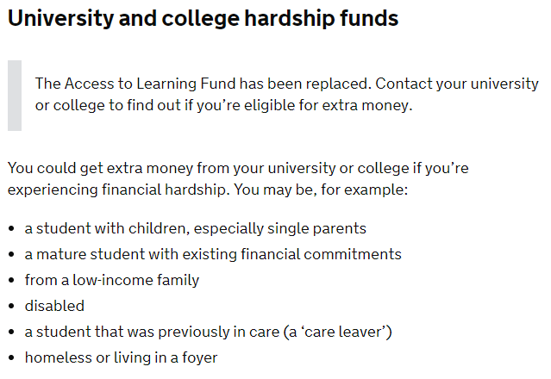
Need a little extra help?

Slide 28
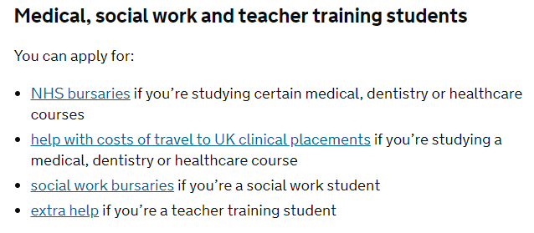
Need a little extra help?

Slide 29
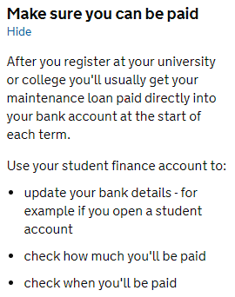
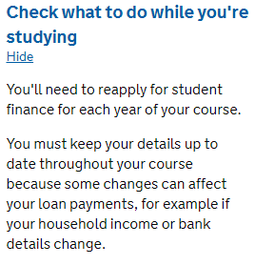
Financial Matters

Slide 30
https://www.savethestudent.org/

Slide 31
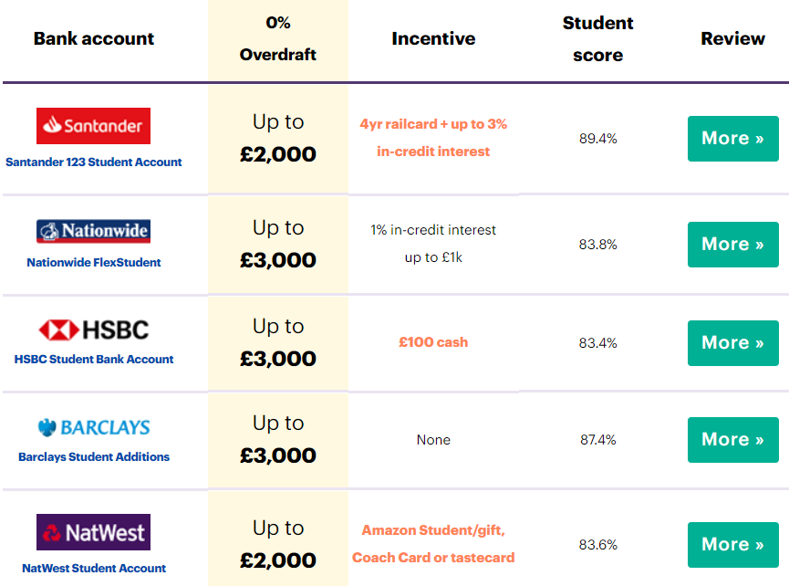
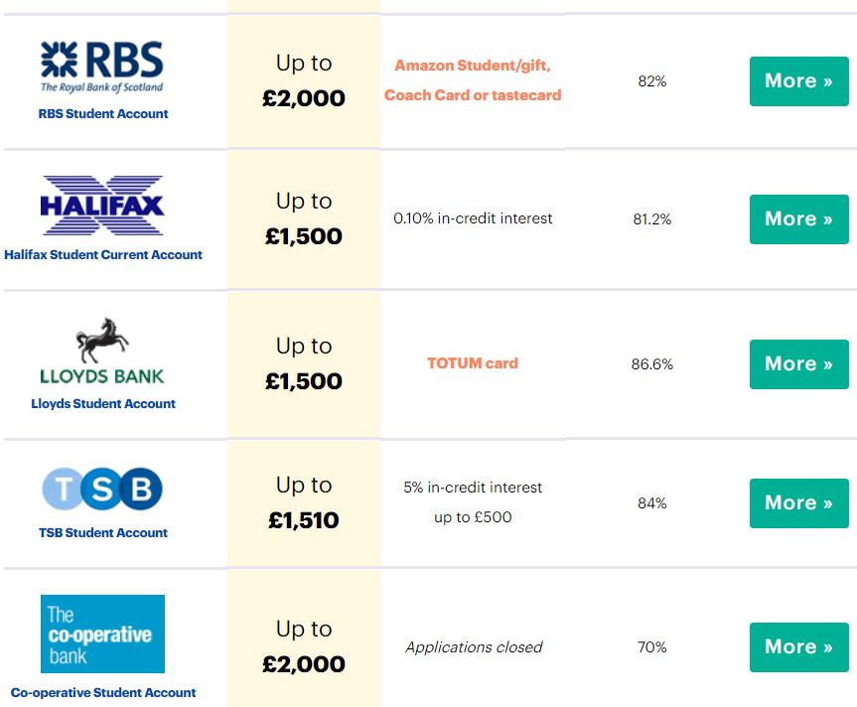
Best student bank accounts 2020
You cannot apply for these until you get your results

Slide 32
What to take and setting up your new life…
What about registering to a new doctor?
Have you changed your car insurance documents?
Do you have your national insurance number?
https://www.savethestudent.org/accommodation/what-to-take-to-university.html

Slide 33
Education Grants
https://www.youtube.com/watch?v=U8UVHGNn7Vg
Scholarship, grants and bursaries explained for UK universities.

Slide 34
Student Finance Explained – For Students
On the YouTube playlist below, you will find the following six videos for your guidance on Student Finance:
What student finance explained.
Can I get student finance.
What evidence you need to send.
Funding for students with disabilities and other needs.
Student finance for EU students.
Student finance for students not supported by their families.
Understanding student loan interest.
Repaying student loans.
https://www.youtube.com/playlist?list=PL4wogSHG9Pv_5B39bVt8VIWRB6T8yiSz3

Slide 35
Student Finance Explained – For Parents
On the YouTube playlist below, you will find the following six videos for your guidance on Student Finance:
What student finance is available to your child 2019/20
What you need to do to support your child's student finance application 2019/20
What evidence you need to send 2019/20
What to do if your income has dropped 2019/20
Myths and facts about your child’s student loan repayment 2019/20
Extra help for students with a disability 2019/20
https://www.youtube.com/playlist?list=PL4wogSHG9Pv9A-pDOpX7uZMzZkGrhj15_

Slide 36
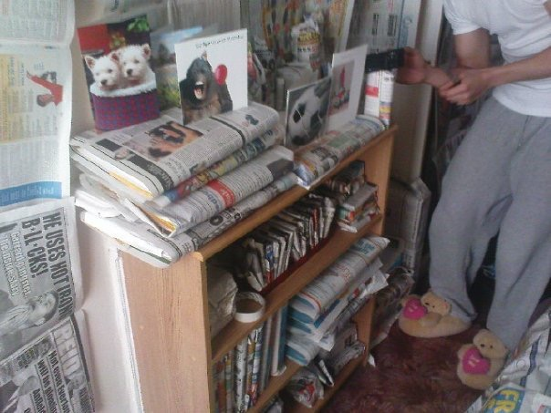
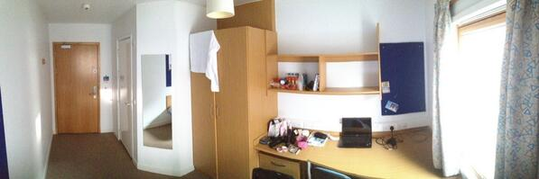
Accomodation

Slide 37
Accomodation
https://www.ucas.com/undergraduate/student-life/undergraduate-accommodation
Check course provider websites – they could have pictures of what their halls of residence look like, and you may be able to reserve a room online. They’ll list the facilities available and any costs associated with them.
Think about private student accommodation – these are often similar to course providers' halls, but you won’t always be living with people who go to your course provider. There may also be different facilities available, and you might have more freedom as to what you can and can’t bring with you. Private halls are often owned by companies who build halls of residence near course providers all over the country, so a quick internet search will provide you with reviews on a national scale.
Read the small print – most accommodation providers (including halls of residence) have strict guidelines and rules on what you can and can’t bring/have with you. There might be other important things you’ll need to know too, like parking restrictions and health and safety issues.

Slide 38
Accomodation
https://www.ucas.com/undergraduate/student-life/undergraduate-accommodation
Check what bills you’ll need to pay – the cost of living in halls of residence usually includes electricity and water bills, but you’ll still need to pay for things like insurance and a TV licence.
Consider the essentials – you'll need things for your bedroom and kitchen. If you move into halls of residence, check what's there already so you don't buy things unnecessarily.
Find out about Unipol’s National Codes – make sure your accommodation is up to standard. These codes ensure what’s advertised is what you will get, repairs are made on time, and good general management.
Look after your deposit – money.co.uk share everything you need to know about how to protect your deposit in their guest blog.

Slide 39
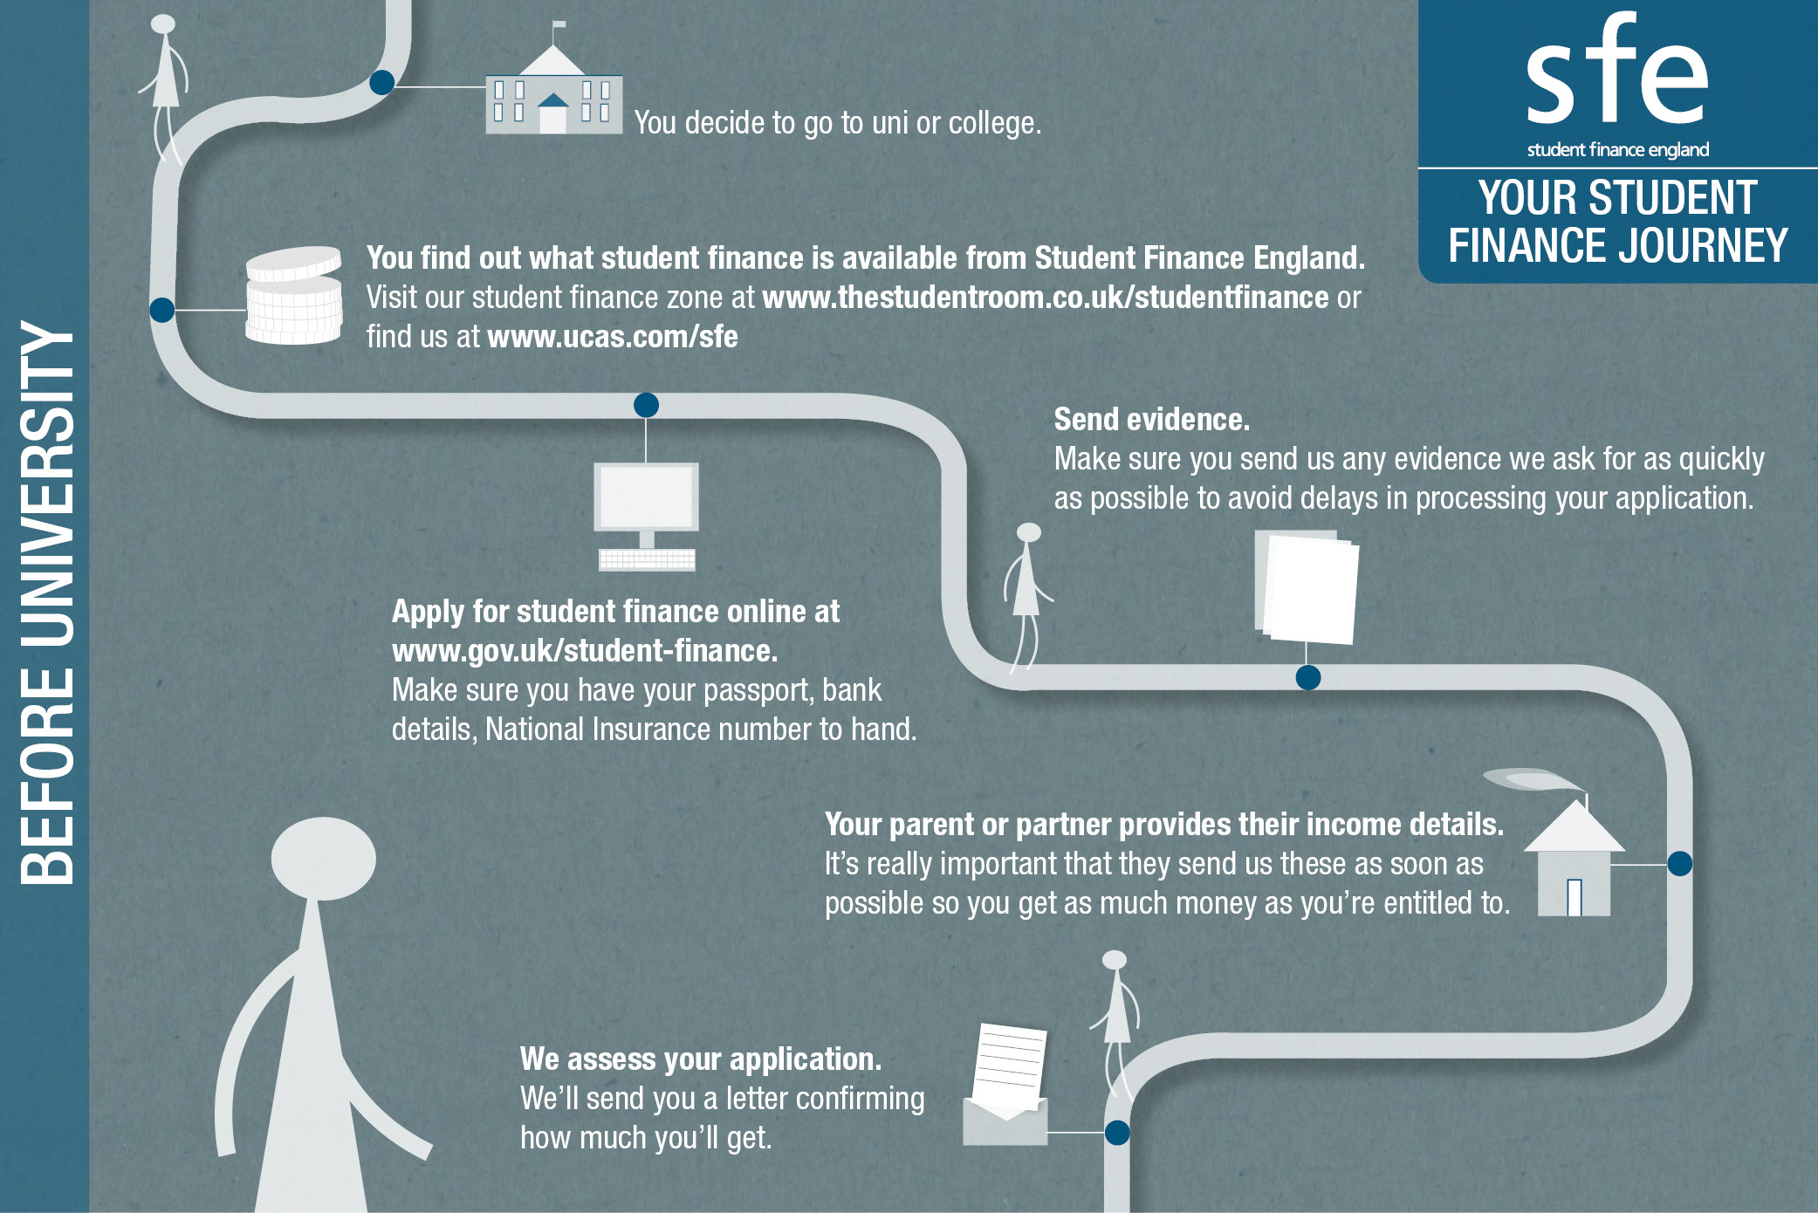

Slide 40
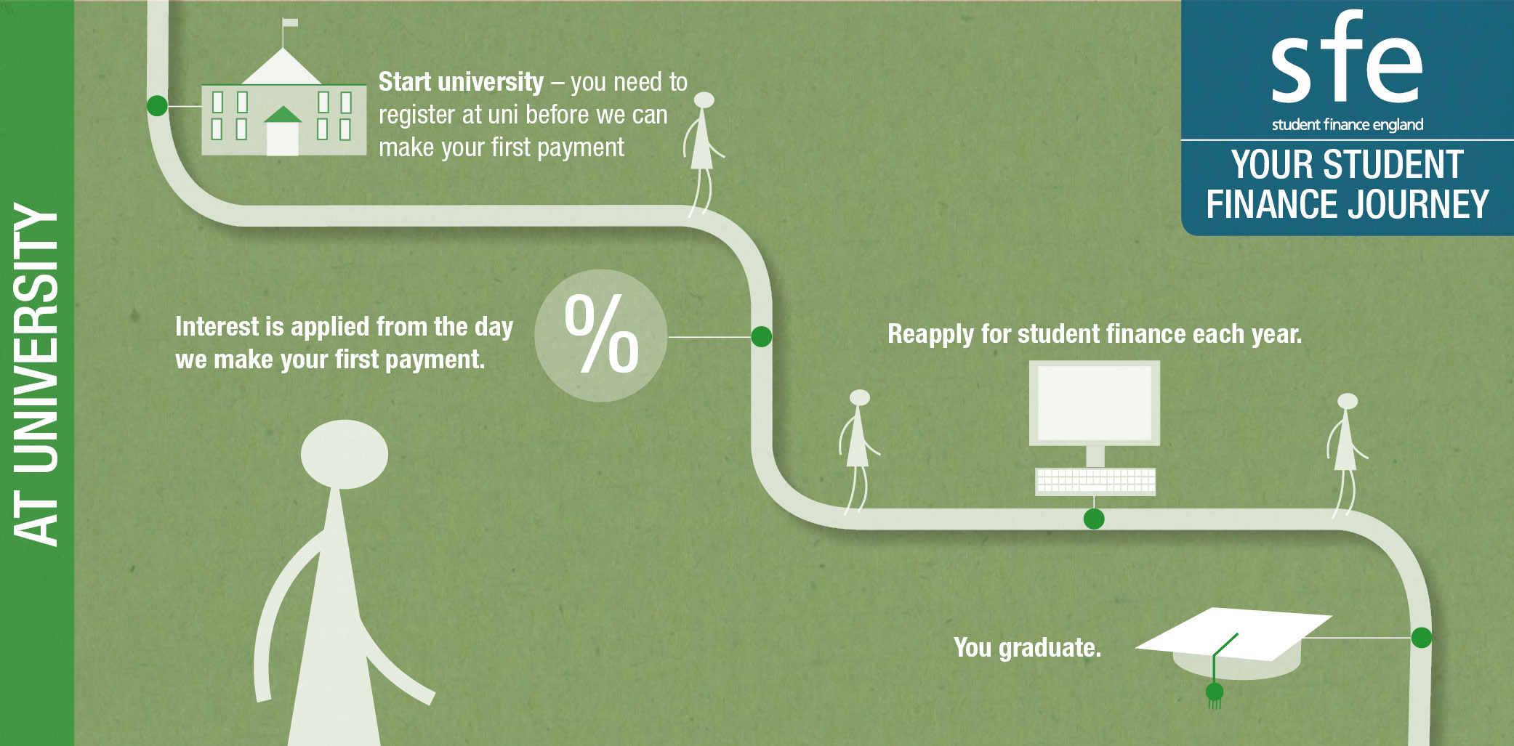

Slide 42
Questions?

Slide 43
Useful Resources
What is UCAS Extra? https://www.ucas.com/undergraduate/after-you-apply/types-offer/extra-choices
What is UCAS Adjustment? https://www.ucas.com/ucas/undergraduate/apply-and-track/results/ucas-adjustment-if-youve-done-better-expected
What is Clearing? https://www.ucas.com/undergraduate/results-confirmation-and-clearing/what-clearing

