Slide 1
What is an apprenticeship? How does it differ from university?

Slide 2
https://www.studential.com/university https://www.studential.com/apprenticeships

Slide 3
PPE Preparation PLC
A checklist of strategies to best prepare for the exams.

Slide 4
Getting Ready
Do I have all of the knowledge in order that I could possibly need?
What don’t I know? What should I know? This is the Diagnosis stage.

Slide 5
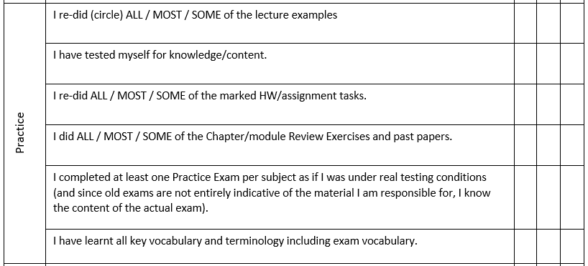
Practice Makes Perfect – This is the Therapy Stage.

Slide 6
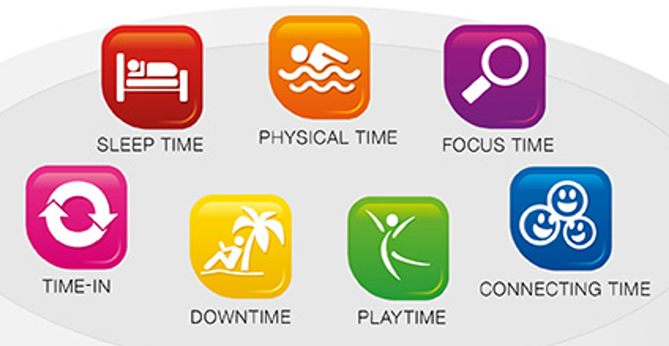
Final Checks
Final Exam preparation – am I being kind to myself? Is my life set up for optimal performance?
Think of the healthy mind platter

Slide 7
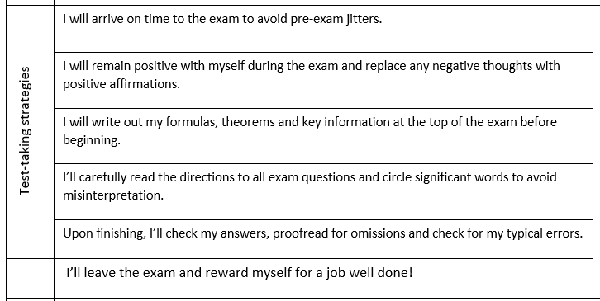
The Testing Stage – how to ensure exam-time is stress free.

Slide 8
The exam is a process is not an event.
Start that Diagnosis, Therapy and Testing cycle all over again.

Slide 9
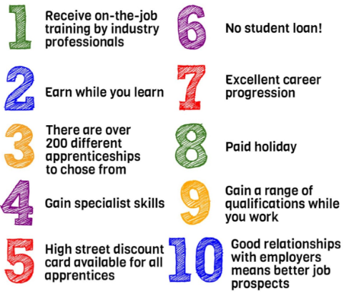
Why choose an apprenticeship over university?
https://www.youtube.com/watch?v=dj-JrMjxivA
https://careersuk.virgin-atlantic.com/apprenticeships

Slide 10
Workshop 6 - Apprenticeships

Slide 11
Today’s journey:
What is an apprenticeship?
What levels of apprenticeship exist?
What are the entry requirements?
Who are apprenticeships for?
Stats, facts and figures.
How do I apply?
When do I apply?
The apprenticeship checklist

Slide 12
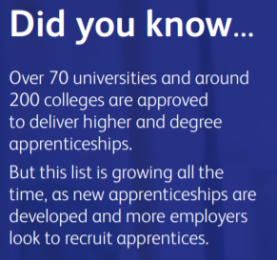
What is an apprenticeship?
A mixture of work and study.
Get paid! And get your course fees covered.
Time-management.
Different levels of apprenticeship based on your qualifications.
Notes:
In essence, an apprenticeship is a job. You’ll spend 80% of the working week at your place of employment, and 20% at your place of study.
You’ll earn a salary, and your course fees will be covered by your employer and the government. You just need to be willing to manage your time between work and study.
There are many different apprenticeships you can apply for depending on your existing qualifications across a broad range of different industries.
Explore our apprenticeships guide to find out everything you need to know.

Slide 13
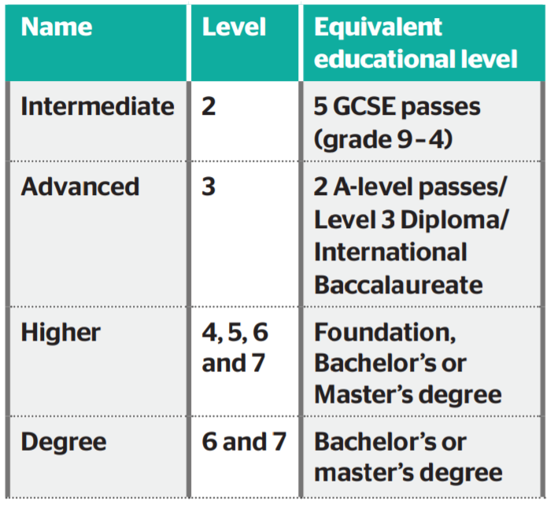
Straight from school.
After sixth form.

Slide 14
Entry Requirements – is it like sixth form or uni?

Slide 15
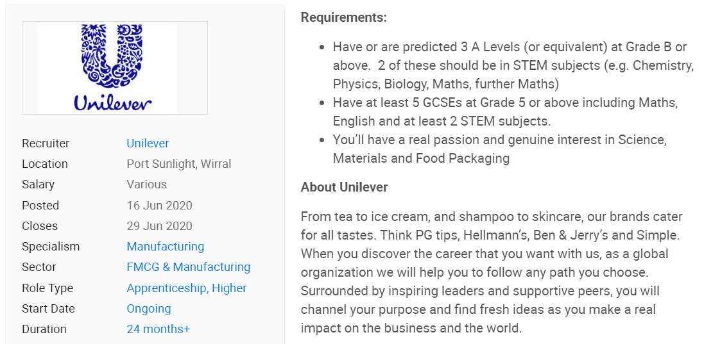
Entry Requirements

Slide 16
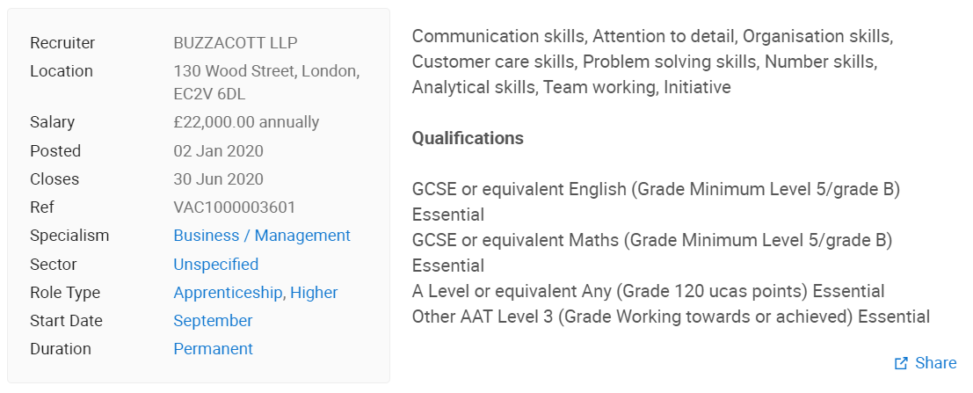
Entry Requirements

Slide 17
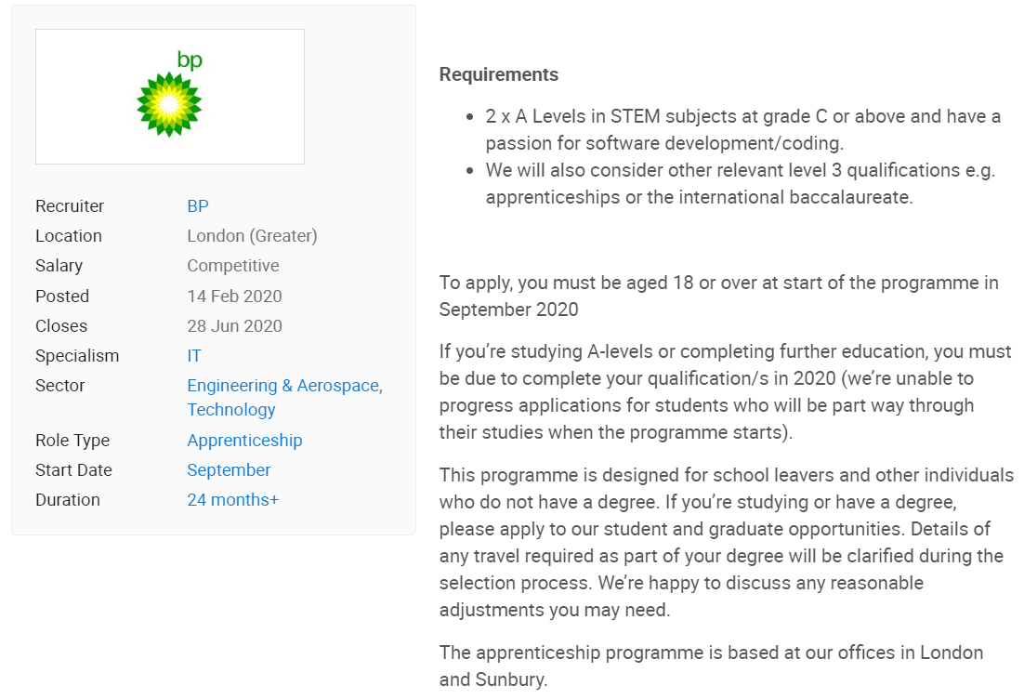
Entry Requirements

Slide 18
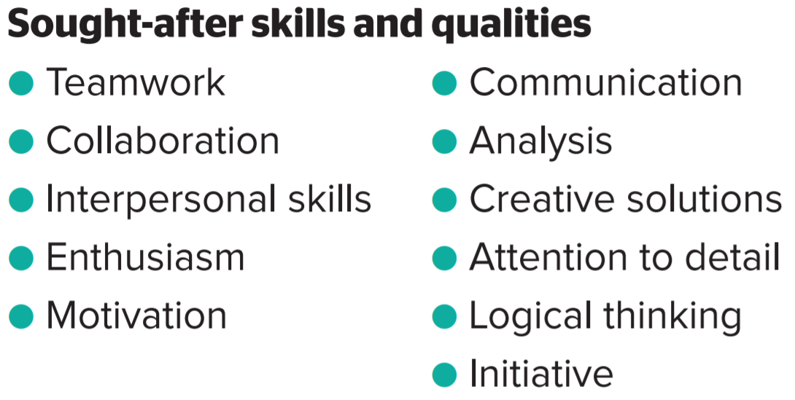
Who are apprenticeships for?
It would suit someone who is willing to commit to both work and study.
Who wishes to develop these skills.
Apprenticeships aren’t the easy open.
Notes:
Apprenticeships would suit someone who:
has a clear idea of the type of career they wish to pursue
is willing to commit to work and study, but would prefer a more practical and work-related approach to learning
is ready to start work with an employer, and be based in the workplace most of the time
is well organised and able to cope with the competing demands of work and academic study at the same time
is ready to be assessed through a mix of assignments and written work, including essays, reports, practical exercises, end tests, and exams
No matter what kind of career you want to follow, you need to do your research and find out if you can reach your career goals through an apprenticeship, or if you need/would prefer to study full-time at university or college.
Apprenticeships aren’t the ‘easy’ option. Holding down a full-time job and studying takes commitment and hard work, and it won’t be right for everyone. You’ll need to prove yourself in the workplace, while getting to grips with studying for a higher level qualification. You’ll be expected to achieve academically and at work, managing your time and adjusting to longer hours, with fewer holidays than at school, college, or university. You might have to travel or relocate to find the right opportunity for you.

Slide 19
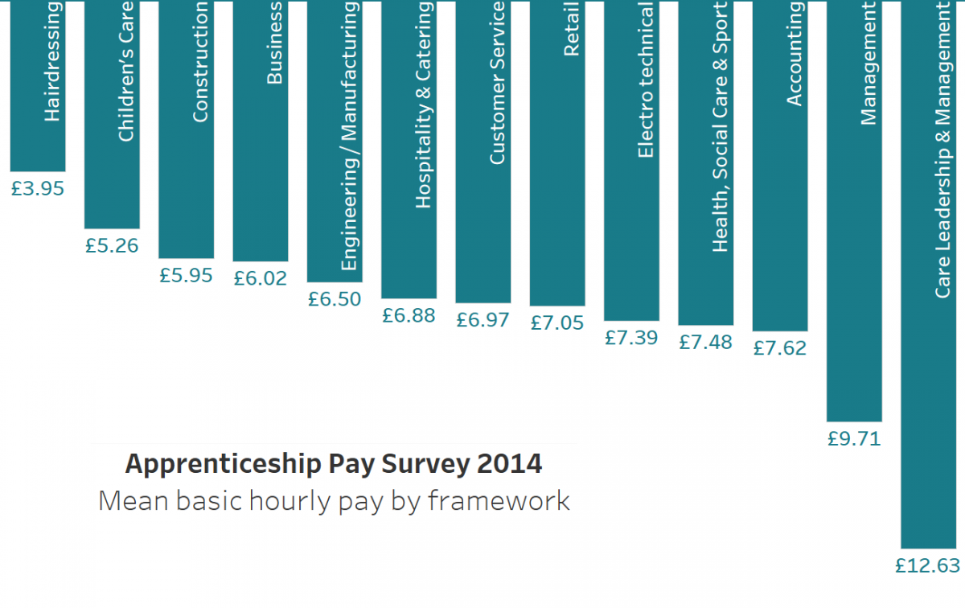
Notes:
Not debt but will have build up money behind you

Slide 20
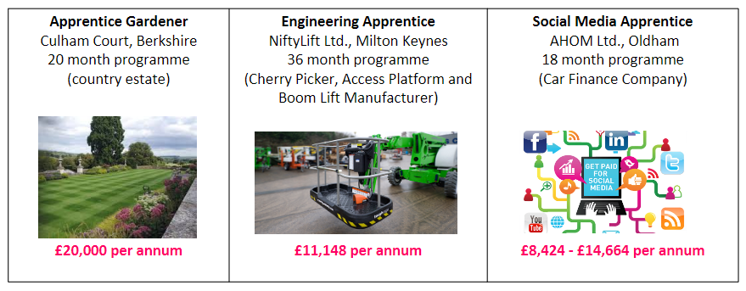
Advanced Apprenticeship
(2-3 A Levels or BTEC)
Notes:
Not debt but will have build up money behind you

Slide 21
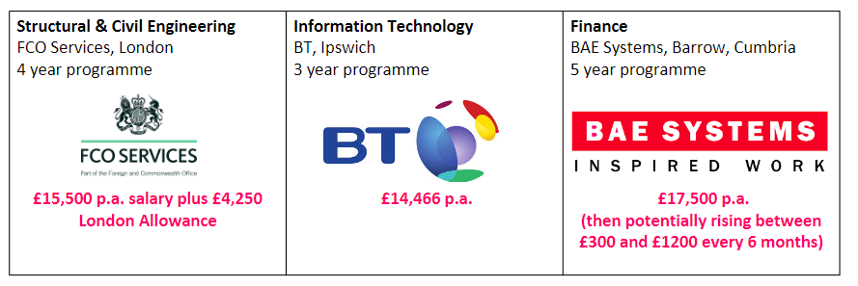
Higher Apprenticeship (Foundation, Bachelors and Masters degrees)
Notes:
Not debt but will have build up money behind you

Slide 24
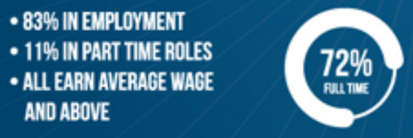
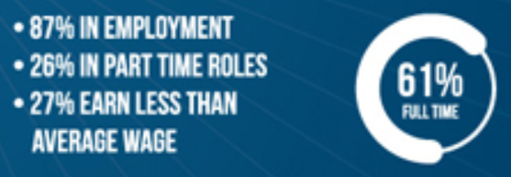

Slide 25
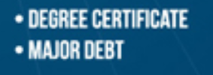

Slide 26
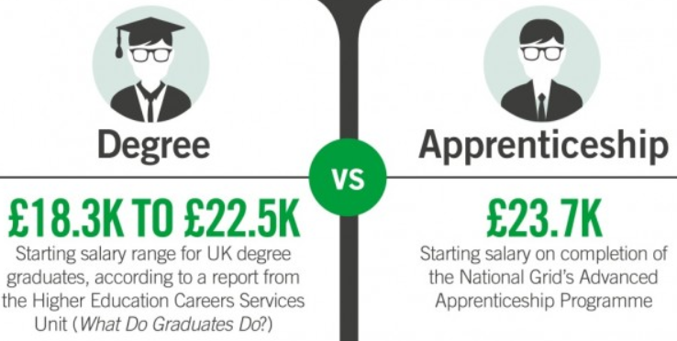

Slide 27
What type of apprenticeships are available?
Creative, media, arts, and digital technologies – degree, higher, advanced
Information and communication technology – degree, higher, advanced
TV production and broadcasting – degree, higher, advanced
Business management, administration, law, and financial services – degree, higher, advanced
Construction, planning, and the built environment – degree, higher, advanced
Engineering and manufacturing – degree, higher, advanced
Notes:
This sector covers jobs from photography, visual effects, and journalism, to technical theatre, interactive product development, and technology. There are also degree apprenticeships available in digital technologies, including television, archive, animation, interactive media, film, photo imaging, and radio. This sector is known for being very competitive and there is high demand for apprenticeships.
Apprenticeships include IT infrastructure, systems analysts, IT security, software specialists, testers, website developers, and network engineers. There are also other IT-based apprenticeships in digital industries, which are included in the creative sector above. Employers include large IT and business-related companies such as BT, Capgemini, Cisco, Santander, Deloitte, BAE Systems, GCHG, HP, and banks.
Job roles in this sector include broadcast production assistant, production runner, assistant camera crew, and researcher. For those with an engineering or technical degree, there is a postgraduate-level apprenticeship in outside broadcasting engineering. Employers include BBC Academy, ITV, 4Talent, and Sky Academy.
There are many occupations across these sectors which can lead to careers in every sort of industry and business. Apprenticeships range from administration through to HR, management, leadership, marketing, PR, finance, accounting, consultancy, and a variety of legal roles, including solicitor, conveyancing technician, and legal executive. There are also banking and investment-related specialisms.
Construction is a huge sector, including varied jobs from practical hands-on plumbing, heating, and construction, through to chartered surveyors, construction engineers, civil engineering, and engineering technology. Employers range from large construction companies to specialists.
Apprenticeships in these sectors include aerospace, maritime, gas, power, water, defence, and nuclear industries, as well as vehicle, automotive, and electrical systems. This extends to a range of manufacturing specialisms such as furniture, tailoring, silversmithing, print, and packaging, as well as food technology and production. Employers range from large engineering and aerospace companies, power suppliers, defence industry, and food manufacturing companies, to smaller, specialist companies supplying key parts and services.

Slide 28
What type of apprenticeships are available?
Health and care – degree, higher, advanced
Life and industrial sciences – degree, higher
Retail and commercial enterprise – higher, advanced
Agriculture, horticulture, and animal care – higher, advanced
Public sector/public services – higher, advanced
Education and training – advanced
Leisure, travel, and tourism – advanced
Notes:
Apprenticeships range from dispensing medicines in a pharmacy, to dental nursing, maternity support, and social work. A new nursing degree apprenticeship is in development. The NHS is the largest employer for this sector, as well as independent healthcare organisations, voluntary, and non-profit organisations.
These apprenticeships offer the training to go into a range of science and research-based jobs, including laboratory technicians and science manufacturing technicians. These jobs are in a wide range of companies, including chemical and pharmaceutical businesses, biotechnology, and nuclear manufacturing.
There are higher level apprenticeships in facilities and hospitality management, as well as supply chain management. The advanced level apprenticeships range from retail and customer services, to beauty, fashion, hair, and hospitality. Many local and national employers are involved in apprenticeships, including retailers of all sizes and specialist businesses.
This is a broad sector covering everything from farming and farriery, to veterinary nursing, horticulture, animal care, and land-based engineering. Many universities and colleges offer a range of courses in agriculture, horticulture, and animal care, as well as specialist agricultural colleges offering courses and apprenticeships. Employers in this sector are smaller businesses, as well as farms of all sizes, and specialist companies and services.
These apprenticeships can lead you into a wide range of careers from the fire and ambulance services, waste management, social services, youth work, supported housing, and policing. They range from entry level jobs through to senior management. Key employers include the civil service and armed forces, local authorities, police, and fire and ambulance services. Specialist services also run their own apprentice training.
If you’re interested in teaching or training, apprenticeships are available as a teaching assistant and learning support assistant. Many universities and colleges also offer a range of teacher training and learning support programmes. Higher level apprenticeships are in development, and will be available once the standards have been approved.
There is a range of advanced apprenticeships for careers in these industries, including travel consultancy, leisure management, exercise and fitness, coaching, personal training, and sports development. These jobs operate across a wide range of businesses and locations, offering opportunities for career progression. Many colleges offer a range of apprenticeships across this sector, working with local and national employers, from small enterprises through to major tourism and leisure venues.

Slide 29
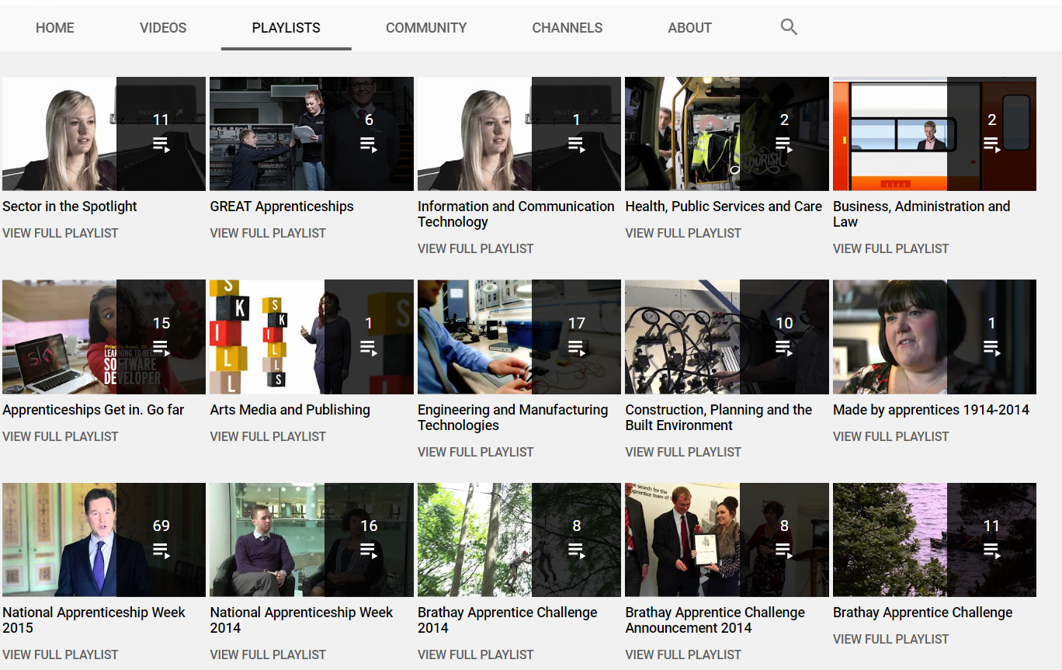
Doing your research
https://www.youtube.com/user/ApprenticeshipsNAS

Slide 30
How to apply?
https://www.ucas.com/understanding-apprenticeships
www.notgoingtouni.co.uk
https://www.ratemyapprenticeship.co.uk/
https://www.gov.uk/topic/further-education-skills/apprenticeships
Notes:
Use the websites – change your preferences much like the UCAS course search tool
Once you have found an apprenticeship you like the sound of, you will need to apply to the employer.
• many employers use their own online application system • some vacancies in England use the National Apprenticeships Service application form • you can find out how to apply at ucas.com/apprenticeships-how-to-apply

Slide 31
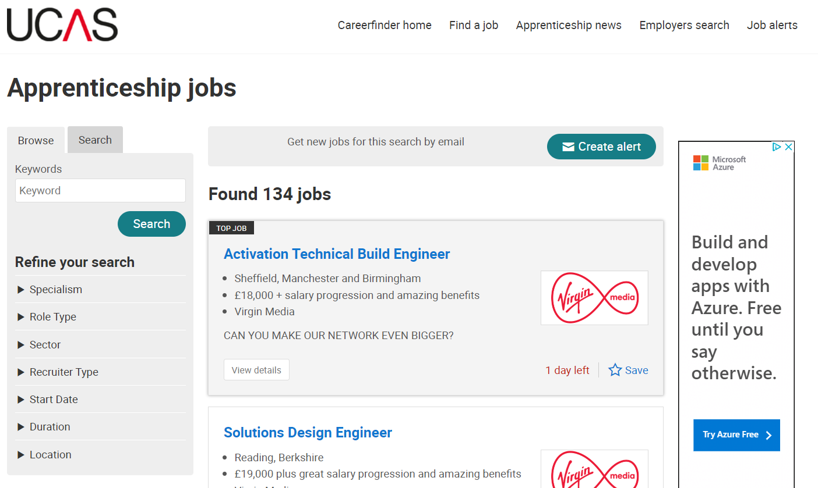
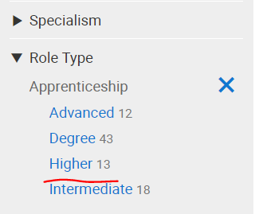

Slide 33
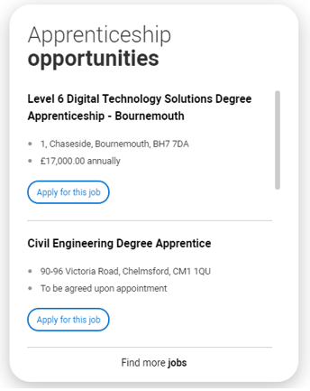

Slide 34
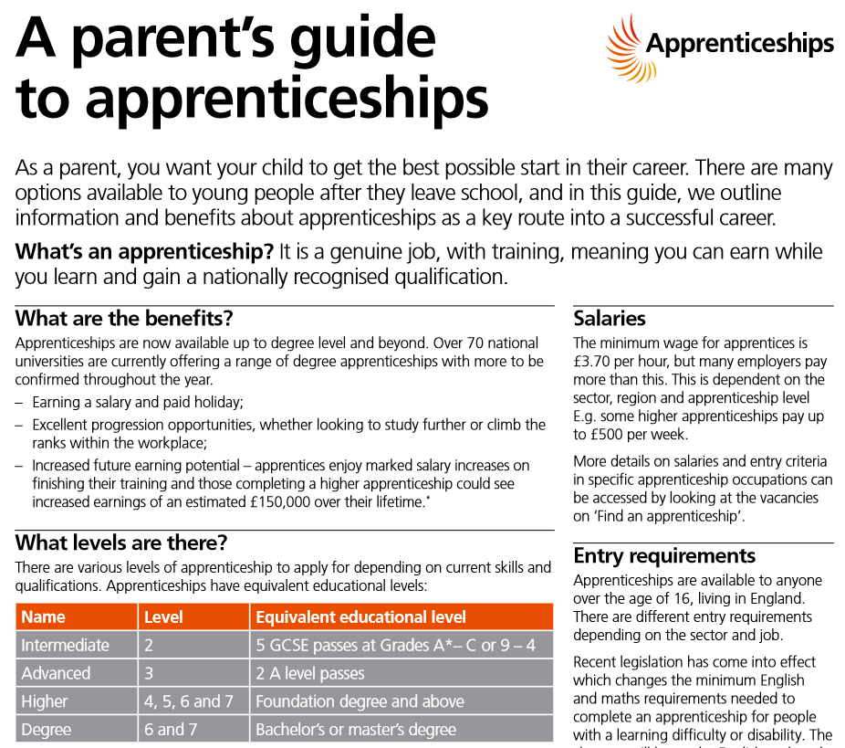
A guide for parents

Slide 35
When do I apply?
Having an annual recruitment cycle.
Recruiting apprentices for immediate start.
Ongoing recruitment.
Notes:
Having an annual recruitment cycle. This involves having an annual start date for new apprentices to begin work and recruiting well in advance. This approach is most common at large employers offering higher apprenticeships, degree apprenticeships and accountancy-related school leaver programmes, and who ask for A levels/Highers/the IB. Often the start date is in early autumn, around the time that friends will be heading off to university. Applications tend to open between September (in the previous calendar year) and March. Closing dates typically fall between late October and early May, so be on the lookout from the start of year 13/S6.
Recruiting apprentices for immediate start. Some employers advertise for apprentices as and when they need them, and want them start work straight away. This is quite common for opportunities that don’t require A levels/Highers/the IB (such as intermediate apprenticeships and advanced apprenticeships) and that are with smaller employers, or local branches of national chains. There’s no point applying until you finish school or college, as you won’t be available to start work.
Ongoing recruitment. A few recruiters describe their apprenticeship recruitment as ‘ongoing’. This means that they are happy to receive applications at any time of year – however, there may not be a position available to start immediately, so be prepared to wait. You’re more likely to find this approach with larger employers.

Slide 36
Entry Requirements

Slide 37
A day in the life of an IBM apprentice
https://youtu.be/9BclGgbO7mg

Slide 38
The apprenticeship checklist:
Make sure you are employable
PSHE,
CV writing workshop,
Work Experience,
Start Profile,
Interview preparation,
World of Work booklet.
Work out what you want from an apprenticeship.
Decide in which field you wish to work.
Research – use the websites to find apprenticeships that suit your preferences.
Decide and apply! Tailor your CV to that job.

Slide 39
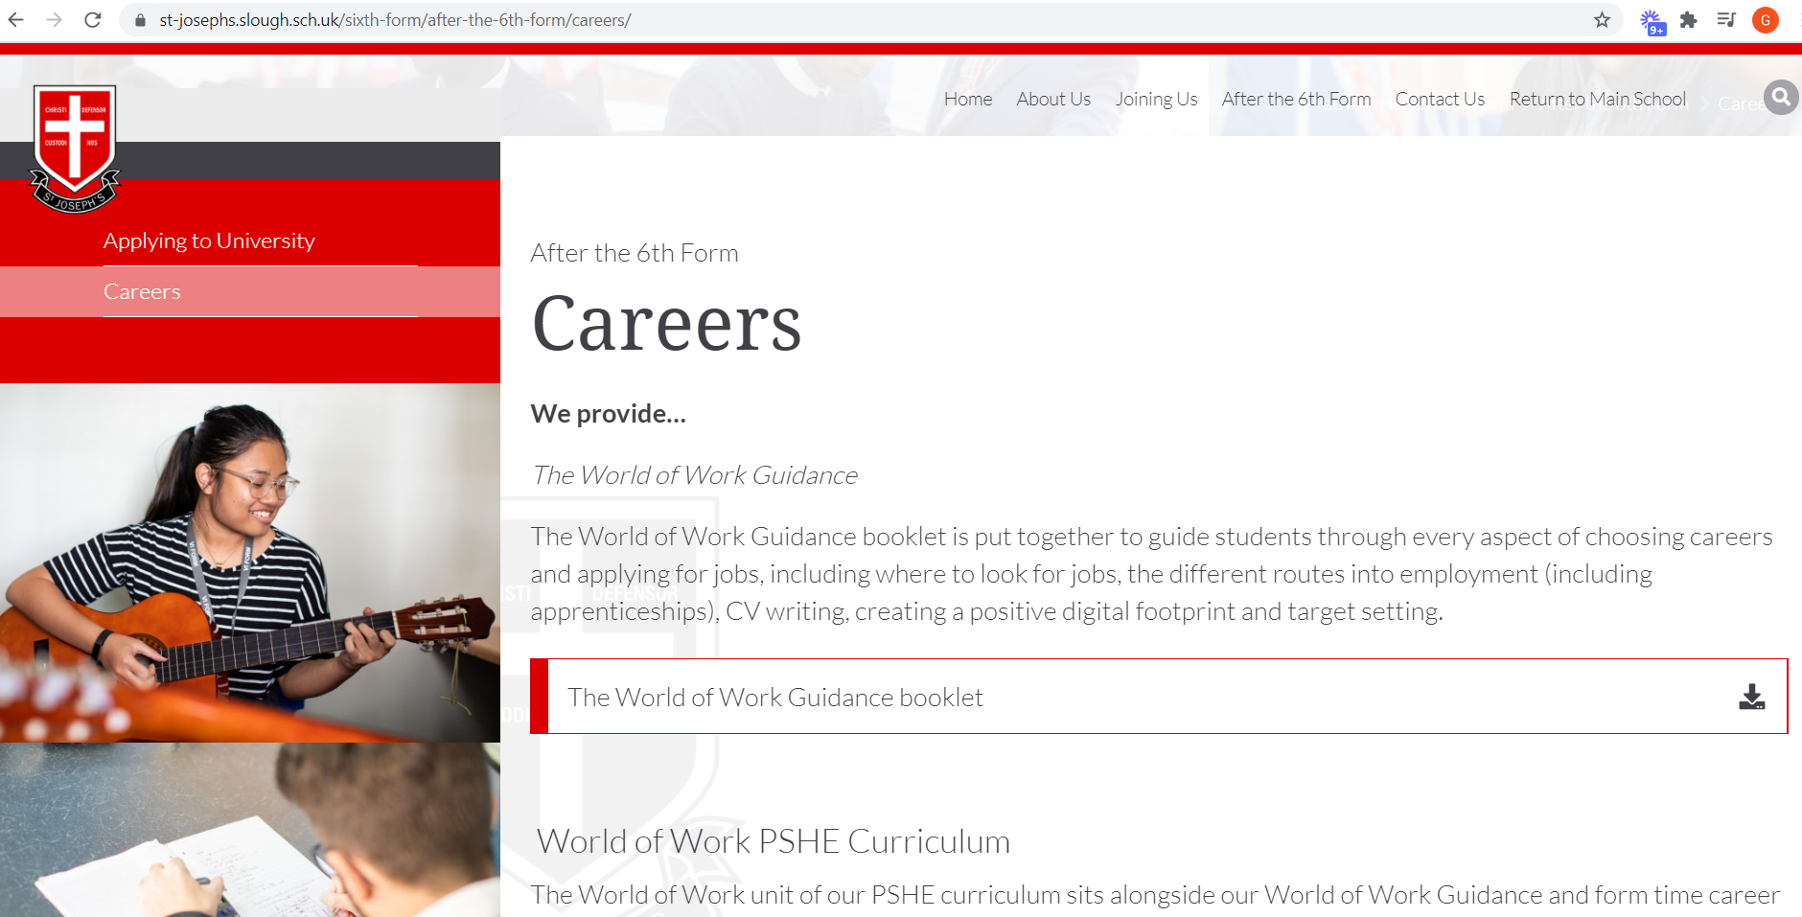
Careers Information and Guidance on our website
https://www.st-josephs.slough.sch.uk/sixth-form/after-the-6th-form/careers/

Slide 40
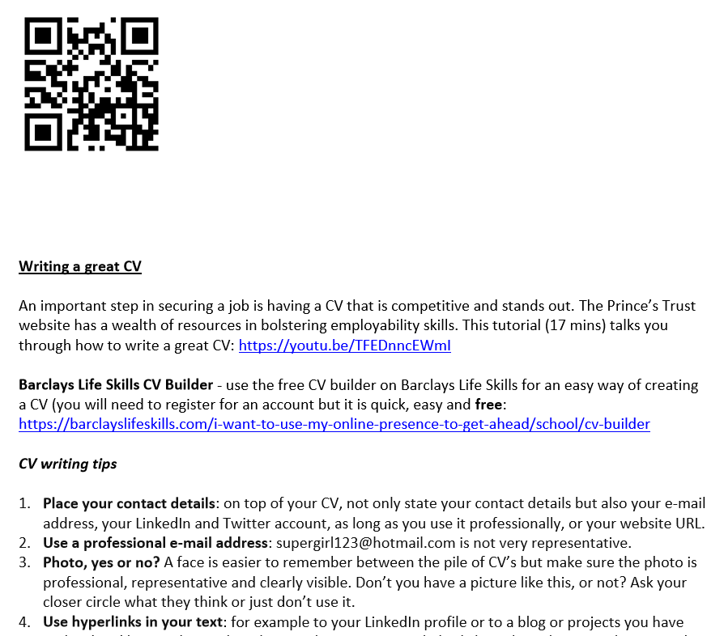
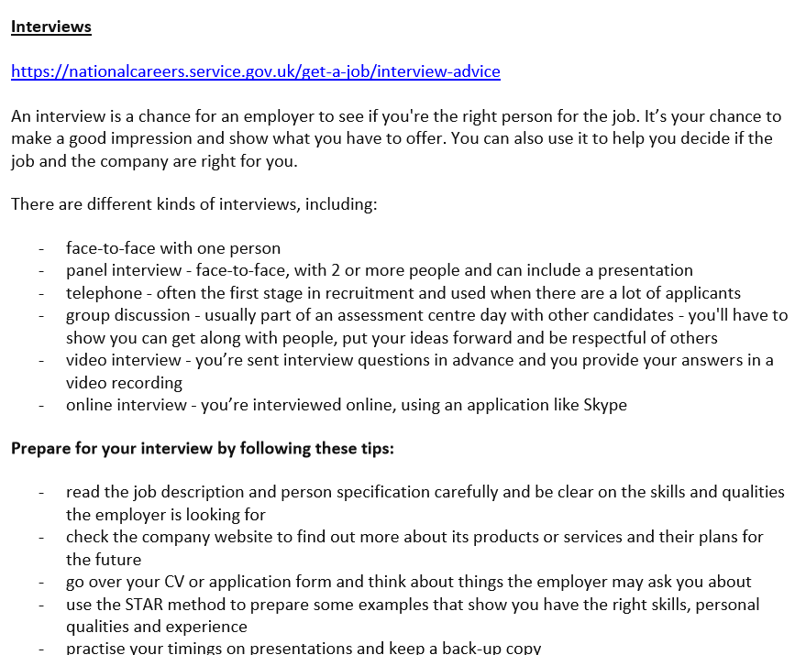

Slide 41
Start Profile – student
Getting started – please watch this video https://youtu.be/0Z9tc3ZtraA

Slide 42
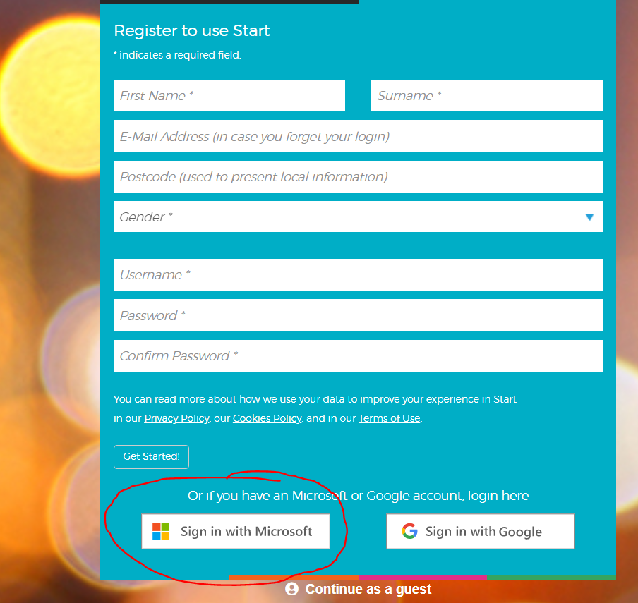
Register
https://login.startprofile.com/RegisterOne.aspx use this link to register with your school email address and password (you will see ‘sign in with Microsoft at the bottom of the page).
You will then be asked to input your:
Postcode
Gender

Slide 43
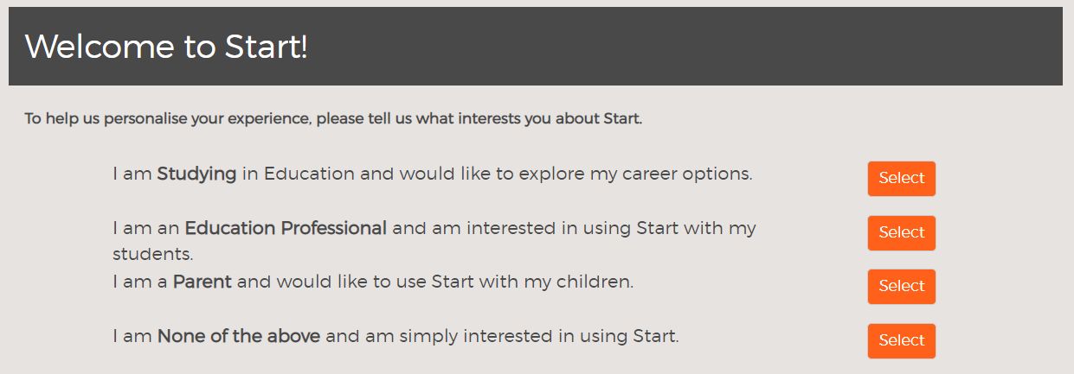
https://login.startprofile.com/RegisterOne.aspx use this link to register with your school email address and password (you will see ‘sign in with Microsoft at the bottom of the page).
Then make the choice above.

Slide 44
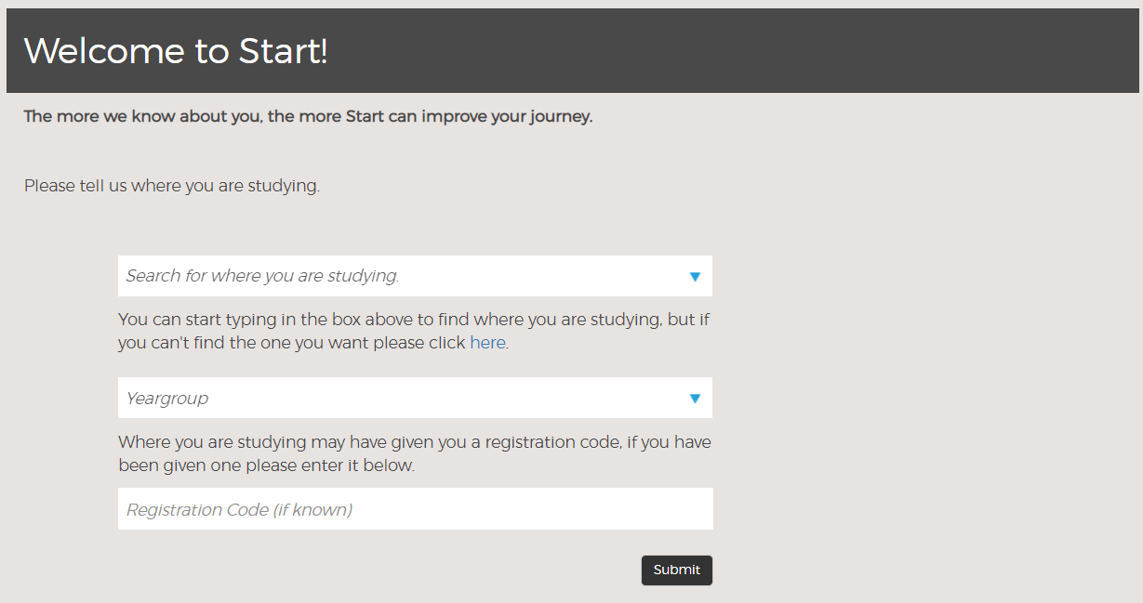
St Joseph’s Catholic High School, SL2 5HW
Year 12 or 13
Then fill in the information above (except the registration code.

Slide 45
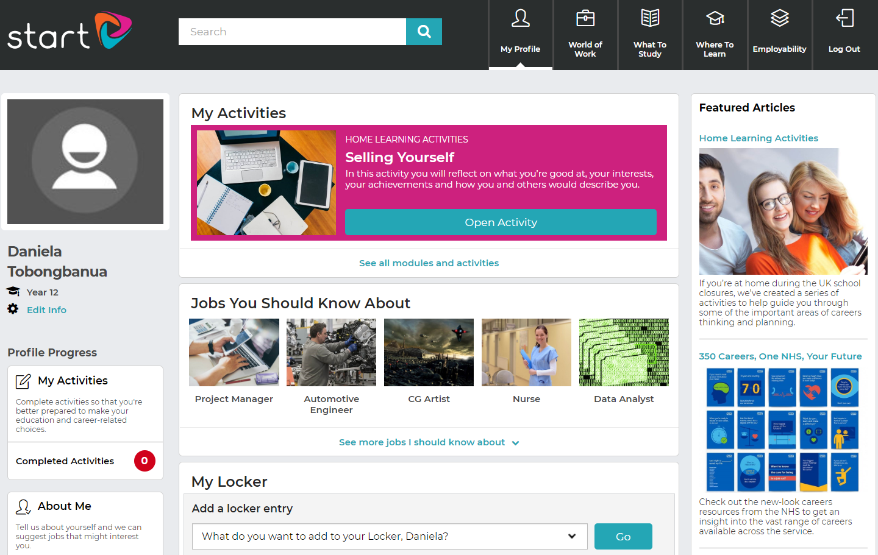
You will then see key areas of your Start Profile.
The first step is to complete your profile.
My activities are those that you have completed.
About me is where you input information so that Start can suggest jobs that suit your skills, qualities and preferences. Similar with ‘my likes’.

Slide 46
You will also see ‘my records’, this is where you can keep records of things you have achieved and tasks you need to complete.

Slide 47
This is where Start will suggest jobs based on your profile

Slide 48
This is where you will complete weekly activities that will take you through employability skills (such as CV writing) and activities that will help you choose potential career paths. You will learn the following modules:
Exploring my future
Improving my employability
Making my choices
Student surveys (ignore this)
Home learning (set one per week to complete ahead of next Friday).

