Slide 1
The UCAS Hub
Learning objectives:
To create a UCAS Hub account.
To use the UCAS Hub account to guide choices regarding university and apprenticeship applications.
To add great value to your UCAS application by searching for taster course and exhibition options.
To complete the activities in your UCAS booklet to finalise your UCAS application.
Search for:
universities,
colleges,
courses,
apprenticeships,
open days,
calculate your UCAS Tariff points,
start writing your personal statement

Slide 2
The UCAS Hub
Learning objectives:
To create a UCAS Hub account.
To use the UCAS Hub account to guide choices regarding university and apprenticeship applications.
To add great value to your UCAS application by searching for taster course and exhibition options.
To complete the activities in your UCAS booklet to finalise your UCAS application.
UCAS Hub brings everything to do with your UCAS application into one area and your personalised settings means that UCAS will give you bespoke information, guidance and opportunities.

Slide 3
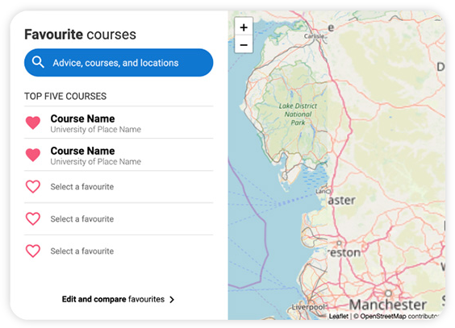
Search for courses, view your top five choices, manage and edit your favourites.
Learning objectives:
To create a UCAS Hub account.
To use the UCAS Hub account to guide choices regarding university and apprenticeship applications.
To add great value to your UCAS application by searching for taster course and exhibition options.
To complete the activities in your UCAS booklet to finalise your UCAS application.

Slide 4
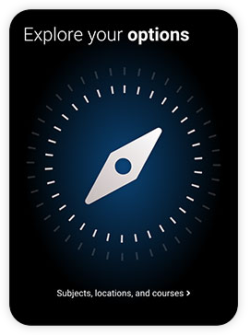
Explore over 35,000 options and favourite subjects, locations, unis, colleges, and courses.
Learning objectives:
To create a UCAS Hub account.
To use the UCAS Hub account to guide choices regarding university and apprenticeship applications.
To add great value to your UCAS application by searching for taster course and exhibition options.
To complete the activities in your UCAS booklet to finalise your UCAS application.

Slide 5
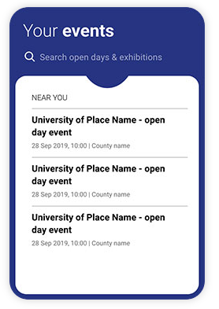
Search for uni open days and UCAS events, and keep track of them all in one handy place.
Learning objectives:
To create a UCAS Hub account.
To use the UCAS Hub account to guide choices regarding university and apprenticeship applications.
To add great value to your UCAS application by searching for taster course and exhibition options.
To complete the activities in your UCAS booklet to finalise your UCAS application.

Slide 6
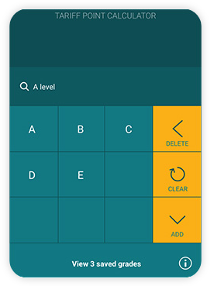
The easy way to calculate you Tariff points and store your predicted grades.
Learning objectives:
To create a UCAS Hub account.
To use the UCAS Hub account to guide choices regarding university and apprenticeship applications.
To add great value to your UCAS application by searching for taster course and exhibition options.
To complete the activities in your UCAS booklet to finalise your UCAS application.

Slide 7
The UCAS personal statement builder helps you structure your writing, and introduce yourself to universities.
Learning objectives:
To create a UCAS Hub account.
To use the UCAS Hub account to guide choices regarding university and apprenticeship applications.
To add great value to your UCAS application by searching for taster course and exhibition options.
To complete the activities in your UCAS booklet to finalise your UCAS application.

Slide 8
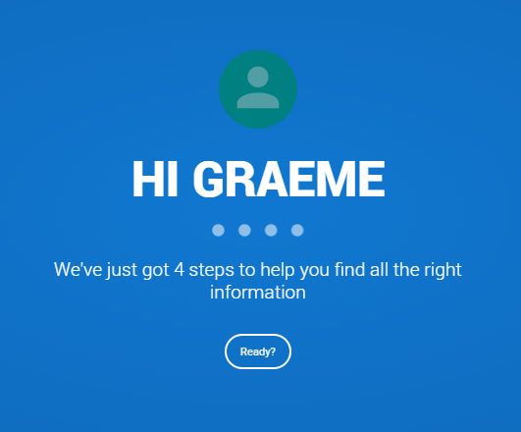
The process of setting up your account – go to https://www.ucas.com/students . You will see the option to sign up/register for UCAS Hub (above the usual apply/track portal log in.
Learning objectives:
To create a UCAS Hub account.
To use the UCAS Hub account to guide choices regarding university and apprenticeship applications.
To add great value to your UCAS application by searching for taster course and exhibition options.
To complete the activities in your UCAS booklet to finalise your UCAS application.

Slide 9
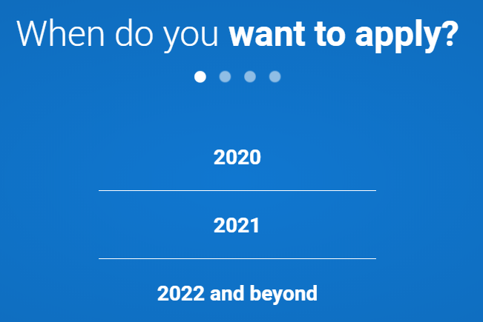
Learning objectives:
To create a UCAS Hub account.
To use the UCAS Hub account to guide choices regarding university and apprenticeship applications.
To add great value to your UCAS application by searching for taster course and exhibition options.
To complete the activities in your UCAS booklet to finalise your UCAS application.
Select the year you wish to apply.

Slide 10
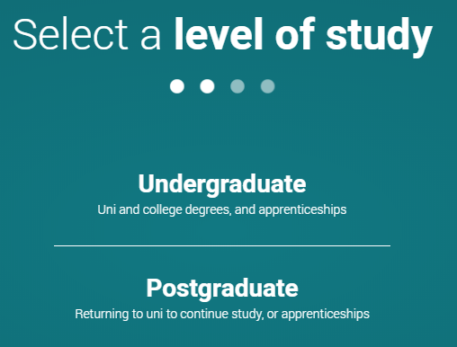
Learning objectives:
To create a UCAS Hub account.
To use the UCAS Hub account to guide choices regarding university and apprenticeship applications.
To add great value to your UCAS application by searching for taster course and exhibition options.
To complete the activities in your UCAS booklet to finalise your UCAS application.
Select the year you wish to apply – at this stage, you are all undergraduate including those who wish to search for apprenticeships.

Slide 11
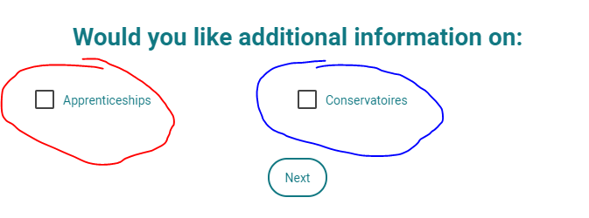
UCAS is a great tool for finding the ideal apprenticeship opportunity for you – even if you are not applying to university – you should use UCAS hub to find apprenticeships linked to your goals and interests (it is the best tool out there).
All courses at conservatoires (for music, drama and dance) have a strong vocational, performance orientation, and course structures are reflective of the industry. This means graduates from conservatoires will be accustomed to the ways of working, hours, and expectations of the industry they are going to work in, as they will have practised this throughout their course.

Slide 12
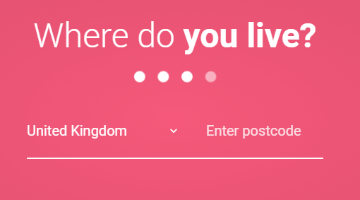
Learning objectives:
To create a UCAS Hub account.
To use the UCAS Hub account to guide choices regarding university and apprenticeship applications.
To add great value to your UCAS application by searching for taster course and exhibition options.
To complete the activities in your UCAS booklet to finalise your UCAS application.
Type in your postcode.

Slide 13
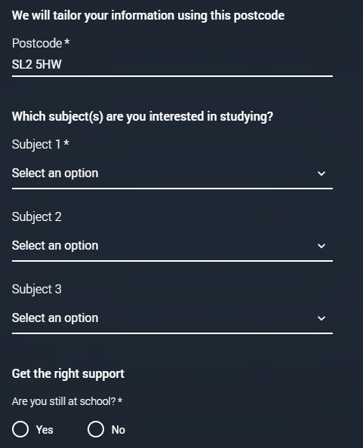
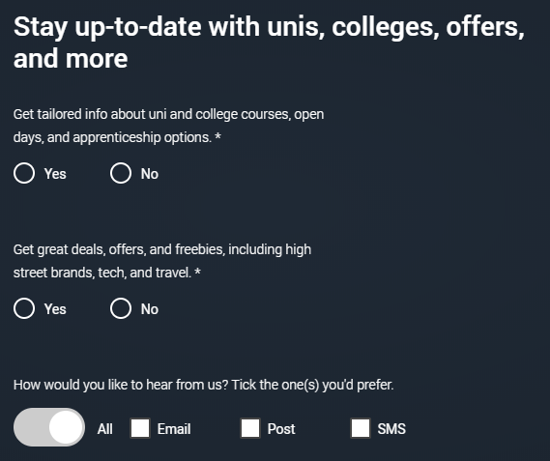
Personalise your UCAS information and receive bespoke guidance e.g. the subjects that interest you will generate degrees and apprenticeships that link to those subjects.
Also receive offers specific for students.

Slide 14
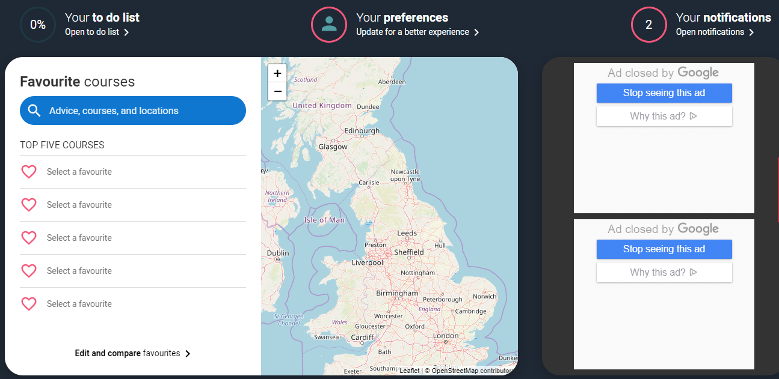
Receive key notifications and updates to keep you organised here.
Change preferences so that the information you receive is tailored specifically to you and your goals here.
Search courses, subject interests and locations and save them – you can compare them alongside each other here.

Slide 15
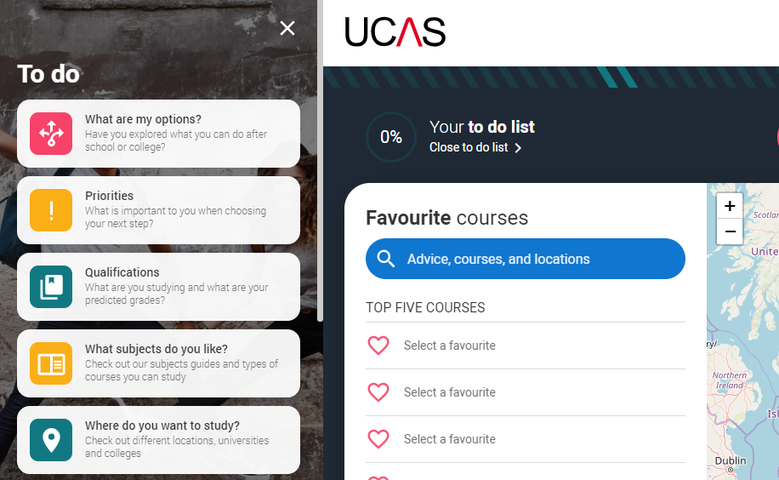
Learning objectives:
To create a UCAS Hub account.
To use the UCAS Hub account to guide choices regarding university and apprenticeship applications.
To add great value to your UCAS application by searching for taster course and exhibition options.
To complete the activities in your UCAS booklet to finalise your UCAS application.
Keep yourself organised using the to do list function that opens on the side.

Slide 16
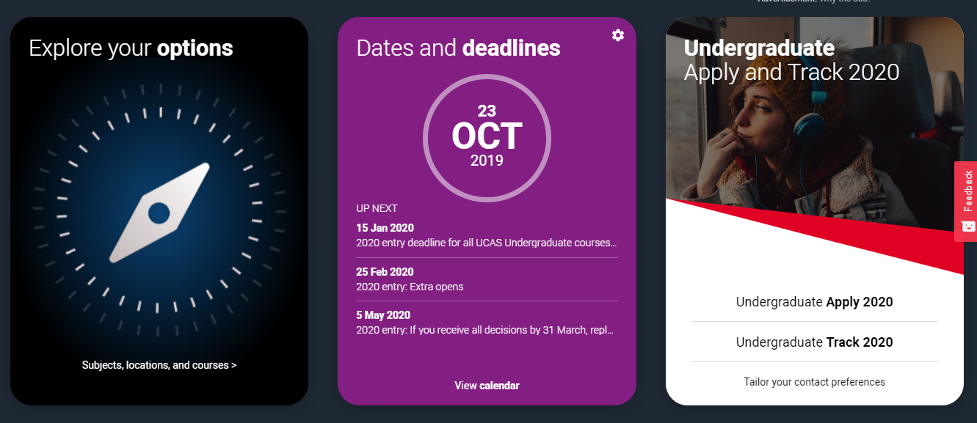
Explore based on subjects that you like, locations, courses, institutions and favourite them.
Keep yourself organised with the dates and deadlines function specific to your application.
To log in to your application portal.

Slide 17
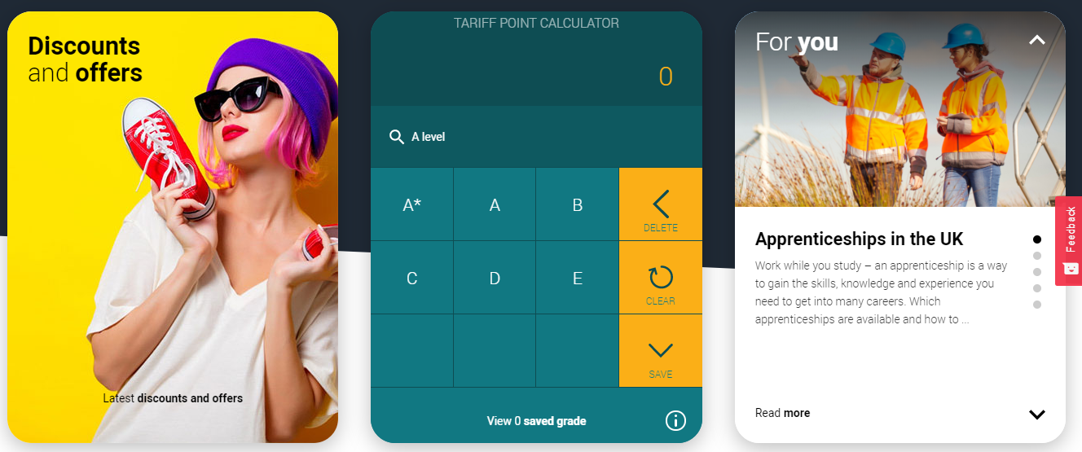
Search your subjects and saved your current grades – how far away are you from your UCAS entry requirement? Are you there already? How much further could you push your grades to go to a better university?
Save yourself some money ☺
Everything you need to find the best apprenticeship for you.

Slide 18
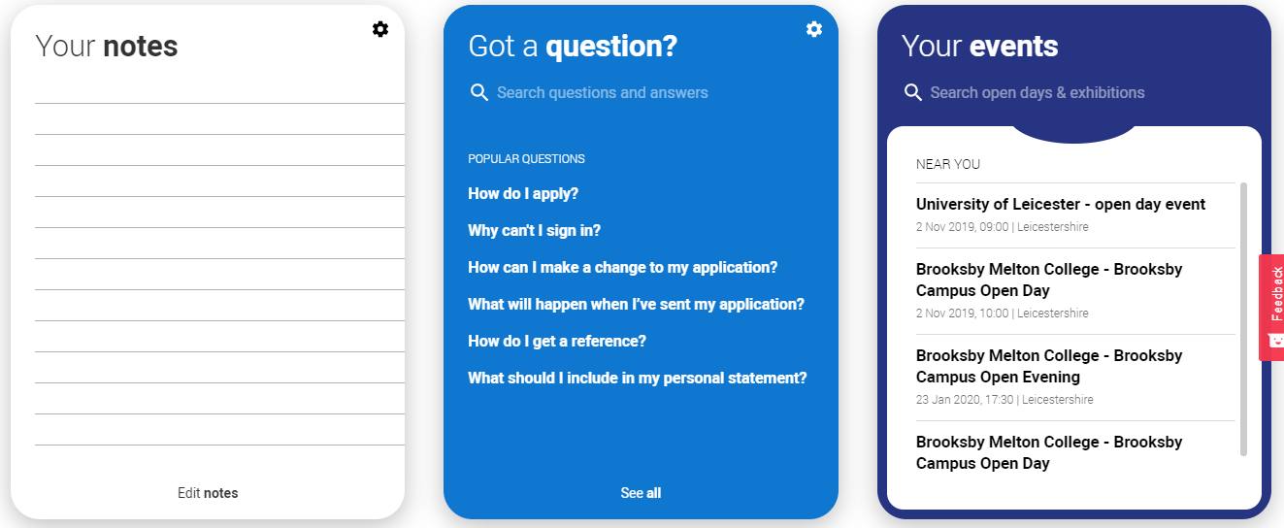
Frequently asked questions about anything to do with your application (you may get a quicker response than your HoY/Ho6)
Find Open Days but more importantly taster days linked to your career goals!
Make any notes regarding your application.

Slide 19
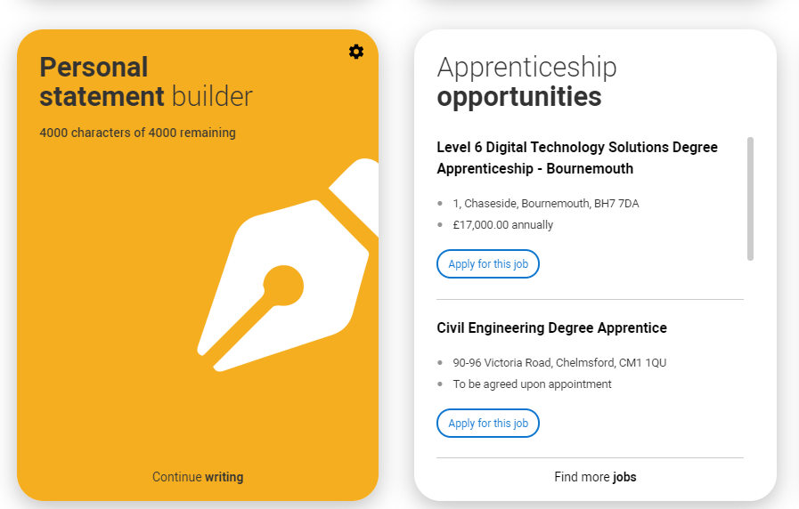
A tool for writing, saving and finding guidance on writing the best personal statement.
Please update your One Drive doc every time you tweak it so that we can give feedback.
Apprenticeship opportunities based on your preferences.

