Slide 1

University Account set-up
Starter:
On a Post-It note – write your name and the course you are applying for and hand them to your teacher.
Bonus! Discuss with your partner – what 5 reasons for you choosing your course.

Slide 2

In this session, you will:
Understand how to complete the registration of your UCAS account.
Understand how to complete the application form on your UCAS account.

Slide 3

UCAS – Key Features
You will choose a maximum of 5 courses
    Some choice restrictions:
    Medicine, Veterinary and Dentistry – max of 4 choices
    Oxford or Cambridge – usually you can only apply for one course at one or the other.
UCAS operates an invisibility policy. This means that each university that you apply to can't see which other institutions has also received an application from you.
Payment of £26 to apply – made online by card.
You can only send one UCAS application in each year’s cycle.

Slide 4

The UCAS Journey – Apply 2021
Summer Term 2020
Personal Statement (completed on the Word Online document only)
5th of May – UCAS search tool Entry 2021 goes live.
19th of May – UCAS entry UCAS Undergraduate Apply goes live - create and account and update Personal details, Choices and Education & Employment.
Your teachers, tutors and Heads of Year will be writing your references.
Autumn Term 2020
8th of September – UCAS applications may be submitted for Entry 2021.
Your HoY(s) will update your predicted grades based on your most recent PPE results.
October – Medicine, Vet and Dental applications to be sent.
Spring Term 2021
January – all UCAS applications submitted – a balance between too early and too late.
Universities will make decisions on your application (conditional, unconditional or unsuccessful).
May – deadline to make firm and insurance choices – be aspirational!

Slide 5
Step 1: UCAS – Register
Please watch the video on the page above for a step by step guide of how to fill in your application.
https://www.ucas.com/undergraduate/applying-university/filling-your-ucas-undergraduate-application

Slide 6
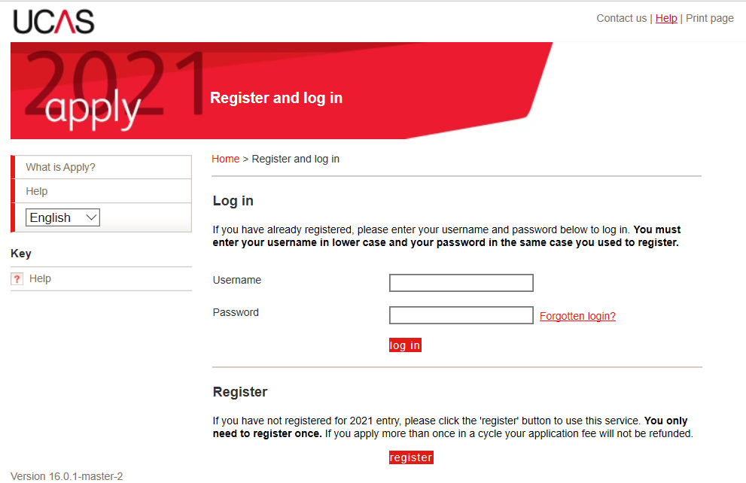
Step 1: UCAS – Register https://2021.undergrad.apply.ucas.com/appreg/SecurityServlet
Click here!
Click!

Slide 7
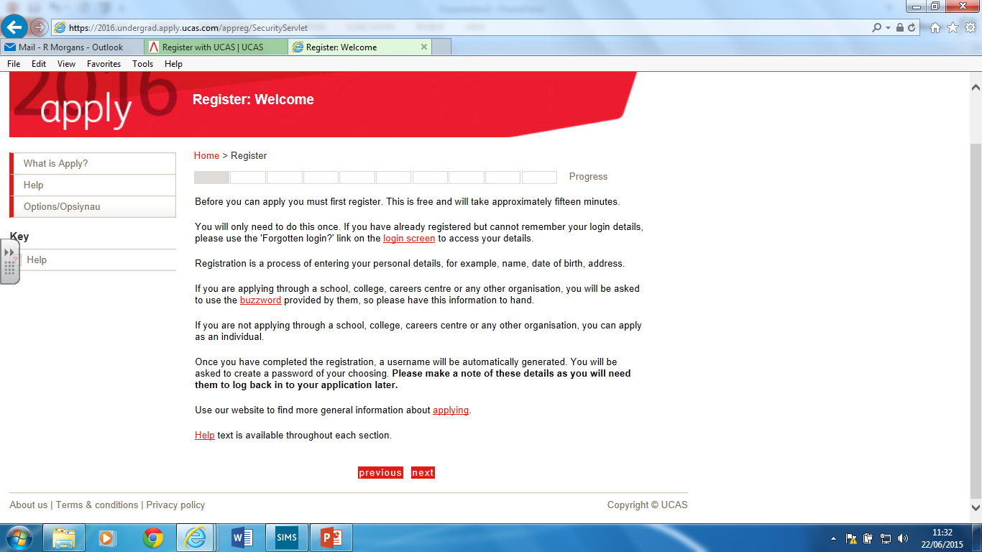
Click here!

Slide 8
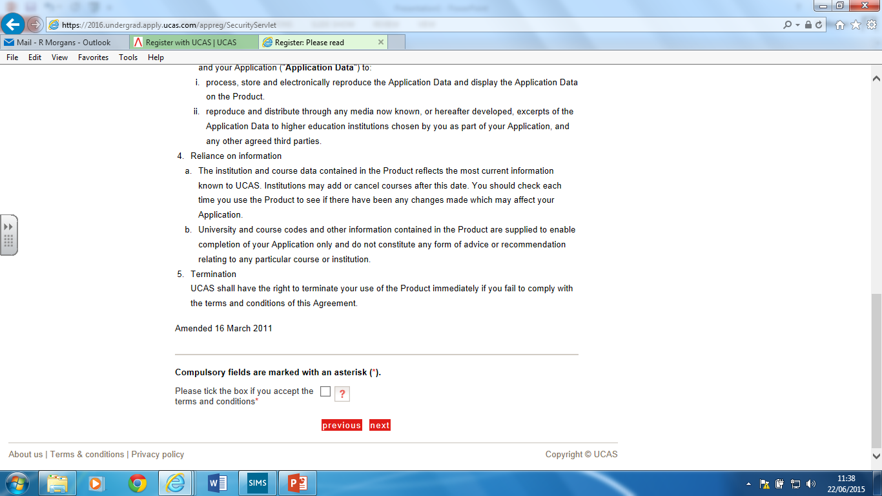
Make sure you have read the Ts & Cs and selected the box.

Slide 9
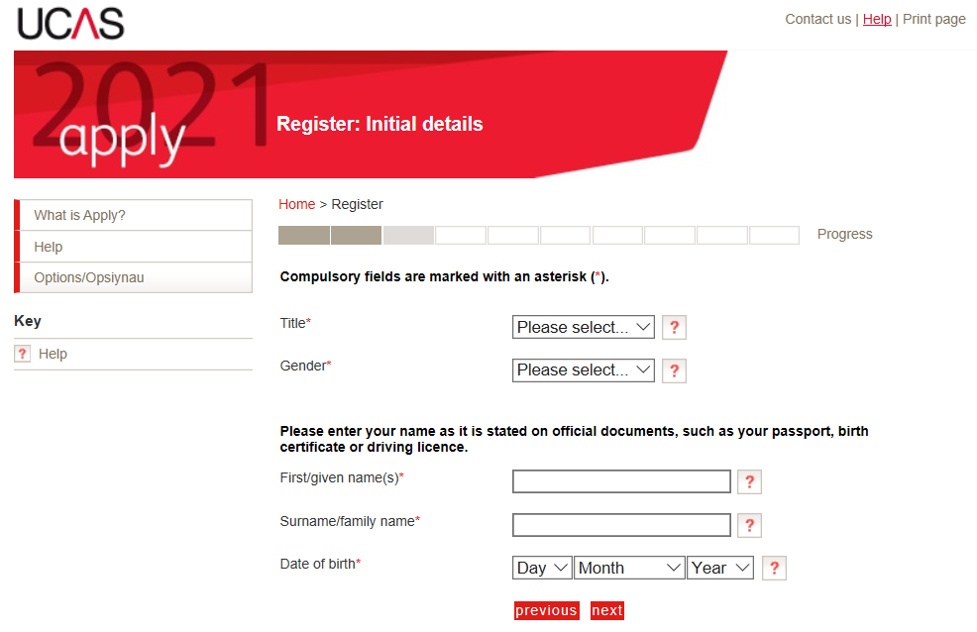
Step 3: UCAS – Register

Slide 10
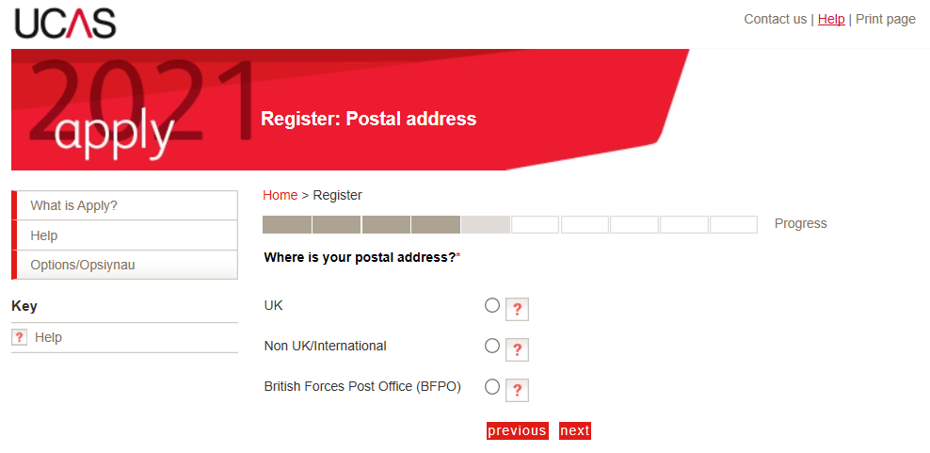
Step 4: UCAS – Register

Slide 11
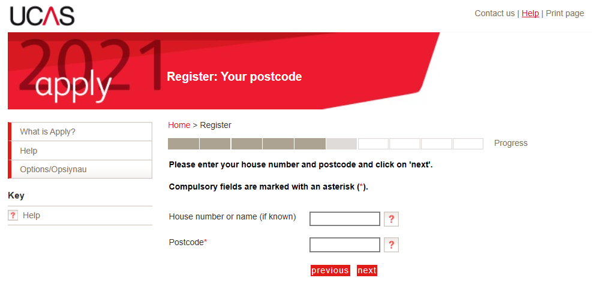
Step 5: UCAS – Register

Slide 12
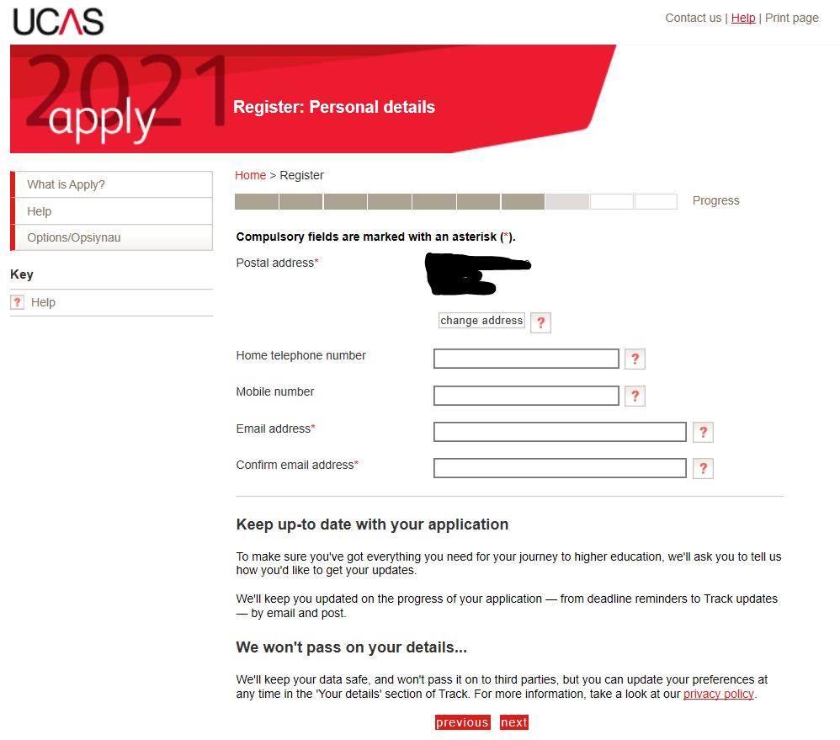
Step 6: UCAS – Register
Record these details somewhere safe so that you do not forget them.

Slide 13
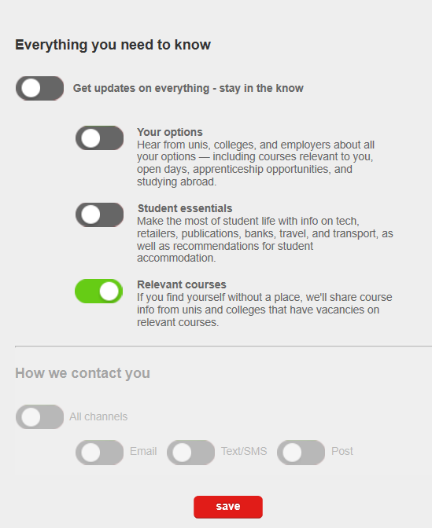
Step 6.1: UCAS – Register

Slide 14
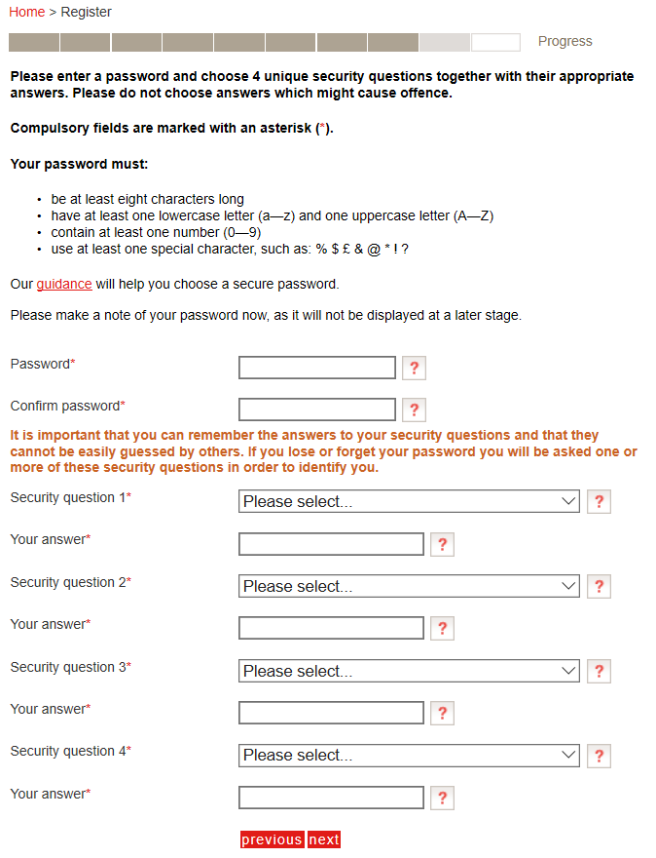
Step 7: UCAS – Register
Record these details somewhere safe so that you do not forget them.

Slide 15
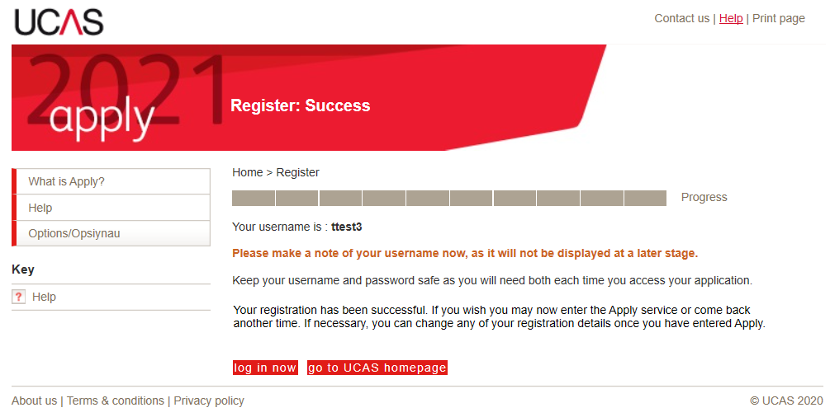
Step 8: UCAS register
Record these details somewhere safe so that you do not forget them.
Click!

Slide 16
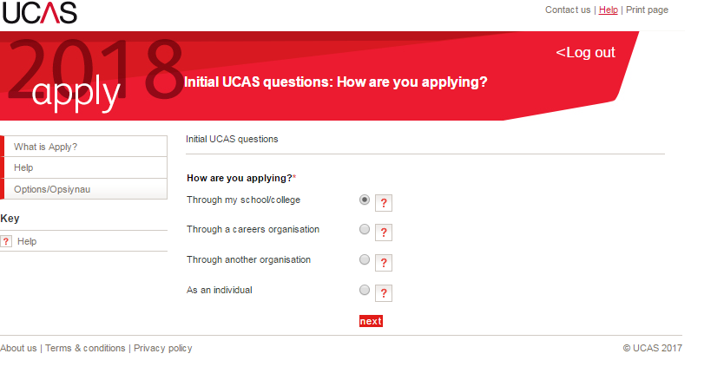
Step 9: UCAS – Log in
Click here!

Slide 17
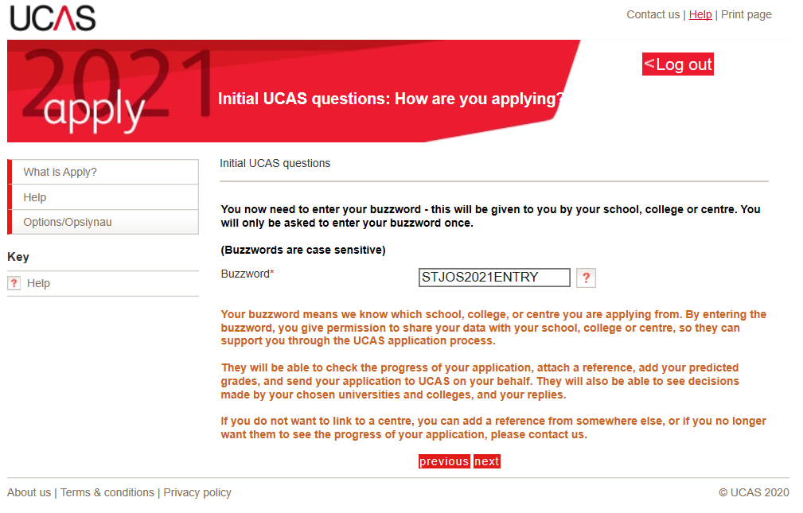
Step 10: UCAS – Log in
Enter the school’s buzzword here: STJOS2021ENTRY

Slide 18
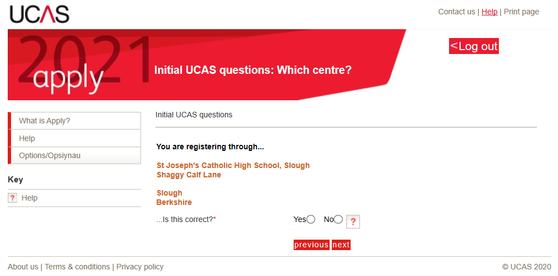
Step 11: UCAS – Log in

Slide 19
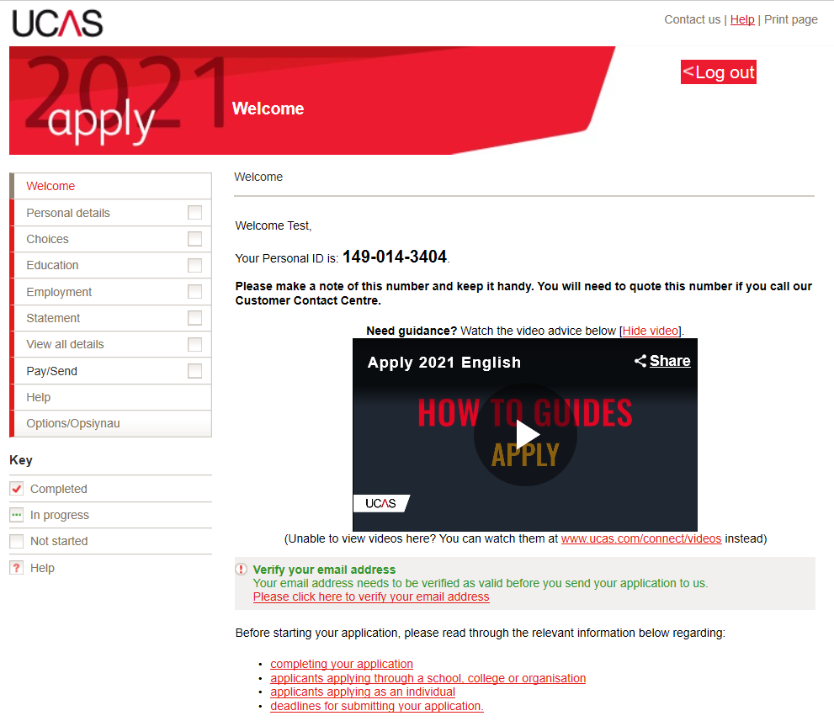
UCAS Registration complete!
Record your personal ID along with your username and password!!!
You can now visit each section of the application and save your progress as is necessary.
Remember to verify your email address.

Slide 20
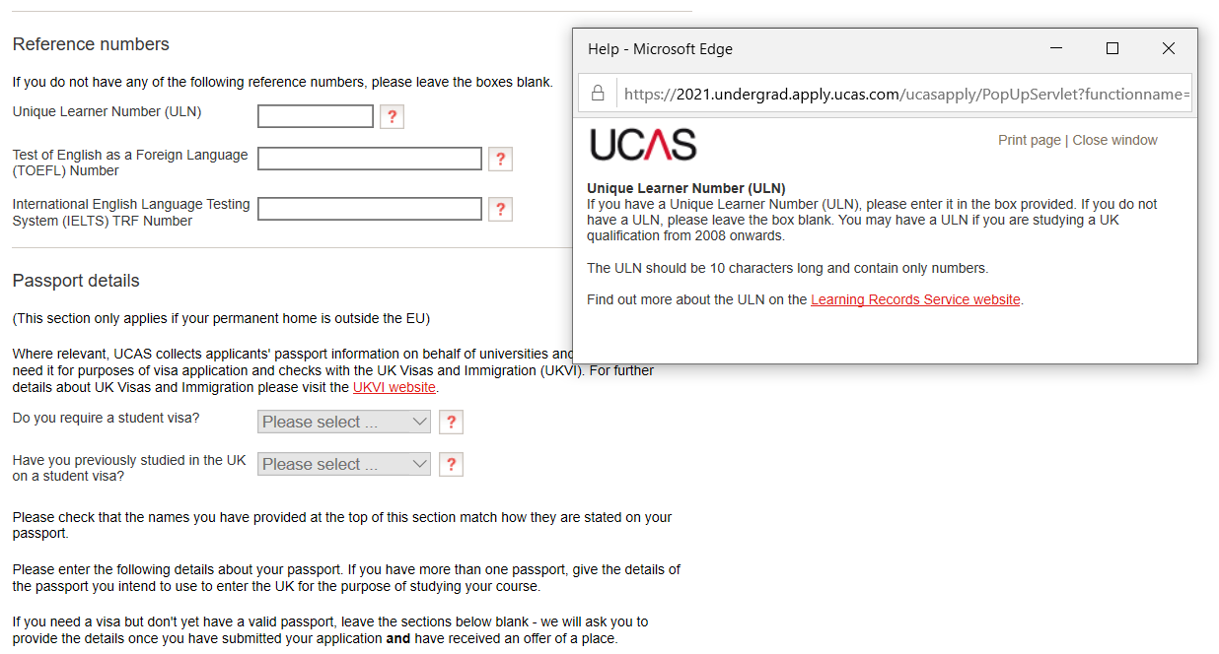
Personal Details
You will need to fill out your personal details, some will have been copied from your registration.
There will be sections in this that may be confusing. Firstly, click the ? Box as this will give you an explanation of what is needed (most bits can be added at a later date).
Points to note:
ULN – we have this for you at school and Mr Clark will send these to your tutors for you to access.
Fee Codes – if you were born in the UK or have an EU passport, you will use the code 02. If you were born outside the EU and have a non-EU passport, you will use code 99 (for not known).
Student support arrangements – type in Slough (or select it from the list).

Slide 21
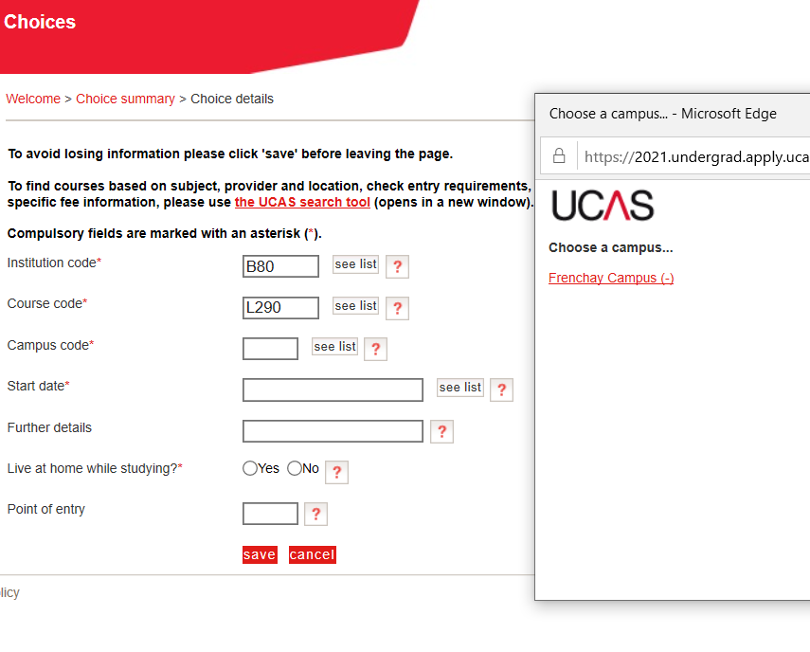
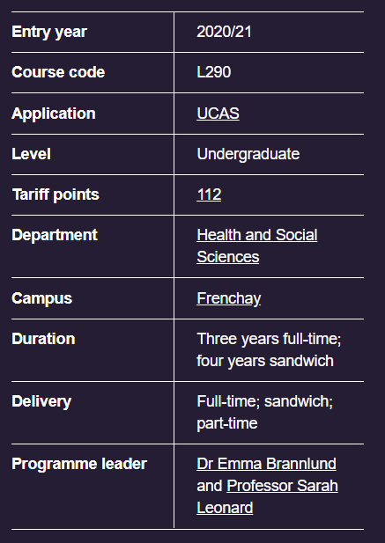
Choices
You will find this information on the university webpage for a given course. See the example given below.
https://courses.uwe.ac.uk/L290/politics-and-international-relations

Slide 22
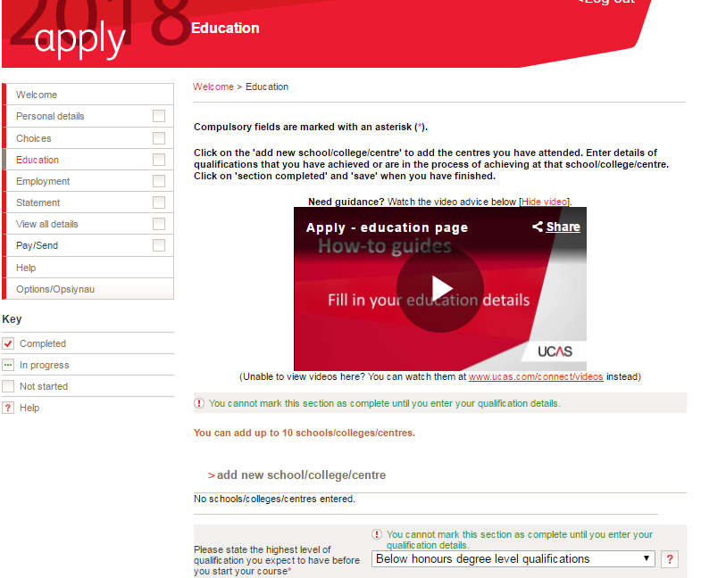
Education
This is where you add your school, qualifications and results.
GCSEs - add your GCSES (exam board, subject and overall grade only).
A-Levels – add each subject for A Level and AS if taking an AS subject. You must enter your grade as ‘pending’ – we will enter this based on your predicted grades from your PPEs.
CAUTION!!!
BTECs - all modules to be entered for your BTEC Level 3 National Extended Certificate (360) with the correct exam board – if in doubt, ask Ms Toombs or your BTEC teacher (you can come back to this if necessary).

Slide 23
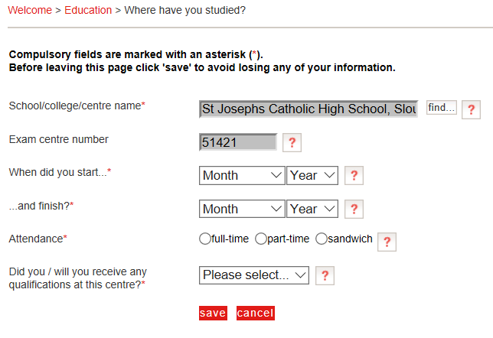

Slide 24
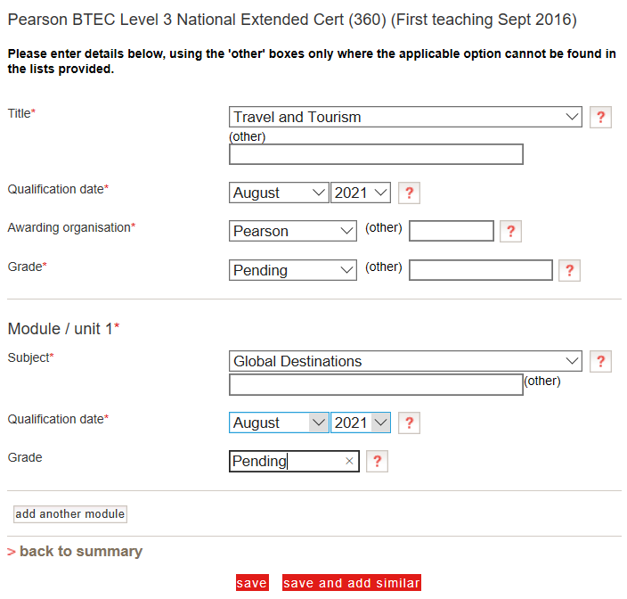
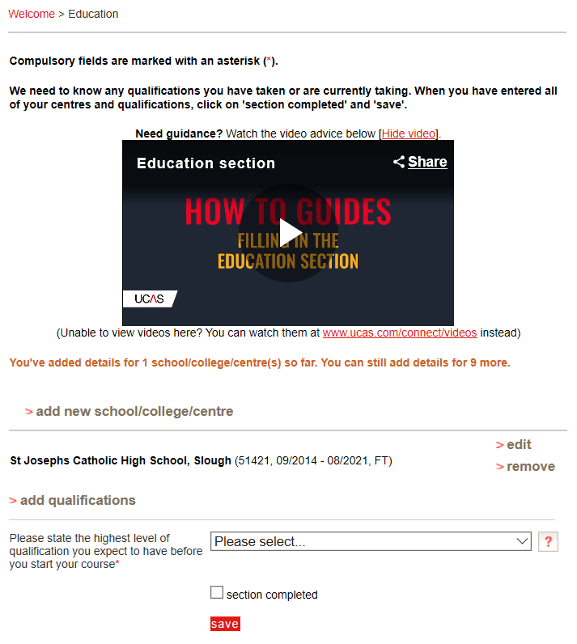
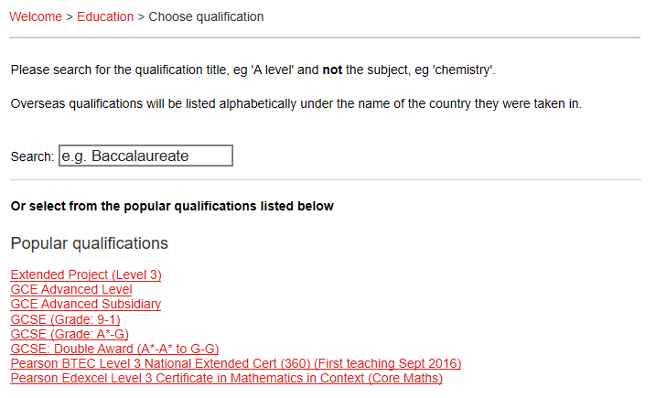

See the subjects section of the Sixth Form prospectus for the awarding organisation (i.e. exam board).

Slide 25
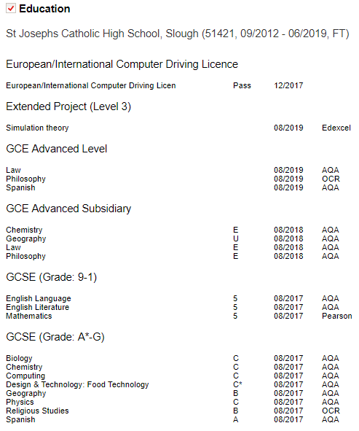
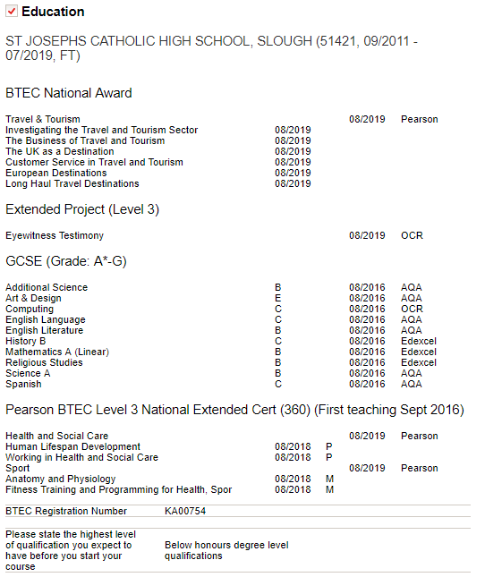
Put a shortened version of your EPQ title if it will not fit
Examples of how the Education section is completed.
Ask your BTEC teacher for your BTEC registration number

Slide 26
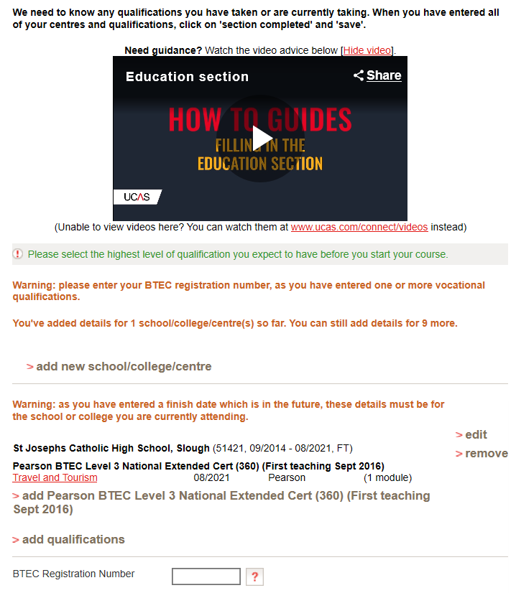
BTEC Registration Number
Speak to your teacher for what your BTEC registration number is.
Speak to your teacher for what your BTEC registration number is.

Slide 27
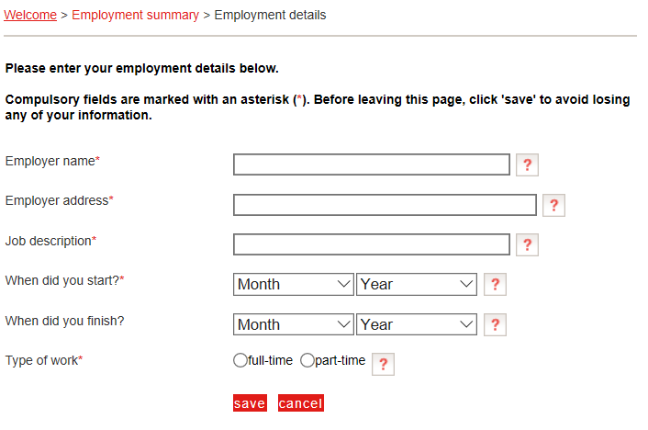
Employment Summary

Slide 28
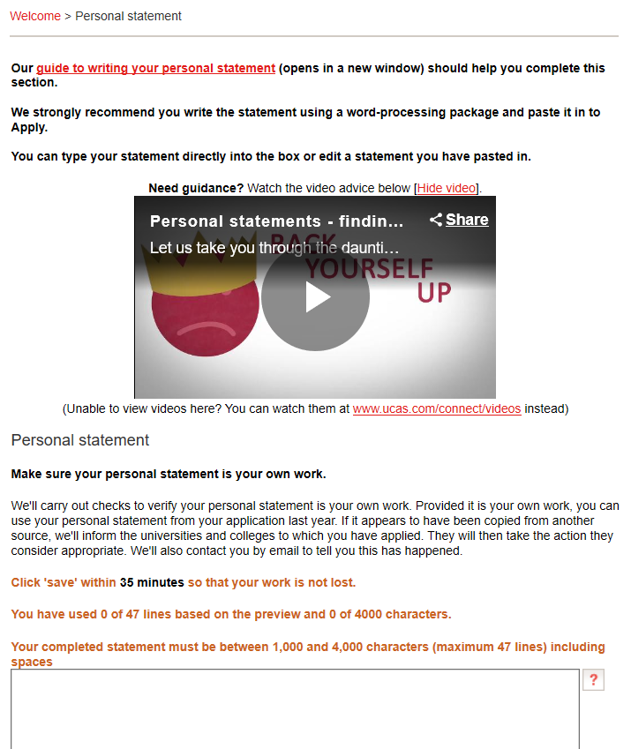
Your Personal Statement
You must complete this on the Word Online doc only and then copy and paste it into this when it is complete.
We cannot give you feedback if you do not do so.
Although we have provided you with a UCAS booklet and workshop dedicated to the personal statement, there are resources in this section to help you with this ☺
Your personal statement must only use 47 lines and 4000 characters including spaces. Bear this in mind when writing it on your template.

Slide 29

Pay and Send
This can be paid for through the bursary if necessary.
You only need to pay for the application, when you send it.
It will then come to us to check it over for mistakes before it is sent off.
You will not need to pay twice.

Slide 30

Troubleshooting
https://www.ucas.com/contact-us
Give their customer services a call – in a lot of cases this is what I will end up doing so you will get an answer more quickly.

Slide 31
The UCAS Journey – Apply 2021
Summer Term 2020
Personal Statement (completed on the Word Online document only)
5th of May – UCAS search tool Entry 2021 goes live.
19th of May – UCAS entry UCAS Undergraduate Apply goes live - create and account and update Personal details, Choices and Education & Employment.
Your teachers, tutors and Heads of Year will be writing your references.
Autumn Term 2020
8th of September – UCAS applications may be submitted for Entry 2021.
Your HoY(s) will update your predicted grades based on your most recent PPE results.
October – Medicine, Vet and Dental applications to be sent.
Spring Term 2021
January – all UCAS applications submitted – a balance between too early and too late.
Universities will make decisions on your application (conditional, unconditional or unsuccessful).
May – deadline to make firm and insurance choices – be aspirational!

