Slide 1

UCAS Workshop 3
Getting into Your Top Choice University

Slide 2
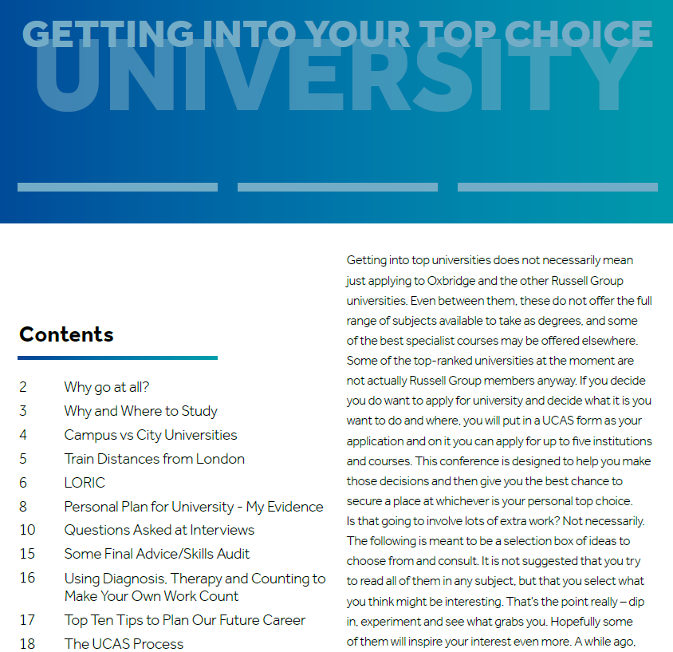
PiXL – Getting into your Top Choice University
The PDF booklet has been sent out alongside this workshop.

Slide 3
UCAS Entry 2021 Goes Live
19th of May 2021.
Workshop 4 – How to Complete your UCAS Application
Workshop 5 – The UCAS Hub

Slide 4
In this session, we will look at:
What are the top universities?
Academic and Personal skills & qualities
My university action plan
Super curriculum – the list, MooCs and EPQ
Interviews
The UCAS journey for Entry 2021

Slide 5
The Russell Group Universities:
Birmingham, Bristol, Cambridge, Cardiff, Durham, Edinburgh, Exeter, Glasgow, Imperial, King’s, Leeds, Liverpool, LSE, Manchester, Newcastle, Nottingham, Oxford, Queen’s Belfast, QMC, Sheffield, Southampton, UCL, Warwick, York.
The Russell Group is a catch-all term for a group of universities with a shared focus on research and a reputation for academic achievement.

Slide 6
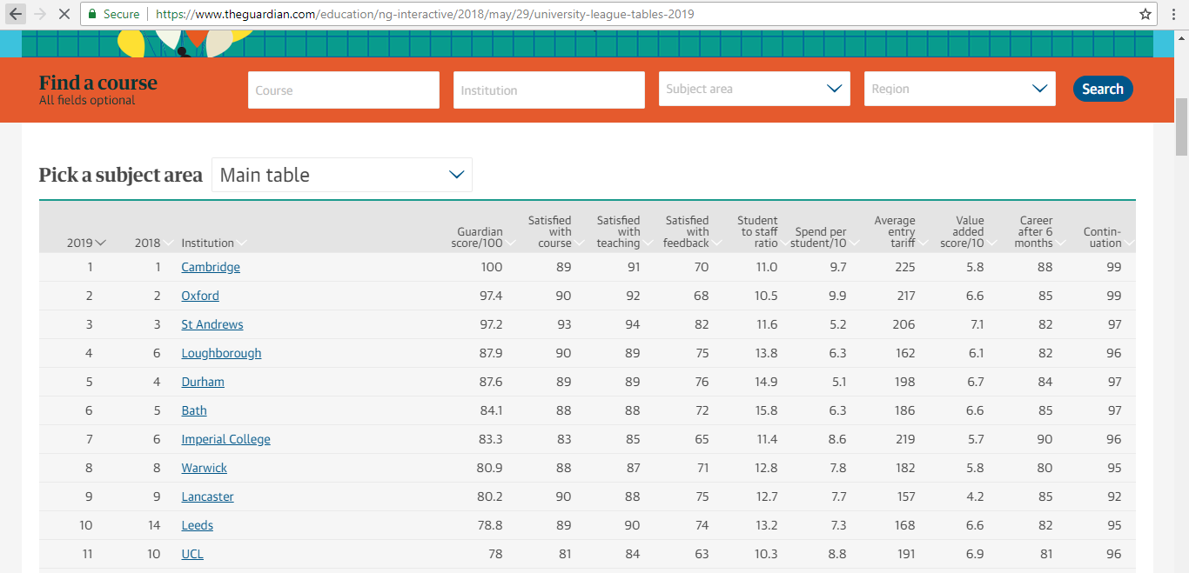
The Guardian University League Table (BBB = 120 pts)
Search for your course here and then find out:
Overall rankings
Rankings for different criteria
Rankings for subjects
Course information by university
https://www.theguardian.com/education/ng-interactive/2018/may/29/university-league-tables-2019

Slide 7
The Russell Group Universities:
Birmingham, Bristol, Cambridge, Cardiff, Durham, Edinburgh, Exeter, Glasgow, Imperial, King’s, Leeds, Liverpool, LSE, Manchester, Newcastle, Nottingham, Oxford, Queen’s Belfast, QMC, Sheffield, Southampton, UCL, Warwick, York.
The Russell Group is a catch-all term for a group of universities with a shared focus on research and a reputation for academic achievement.

Slide 8

GETTING THE EDGE ACADEMICALLY
Demonstrating LORIC – skills of
LOVE OF LEARNING
OPEN MINDED
READING AND RESEARCH
INTERESTING TO TEACH
CRITICAL THINKER

Slide 9
GETTING THE EDGE PERSONALLY…
Demonstrating LORIC – skills of
LEADERSHIP
ORGANISATION
RESILIENCE
INITIATIVE
COMMUNICATION

Slide 10
LEADERSHIP: LOVE OF LEARNING
Work experience (get the most from it)
Work shadowing
Articles, Radio (4), TV & Opinions
Lectures at local institutions
Open Days
Track what your Year 13s are doing

Slide 11
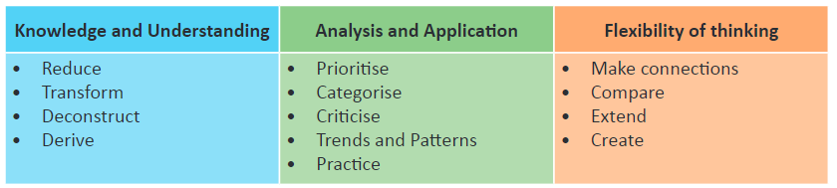
ORGANISATION: READING AND RESEARCH: CRITICAL THINKER
READ
RESEARCH
ENJOY
https://www.youtube.com/watch?v=9PsLktb7HTA

Slide 12
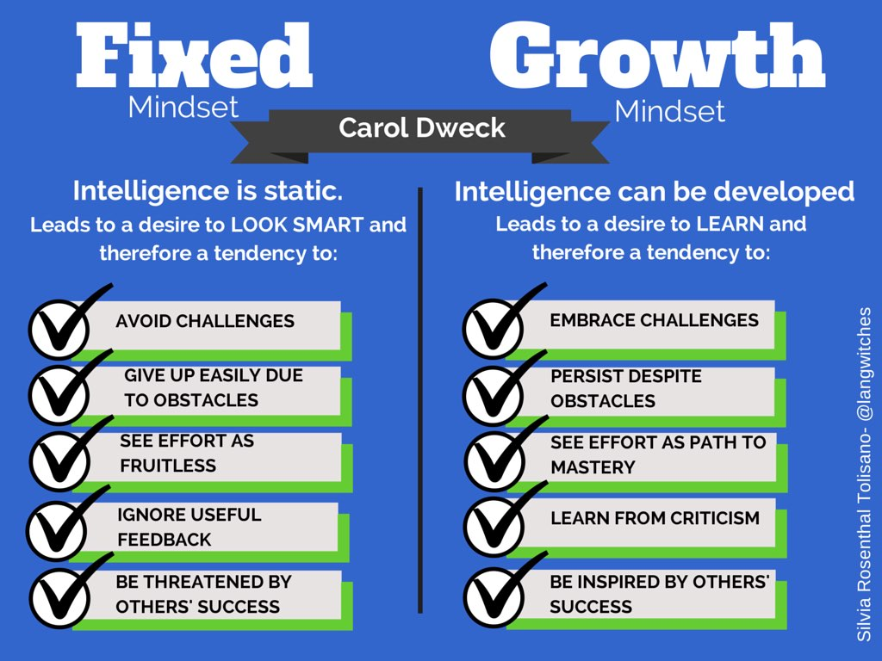
RESILIENCE: OPEN MINDED

Slide 13
COMMUNICATION:
INTERESTING TO TEACH
Volunteer for school events
Debate
Peer Mentoring
Interviews
If I was an Admissions Tutor or an Employer, what criteria would I use to decide who I offered a place to?

Slide 14
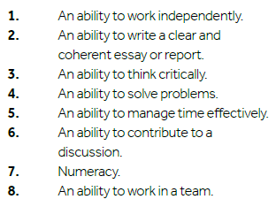

Slide 15
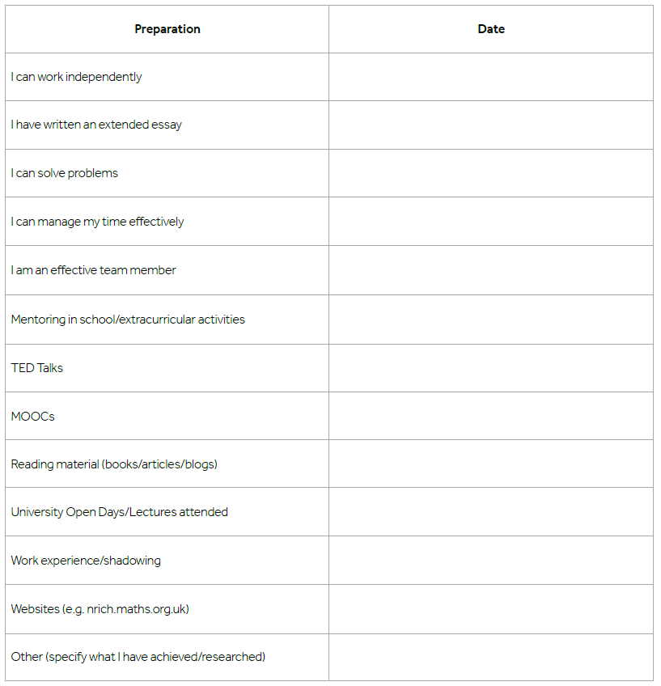
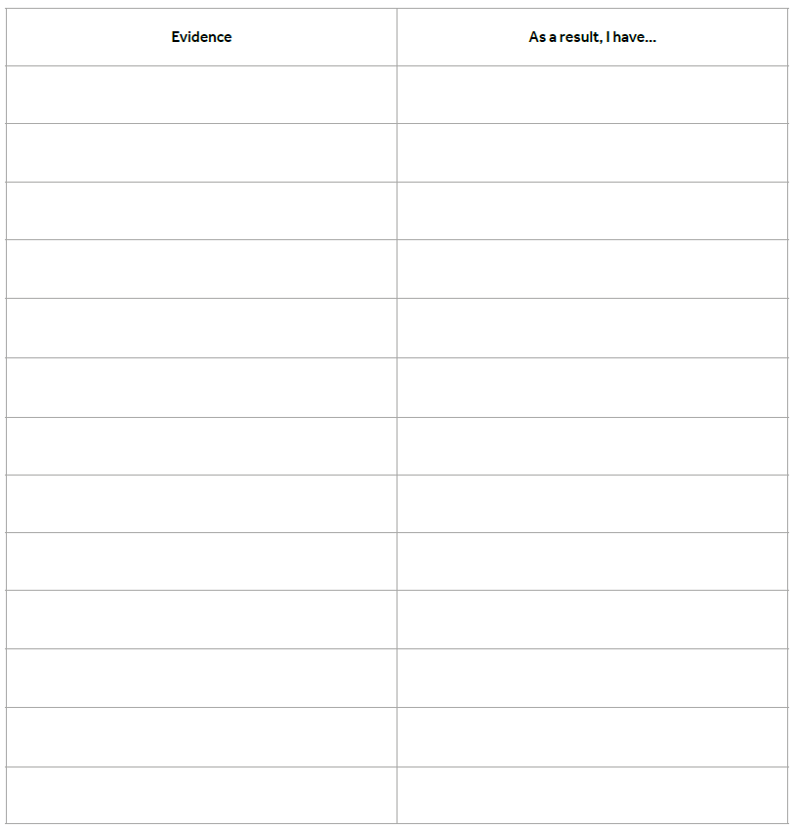

Slide 16


St Joseph’s Sixth Form Learner Vision
Be CAR – you are in the driving seat
Key expectations | Curious | Autonomous | Resilient
The highest of achievers: | Are reflective on their learning Ask questions to reach new hypotheses Take academic risks Seek opportunities to extend their learning | Independently seek learning opportunities Are organised and have a clear plan Pro-actively solve problems Have an aspirational and ambitious approach to their career goals Are future leaders | Are driven to achieve their goals Plan ahead and plan for the unknown Bounce back from every set back Adapt to whatever life throws at them

Slide 17

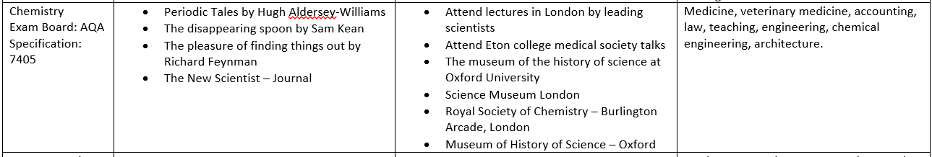
The Super Curriculum
Read it, see it, listen to it, reflect on it.

Slide 18

MooCs
MOOCs are Massive Open Online Courses
Taster courses from universities all over the world
3-8 weeks each and requiring 2-6 hours a week
With modules on all sorts of subjects
Look at www.futurelearn.com

Slide 19

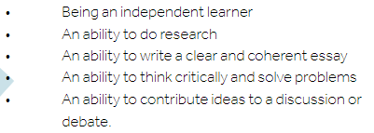
EPQ
The Extended Project Qualification (EPQ) gives you the chance to do a piece of research of your own choice, get a grade from it (up to A*) and extra 24 UCAS points.

Slide 20

Interviews
Pages 10-15 of your World of Work booklet.
Proper Prior Preparation Prevents Piss-Poor Performance.
Practice (see questions).
Build a portfolio

Slide 21
The UCAS Journey – Apply 2021
Summer Term 2020
Personal Statement (completed on the Word Online document only)
5th of May – UCAS search tool Entry 2021 goes live.
19th of May – UCAS entry UCAS Undergraduate Apply goes live - create and account and update Personal details, Choices and Education & Employment.
Your teachers, tutors and Heads of Year will be writing your references.
Autumn Term 2020
8th of September – UCAS applications may be submitted for Entry 2021.
Your HoY(s) will update your predicted grades based on your most recent PPE results.
October – Medicine, Vet and Dental applications to be sent.
Spring Term 2021
January – all UCAS applications submitted – a balance between too early and too late.
Universities will make decisions on your application (conditional, unconditional or unsuccessful).
May – deadline to make firm and insurance choices – be aspirational!

Slide 22

Please come and see me any of the sixth form team if you need any other help.

