Slide 1
My desire to pursue a career in medicine stems from a personal and academic appreciation of the profession. I have always enjoyed studying the sciences: first cultured during a visit to London's Science Museum, my scientific interest continues to develop. I particularly enjoy exploring fields such as genetics and bioengineering. Witnessing my mother's role within the nursing profession, I appreciate the daily attention and care a medical career demands. Volunteering at Wexham Park Hospital has given me a valuable insight into the mechanics of the hospital wards. I have been able to witness, first-hand, the symbiotic relationship doctors and nurses need to deliver the most effective care for their patients. Shadowing.
To increase my knowledge of how Accounting and Finance works, I have decided to read some useful resources that are based around this topic. This would include, books, magazines and the internet. An example I have found was reading an article on the internet which suggests that "Gender pay reporting will work, say financial professionals". In my opinion, I find Gender pay a controversial topic to write about due to the statistics that are publicly shown on how men are earning more than women and how the public are reacting to this. Other reports I have read would include " ACCA updates tax report as debates about company taxation remain highly controversial in an increasingly digitalised economy". In my opinion, I think the ACCA (Association of Charted Certified Accountants), aims to improve the importance of accounting in culture through government research. This involves extreme positions on international issues to ensure transparency as a discipline continues to expand in credibility and importance.

Slide 2
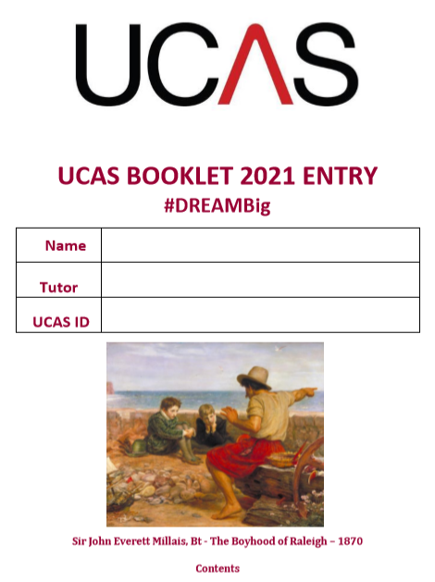

Slide 3
The Personal statement

Slide 4
The personal statement is a vital part of decisions made as you will not have AS grades as previous cohorts have.
Universities will also consider your GCSE grades, your references and your predicted grades and will have much more gravitas than previous cohorts.

Slide 5
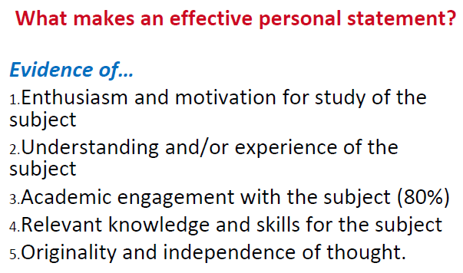
This is key, your next few months should be spent bolstering this evidence.

Slide 7
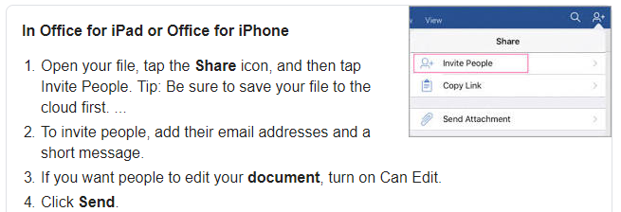
Word Online Docs
Your tutor has set up a Microsoft Word Online Document for you on which to complete your Personal Statement. You must use this and only this. Please share it with your subject teachers, HoY and Head of Sixth Form.
This will make it far easier to give feedback and monitor changes.
Everyone accessing the document can edit it at the same time without saving other versions (you will never lose it!).
It stops lots of emails being set around:

Slide 8
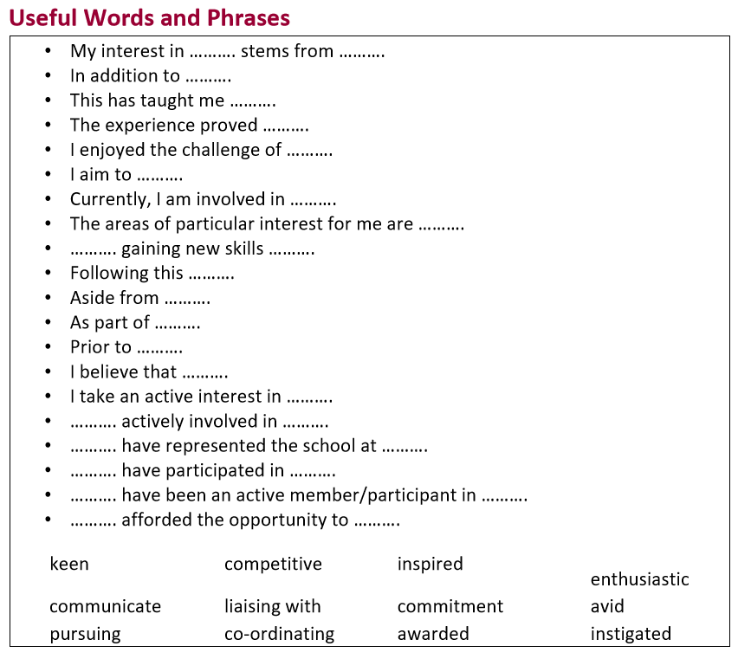

Slide 9
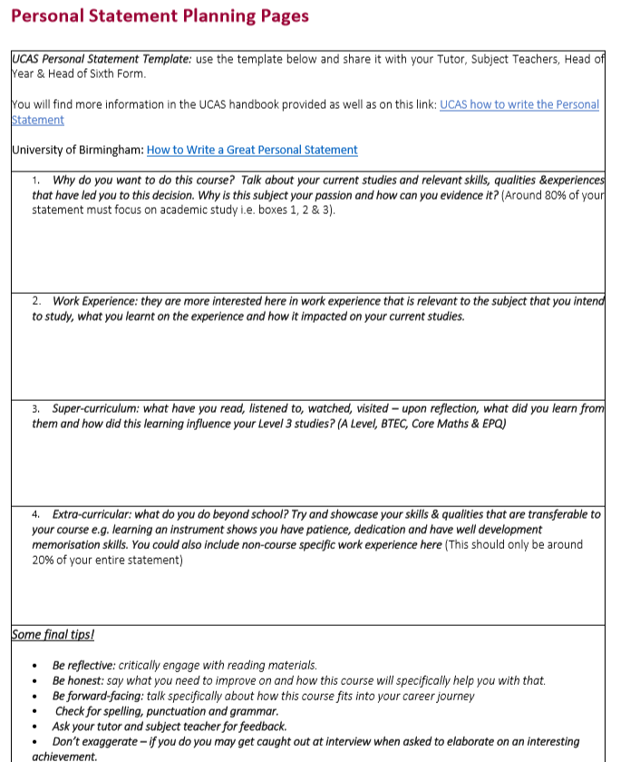

Slide 11
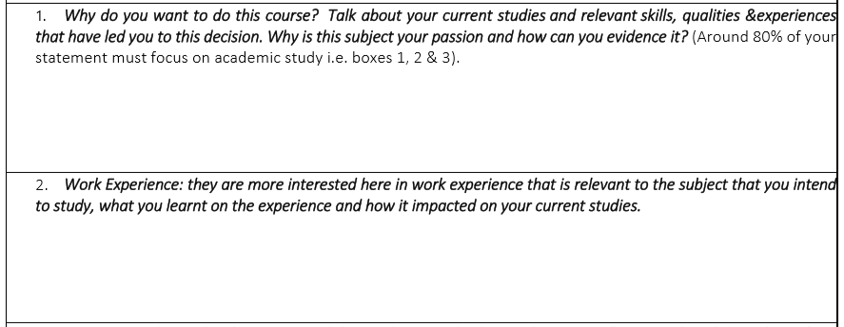

Slide 12
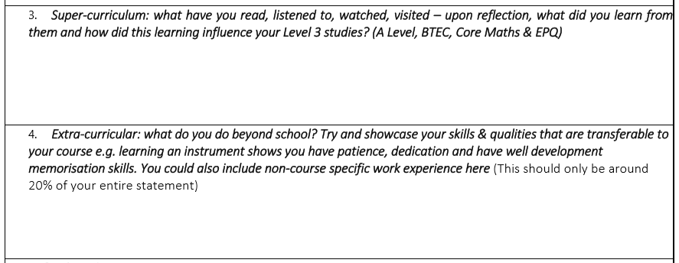

Slide 13
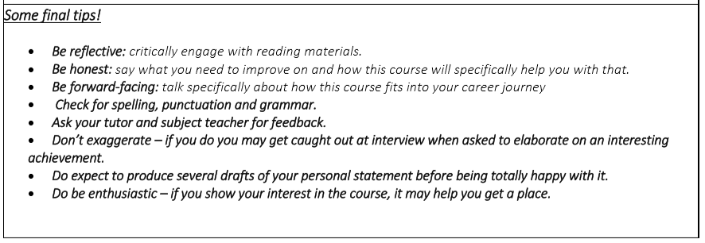

Slide 16
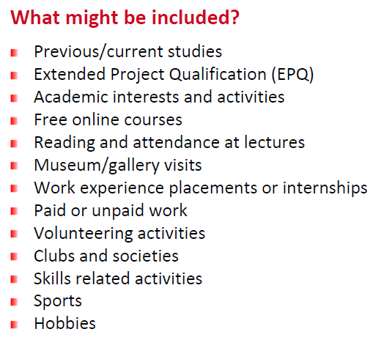

Slide 17
Super curricular – learning that is pursued in addition to your course e.g. wider reading, visiting an exhibition, specific work experience.
Always include in your notes:
Who you spoke to?
When?
What you saw?
How is it relevant to your course?
Reflect upon what you learnt and how you can apply that new knowledge.

Slide 18
The bottom line is that universities care about your academics and not a lot else.
Universities would prefer to hear about what you learnt from an exhibition and how you applied it to your studies than how many you went to.

Slide 19
Two Final No-Nos
Guarantee you have not wanted to be ‘x’ since you were a young girl/boy…
Do not try and use words from the thesaurus on which you are not clear on the meaning (clear and concise better than ‘trying too hard’.

Slide 20
The UCAS Process – Apply 2021
Summer Term 2020
Personal Statement (completed on the Word Online document only)
5th of May – UCAS search tool Entry 2021 goes live.
19th of May – UCAS entry UCAS Undergraduate Apply goes live - create and account and update Personal details, Choices and Education & Employment.
Your teachers, tutors and Heads of Year will be writing your references.
Autumn Term 2020
8th of September – UCAS applications may be submitted for Entry 2021.
Your HoY(s) will update your predicted grades based on your most recent PPE results.
October – Medicine, Vet and Dental applications to be sent.
Spring Term 2021
January – all UCAS applications submitted – a balance between too early and too late.
Universities will make decisions on your application (conditional, unconditional or unsuccessful).
May – deadline to make firm and insurance choices – be aspirational!

Slide 21
Please come and see me any of the sixth form team if you need any other help.

Slide 22
UCAS Workshop 3
Getting into Your Top Choice University

Slide 23
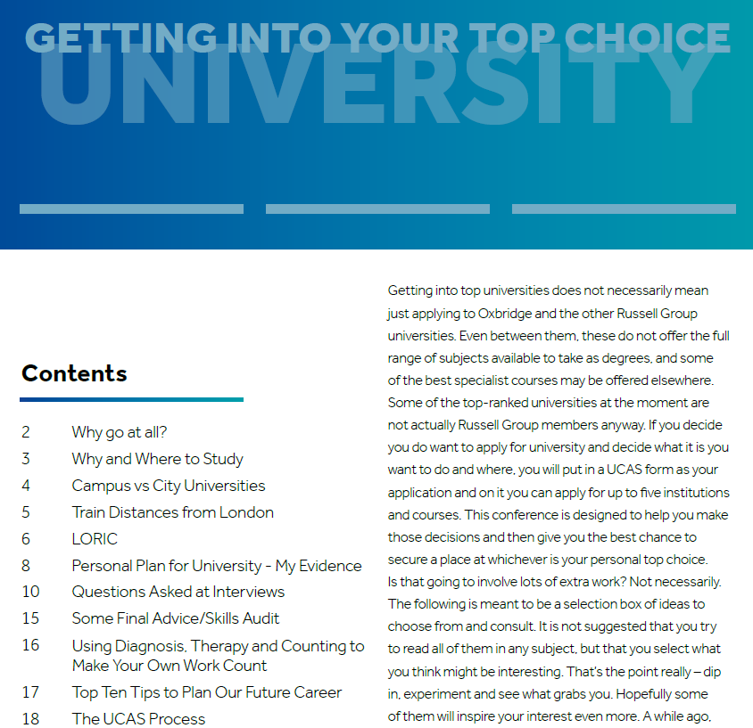
PiXL – Getting into your Top Choice University
The PDF booklet has been sent out alongside this workshop.

Slide 24
UCAS Entry 2021 Goes Live
19th of May 2021.
Workshop 4 – How to Complete your UCAS Application
Workshop 5 – The UCAS Hub

Slide 25
In this session, we will look at:
What are the top universities?
Academic and Personal skills & qualities
My university action plan
Super curriculum – the list, MooCs and EPQ
Interviews
The UCAS journey for Entry 2021

Slide 26
The Russell Group Universities:
Birmingham, Bristol, Cambridge, Cardiff, Durham, Edinburgh, Exeter, Glasgow, Imperial, King’s, Leeds, Liverpool, LSE, Manchester, Newcastle, Nottingham, Oxford, Queen’s Belfast, QMC, Sheffield, Southampton, UCL, Warwick, York.
The Russell Group is a catch-all term for a group of universities with a shared focus on research and a reputation for academic achievement.

Slide 27
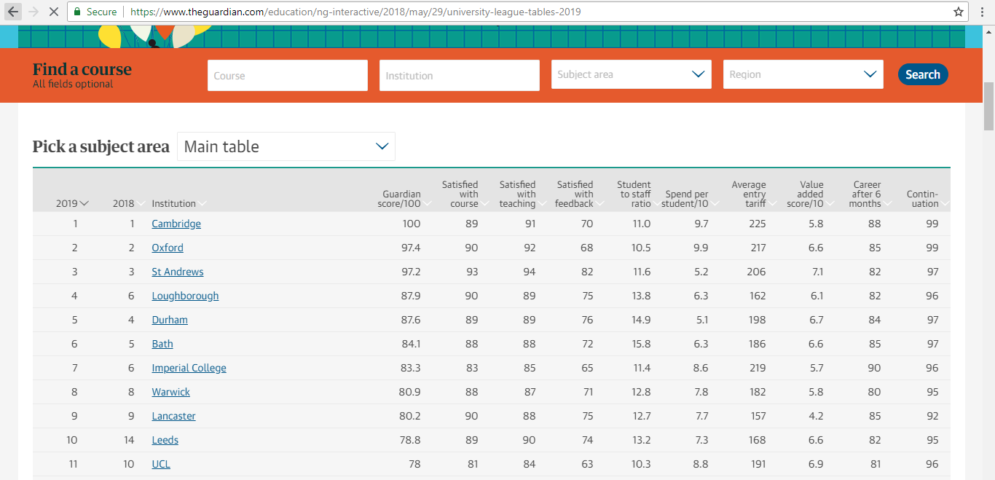
The Guardian University League Table (BBB = 120 pts)
Search for your course here and then find out:
Overall rankings
Rankings for different criteria
Rankings for subjects
Course information by university
https://www.theguardian.com/education/ng-interactive/2018/may/29/university-league-tables-2019

Slide 28
The Russell Group Universities:
Birmingham, Bristol, Cambridge, Cardiff, Durham, Edinburgh, Exeter, Glasgow, Imperial, King’s, Leeds, Liverpool, LSE, Manchester, Newcastle, Nottingham, Oxford, Queen’s Belfast, QMC, Sheffield, Southampton, UCL, Warwick, York.
The Russell Group is a catch-all term for a group of universities with a shared focus on research and a reputation for academic achievement.

Slide 29
GETTING THE EDGE ACADEMICALLY
Demonstrating LORIC – skills of
LOVE OF LEARNING
OPEN MINDED
READING AND RESEARCH
INTERESTING TO TEACH
CRITICAL THINKER

Slide 30
GETTING THE EDGE PERSONALLY…
Demonstrating LORIC – skills of
LEADERSHIP
ORGANISATION
RESILIENCE
INITIATIVE
COMMUNICATION

Slide 31
LEADERSHIP: LOVE OF LEARNING
Work experience (get the most from it)
Work shadowing
Articles, Radio (4), TV & Opinions
Lectures at local institutions
Open Days
Track what your Year 13s are doing

Slide 32
ORGANISATION: READING AND RESEARCH: CRITICAL THINKER
READ
RESEARCH
ENJOY
https://www.youtube.com/watch?v=9PsLktb7HTA

Slide 33
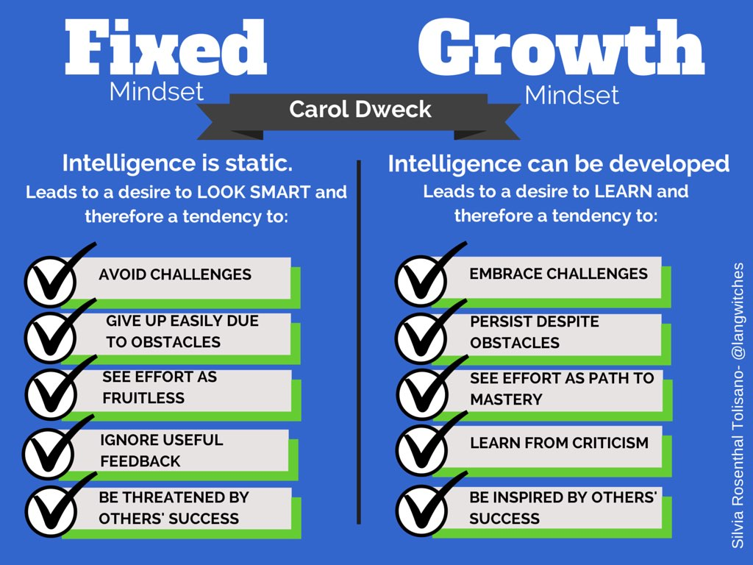
RESILIENCE: OPEN MINDED

Slide 34
COMMUNICATION: INTERESTING TO TEACH
Volunteer for school events
Debate
Peer Mentoring
Interviews
If I was an Admissions Tutor or an Employer, what criteria would I use to decide who I offered a place to?

Slide 35
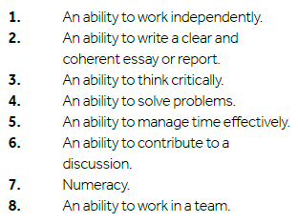

Slide 36
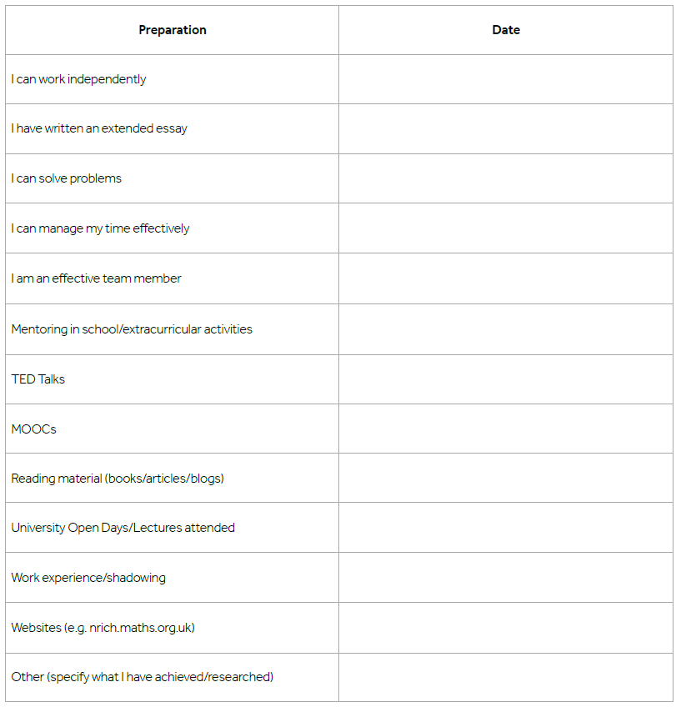
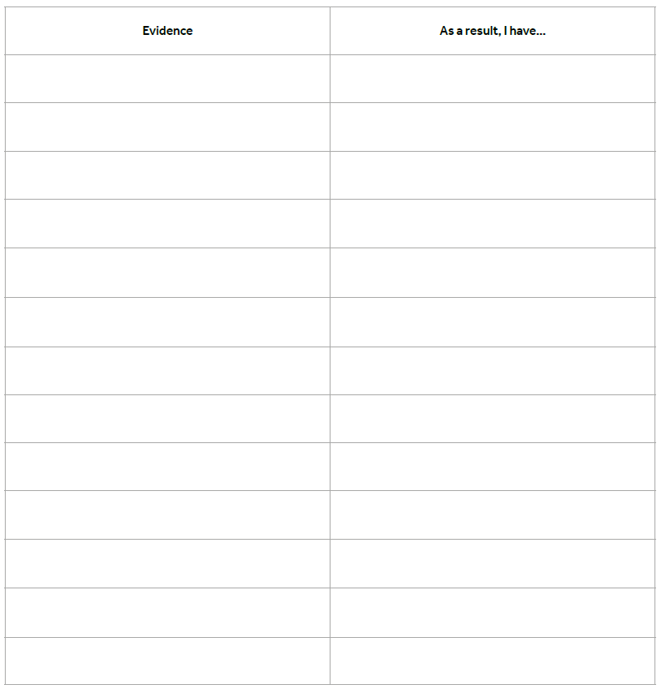

Slide 37
St Joseph’s Sixth Form Learner Vision
Be CAR – you are in the driving seat
Key expectations | Curious | Autonomous | Resilient
The highest of achievers: | Are reflective on their learning Ask questions to reach new hypotheses Take academic risks Seek opportunities to extend their learning | Independently seek learning opportunities Are organised and have a clear plan Pro-actively solve problems Have an aspirational and ambitious approach to their career goals Are future leaders | Are driven to achieve their goals Plan ahead and plan for the unknown Bounce back from every set back Adapt to whatever life throws at them

Slide 38
The Super Curriculum
Read it, see it, listen to it, reflect on it.

Slide 39
MooCs
MOOCs are Massive Open Online Courses
Taster courses from universities all over the world
3-8 weeks each and requiring 2-6 hours a week
With modules on all sorts of subjects
Look at www.futurelearn.com

Slide 40
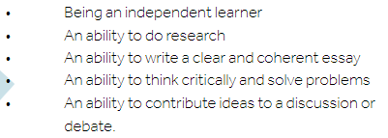
EPQ
The Extended Project Qualification (EPQ) gives you the chance to do a piece of research of your own choice, get a grade from it (up to A*) and extra 24 UCAS points.

Slide 41
Interviews
Pages 10-15 of your World of Work booklet.
Proper Prior Preparation Prevents Piss-Poor Performance.
Practice (see questions).
Build a portfolio

Slide 42
The UCAS Journey – Apply 2021
Summer Term 2020
Personal Statement (completed on the Word Online document only)
5th of May – UCAS search tool Entry 2021 goes live.
19th of May – UCAS entry UCAS Undergraduate Apply goes live - create and account and update Personal details, Choices and Education & Employment.
Your teachers, tutors and Heads of Year will be writing your references.
Autumn Term 2020
8th of September – UCAS applications may be submitted for Entry 2021.
Your HoY(s) will update your predicted grades based on your most recent PPE results.
October – Medicine, Vet and Dental applications to be sent.
Spring Term 2021
January – all UCAS applications submitted – a balance between too early and too late.
Universities will make decisions on your application (conditional, unconditional or unsuccessful).
May – deadline to make firm and insurance choices – be aspirational!

Slide 43
Please come and see me any of the sixth form team if you need any other help.

