Slide 1
EPQ | AS level | A level | New Tariff points | BTEC Subsidiary Diploma
 |  | A* | 56 | D*
 |  | A | 48 | D
 |  | B | 40
 |  | C | 32 | M
A* |  |  | 28
A |  | D | 24
B | A |  | 20
C | B | E | 16 | P
D | C |  | 12
 | D |  | 10
E |  |  | 8
 | E |  | 6
Reflection:
What are your first (firm) and second (insurance) offers?
What do you need to get to for your chosen course?
What subjects are your focus for improvement?

Slide 2
UCAS Workshop 1
Choosing the Right Course

Slide 3
In this session, we will look at:
The UCAS journey for Entry 2021
An overview of the application
How to choose your course
How to choose your institution
Offers

Slide 4
The UCAS Journey – Apply 2021
Summer Term 2020
Personal Statement (completed on the Word Online document only)
5th of May – UCAS search tool Entry 2021 goes live.
19th of May – UCAS entry UCAS Undergraduate Apply goes live - create and account and update Personal details, Choices and Education & Employment.
Your teachers, tutors and Heads of Year will be writing your references.
Autumn Term 2020
8th of September – UCAS applications may be submitted for Entry 2021.
Your HoY(s) will update your predicted grades based on your most recent PPE results.
October – Medicine, Vet and Dental applications to be sent.
Spring Term 2021
January – all UCAS applications submitted – a balance between too early and too late.
Universities will make decisions on your application (conditional, unconditional or unsuccessful).
May – deadline to make firm and insurance choices – be aspirational!

Slide 5
My Journey

Slide 6
My Journey
Yateley School – 3 As, 5Bs, 3Cs and a D grade (2003) – with Miss Morgans (she did better than me)
Yateley Sixth Form – CDD (2005) … with Miss Morgans…she did better than me…
Applied to any university to do English and Politics
Gap year to work and save money (2005-6)
UWE rang me to change course – randomly chose Spanish (2006)

Slide 7
My Journey
Opted for a placement year, teaching in Barcelona (2008)
Left with a 2:2 (1 mark off a 2:1!!!) (2010)…Miss Morgans got a 2:1…
Went travelling (2011)
Applied to Kingston to do a PGCE (2011-12)
Got a job as a Spanish teacher in Southall (2012)
Left for the dream – SLOUGH!!! (2018)

Slide 8
The Point?
I enjoyed the journey and I am lucky to have a job I love.
But I have regrets…
Try and find the balance between planning for a great future, having a good plan B and knowing that set-backs are not the end of the world.

Slide 9
The UCAS Timetable – Year Two
NOVEMBER
OCTOBER
DECEMBER/
JANUARY
Applications
SEPTEMBER
Early bird catches the worm.
Applicant looks well-organised.
Admissions tutors still fresh.
Some places filled.
Huge rush.
Delays.
Tutors tired.
Fewer places.
Applicant looks ill-organised.
Admissions tutors very tired.
Many places gone.
UCAS site can often crash!!
BEST APPLICANTS

Slide 10
The Application
You will choose a maximum of 5 courses
Some choice restrictions:
Medicine, Veterinary and Dentistry – max of 4 choices
Oxford or Cambridge – usually you can only apply for one course at one or the other.
UCAS operates an invisibility policy. This means that each university that you apply to can't see which other institutions has also received an application from you.
Payment of £24 to apply – made online by card.
You can only send one UCAS application in each year’s cycle.
Sections of the application:
Personal Details
Additional Information
Student Finance
Choices
Education

Slide 11
The Personal Statement
The personal statement is an important part of your UCAS application.
It’s your chance to describe your ambitions, skills, and experience to university and college admissions staff.
A personal statement supports your application to study at a university or college. It’s a chance for you to articulate why you’d like to study a particular course or subject.
Passion for the subject and passion for learning.
Evidence of the very highest level of independent study.
Notes:
The personal statement is an important part of your UCAS application. It’s your chance to describe your ambitions, skills, and experience to university and college admissions staff.
A personal statement supports your application to study at a university or college. It’s a chance for you to articulate why you’d like to study a particular course or subject, and what skills and experience you possess that show your passion for your chosen field.

Slide 12
The Reference
Your teachers, your tutor and I fill in a reference for every student.
It contains a comment on the academic suitability for the course and attendance to university.
It includes attendance, punctuality data and a comment on attitude to learning.
Contextual information – we tell the story – sometimes our references have meant a student who may not quite have the predicted grades is made an offer because of a glowing reference.
We have requested references be sent back and be changed before.

Slide 13
How to choose your course:
https://www.thecompleteuniversityguide.co.uk/courses/choosing-a-course/
https://www.ucas.com/undergraduate/what-and-where-study/ucas-undergraduate-what-study
Choosing a subject
Choosing a course
Choosing how to study
Choosing where to study
Notes:
Choosing a university course is one of the first and most important decisions a student makes. Your enjoyment of your course has a huge bearing on your overall university experience and performance.
There are 30,000 courses offered at UK university. While this vast array of choice means that the right course is out there for you, it can be challenging trying to find it. This section will walk you through the key steps in the decision-making process:
1. Choosing a subject
It’s important you choose a subject you enjoy and will help you reach your goals. Here are some things to help you choose the right subject for you:
Think about what you enjoy day-to-day – maybe this could be part of a future job role?
Explore different job sites and graduate career options to look for ideas on what you’d like to do once you've finished your studies.
Think about your career goals and the qualifications required as part of a person specification.
Take a look at our subject guides to get an idea of the types of subjects you could study, and the industries graduates go on to work in.
Search for courses by subject to see what's available.
UK degree courses tend to be very specialised from day one, allowing students to focus on their chosen subject. However, there are others that allow you more flexibility in what you study. Make sure you read the course descriptions carefully, and click through to university websites for further information.
Thinking about more than one course or subject?
To increase your chances of getting a place on a course we give you the option of applying to up to five courses at once, usually all in a similar subject so that your application is relevant to all of them.
Please note, there are a couple of restrictions though:
You can only apply maximum of four courses in any one of medicine, dentistry, veterinary medicine or veterinary science.
Usually you can only apply to one course at either the University of Oxford or the University of Cambridge. There are exceptions though – if you'll be a graduate at the start of the course, and you're applying for graduate medicine (course code A101) at the University of Cambridge, you could then also apply to medicine (course code A100) at Cambridge, as well as graduate medicine (course code A101) at the University of Oxford. (Some applicants will need to complete an additional application form to apply – visit the University of Oxford and the University of Cambridge websites for more information.)
2. Types of undergraduate course
After leaving school, most students going onto university or college study for an undergraduate degree. These are usually made up of modules (some compulsory and some optional) that add up to a full degree.
Here are some examples of the types of undergraduate courses you can do.
Bachelor degree courses
Bachelor degrees usually last either three or four years if studied full-time (although some courses are longer). You can concentrate on a single subject, combine two subjects in a single course (often called dual or joint honours courses), or choose several subjects (combined honours). Most courses have core modules which everyone studies, and many courses allow you to choose options or modules to make up a course that suits you.
Some bachelor degrees offer a sandwich year, involving an additional placement or year in industry, which forms part of the course. If you're an international student, you'll need to check you're eligible to work in the UK, or that your visa allows you to do a placement course. Most international students on a tier 4 visa will be eligible for a year in industry or work placements as part of their course, but there may be some conditions. Check with the university or college before making this choice in your application. You can find out more on the UKCISA website.
There are also courses which include postgraduate-level study, known as integrated master's. Integrated master's being at undergraduate level, then continue for an extra year (or more) so you're awarded a master's degree at the end. These are most common in engineering or science subjects. If you're interested in an integrated master's, you'll need to include the term 'master's' when using the UCAS search tool.
Foundation years
Some degrees offer a foundation or qualifying year as the first year, sometimes called ‘year zero’. They are generally one year, full-time courses delivered at a university or college, and can be offered as a 'standalone' course, or as part of a degree. You'll still be treated as a full-time undergraduate student.
Foundation years are designed to develop the skills and subject-specific knowledge required to undertake a degree course, and specialise in a subject area.
If your grades weren’t suitable, or you studied combinations of subjects at school or college that mean you don’t meet the entry requirements for your chosen course, a foundation year could be perfect. Not all universities and colleges offer foundation years.
Most students who take a foundation year choose to stay at the same university or college to complete their full degree, but it may be possible to apply for a full-time degree course elsewhere if you complete the course successfully. You will need to check this with the individual universities and colleges concerned. You will also pay tuition fees for your foundation year.
If you're interested in a foundation year, you'll need to include this in the undergraduate keyword field in the UCAS search tool.
Diploma in Foundation Studies (art and design)
This one-year qualification – often shortened to ‘Art Foundation’ – is widely recognised as a primary route to gain entry to some of the most prestigious art and design degree courses. The learning is tailored to a student’s specific area of art and design subject interest, so they can progress to study that area at degree level. For funding purposes, this course is classified as a further education course, so student loans (for tuition and living costs) are not available, even if you take the course at a university or college. However, UK/EU students under the age of 19 on 31 August of the year of entry will not be charged a tuition fee. As a result, many students choose to take this course straight after school or college, in their home town or city.
Foundation degrees
Foundation degrees are usually two-year courses (longer if part-time), that are equivalent to the first two years of an undergraduate degree. They are not the same as a foundation year.
These can be a good destination for school leavers at 18, as they offer a qualification that can help gain degree entry. This route is a good option for students who need a course with lower entry requirements and fewer examinations, would prefer a vocational degree/to study while they work, or are not yet ready to commit to three years at university.
Foundation degrees often combine academic skills and knowledge with workplace performance and productivity. They may have been designed in partnership with employers, and therefore focus on a particular job role or profession, enabling you to gain professional and technical skills to further your career. They can be used as a standalone qualification for employment, but are more commonly used as the basis for progression to a final ‘top-up’ year, leading to a full bachelors degree. The final year may be taken at a different university or college.
Degree or graduate level apprenticeship
This is a new type of higher level apprenticeship, which can lead to a bachelors degree as part of an apprenticeship. It is important to check the full details of a given job and apprenticeship with the employer and training provider. These courses are a good fit for students who want to gain work experience rather than studying full-time at university, but would like to achieve the same degree status.
Students need to be highly committed – competition can be fierce and entry qualifications can be high. If you’re considering this option, you may want to keep your options open by making an application to a full-time bachelors degree through UCAS at the same time.
HNCs, HNDs, and other incremental routes
The Higher National Certificate (HNC), a one-year work-related course, is equivalent to the first year of a university degree programme. The Higher National Diploma (HND) is a two-year, work-related course, which is equivalent to the first two years of a bachelors degree. As with a foundation degree, it is possible to progress from these courses to complete a full bachelors degree at a university, either through a specific top-up course, or by directly entering a degree in year three.
If you wanted to study a degree in stages, or exit after one or two years of study, the following qualifications may also be suitable. They don’t directly lead to a degree, but you may be able go on and join the second or third year of a full degree (perhaps at the same university/college, or elsewhere) if you change your mind and want to graduate with a bachelors degree after all.
One year of a degree – a Certificate of Higher Education (CertHE)
Two years of a degree – a Diploma of Higher Education (DipHE)
If you need a visa to study in the UK, you need to check your visa status allows you to do a part-time course, and/or work in the UK. Check if you need a visa and find out if you’re eligible to work on UKCISA's ‘Can you work?’ website.
Looking to study performing arts?
As well as university and college courses, you can also choose to study at a UK conservatoire. Courses at conservatoires are more performance-based than you will find at a uni or college. Conservatoires offer courses in music, dance, drama, and musical theatre.
Find out more
3. Choosing how to study
Most students study undergraduate courses full-time, however this is not the only way. There are lots of different modes of study, designed to fit around your own circumstances.
Part-time
Many universities and colleges offer part-time degree courses, which are normally taken over a longer period, so you can learn at a more relaxed pace, or work (if eligible) alongside your studies.
There are some real benefits to studying part-time:
It might be a challenge to work or take care of your family at the same time as studying, but if you're committed, it can be very rewarding.
These may be delivered via evening and weekend classes, day release, or study breaks, helping you manage study around your other commitments.
Some contain a combination of online and offline work, with regular assignments and tutor support.
Some course deadlines can be altered to fit around your other responsibilities too.
Distance and blended learning
Distance learning means studying remotely, allowing you to learn in your own time. Blended learning combines face-to-face sessions with online learning, giving a good mix of learning from the experts and teaching yourself, with course materials available online.
Your course activities and assignments will be supported by a range of online learning resources, with regular support from your tutor, interacting with fellow students via email, online forums, phone, and virtual conferencing.
Courses often include day schools or residential weekends where you work with other students on a specific project, followed by continued contact with the team as you work together, resulting in another residential where results are presented and assessed.
You will find some distance and blended courses advertised in the UCAS search tool and some on university or college websites. UCAS does not provide a central admissions service for distance or blended learning – you will need to apply directly to the university or college to be considered for the programme.
Accelerated degrees
Accelerated degrees are offered by some universities and colleges, in some subject areas. Students on accelerated degrees undertake the same course content as students on typical degrees, but complete their degrees one year sooner. For example, accelerated degree students can complete the full content of a typical three-year degree, but graduate in two years.
Work-based learning
If you are employed in the UK, it is also possible to study in the workplace. Some course providers partner with official organisations to create customised programmes – right through from a Certificate to a doctorate-level qualification. For example, the Royal Institute of British Architects (RIBA) offers a flexible study programme for those already working in the industry who want to qualify officially.
Higher and degree apprenticeships could also be an option for work-based learning – find out more about apprenticeships.
4. Choosing where to study
Some students set their heart on a particular university, while others just want to choose the course they like the sound of best. Either way is fine, but make sure you do your research, as changing your university or college once you’ve started isn’t always easy.
You could choose to study at a UK higher education college instead of a university – find out more.
Here are five top tips to help you when choosing where to study:
Attend an open day or if you can't visit in person, you can go to an online open day – we cannot recommend this enough. It’s an opportunity for you to meet the course tutors, see the facilities, and explore the area.
If you can’t attend an open day, explore the campus with a virtual tour.
Check the application deadline – some universities and courses have a different application deadline, so make sure you know the deadline associated to your chosen course or uni.
Check the entry requirements – different courses and universities will have different entry requirements, which you can check on the course listing in our search tool. Some universities and colleges make contextual offers. This is where the university or college considers any barriers you may face, and will either reduce their grade requirements or give extra consideration when deciding whether to give you an offer. Check out this blog for more information.

Slide 14
Choosing your subject
What do you enjoy?
What are your career goals?
What sectors have the most opportunity in regionally and nationally?
Take a look at the subject guides
https://www.ucas.com/explore/subjects
Entry requirements
Joint honours?
Notes:
Choosing a university course is one of the first and most important decisions a student makes. Your enjoyment of your course has a huge bearing on your overall university experience and performance.
There are 30,000 courses offered at UK university. While this vast array of choice means that the right course is out there for you, it can be challenging trying to find it. This section will walk you through the key steps in the decision-making process:
1. Choosing a subject
It’s important you choose a subject you enjoy and will help you reach your goals. Here are some things to help you choose the right subject for you:
Think about what you enjoy day-to-day – maybe this could be part of a future job role?
Explore different job sites and graduate career options to look for ideas on what you’d like to do once you've finished your studies.
Think about your career goals and the qualifications required as part of a person specification.
Take a look at our subject guides to get an idea of the types of subjects you could study, and the industries graduates go on to work in.
Search for courses by subject to see what's available.
UK degree courses tend to be very specialised from day one, allowing students to focus on their chosen subject. However, there are others that allow you more flexibility in what you study. Make sure you read the course descriptions carefully, and click through to university websites for further information.
Thinking about more than one course or subject?
To increase your chances of getting a place on a course we give you the option of applying to up to five courses at once, usually all in a similar subject so that your application is relevant to all of them.
Please note, there are a couple of restrictions though:
You can only apply maximum of four courses in any one of medicine, dentistry, veterinary medicine or veterinary science.
Usually you can only apply to one course at either the University of Oxford or the University of Cambridge. There are exceptions though – if you'll be a graduate at the start of the course, and you're applying for graduate medicine (course code A101) at the University of Cambridge, you could then also apply to medicine (course code A100) at Cambridge, as well as graduate medicine (course code A101) at the University of Oxford. (Some applicants will need to complete an additional application form to apply – visit the University of Oxford and the University of Cambridge websites for more information.)
2. Types of undergraduate course
After leaving school, most students going onto university or college study for an undergraduate degree. These are usually made up of modules (some compulsory and some optional) that add up to a full degree.
Here are some examples of the types of undergraduate courses you can do.
Bachelor degree courses
Bachelor degrees usually last either three or four years if studied full-time (although some courses are longer). You can concentrate on a single subject, combine two subjects in a single course (often called dual or joint honours courses), or choose several subjects (combined honours). Most courses have core modules which everyone studies, and many courses allow you to choose options or modules to make up a course that suits you.
Some bachelor degrees offer a sandwich year, involving an additional placement or year in industry, which forms part of the course. If you're an international student, you'll need to check you're eligible to work in the UK, or that your visa allows you to do a placement course. Most international students on a tier 4 visa will be eligible for a year in industry or work placements as part of their course, but there may be some conditions. Check with the university or college before making this choice in your application. You can find out more on the UKCISA website.
There are also courses which include postgraduate-level study, known as integrated master's. Integrated master's being at undergraduate level, then continue for an extra year (or more) so you're awarded a master's degree at the end. These are most common in engineering or science subjects. If you're interested in an integrated master's, you'll need to include the term 'master's' when using the UCAS search tool.
Foundation years
Some degrees offer a foundation or qualifying year as the first year, sometimes called ‘year zero’. They are generally one year, full-time courses delivered at a university or college, and can be offered as a 'standalone' course, or as part of a degree. You'll still be treated as a full-time undergraduate student.
Foundation years are designed to develop the skills and subject-specific knowledge required to undertake a degree course, and specialise in a subject area.
If your grades weren’t suitable, or you studied combinations of subjects at school or college that mean you don’t meet the entry requirements for your chosen course, a foundation year could be perfect. Not all universities and colleges offer foundation years.
Most students who take a foundation year choose to stay at the same university or college to complete their full degree, but it may be possible to apply for a full-time degree course elsewhere if you complete the course successfully. You will need to check this with the individual universities and colleges concerned. You will also pay tuition fees for your foundation year.
If you're interested in a foundation year, you'll need to include this in the undergraduate keyword field in the UCAS search tool.
Diploma in Foundation Studies (art and design)
This one-year qualification – often shortened to ‘Art Foundation’ – is widely recognised as a primary route to gain entry to some of the most prestigious art and design degree courses. The learning is tailored to a student’s specific area of art and design subject interest, so they can progress to study that area at degree level. For funding purposes, this course is classified as a further education course, so student loans (for tuition and living costs) are not available, even if you take the course at a university or college. However, UK/EU students under the age of 19 on 31 August of the year of entry will not be charged a tuition fee. As a result, many students choose to take this course straight after school or college, in their home town or city.
Foundation degrees
Foundation degrees are usually two-year courses (longer if part-time), that are equivalent to the first two years of an undergraduate degree. They are not the same as a foundation year.
These can be a good destination for school leavers at 18, as they offer a qualification that can help gain degree entry. This route is a good option for students who need a course with lower entry requirements and fewer examinations, would prefer a vocational degree/to study while they work, or are not yet ready to commit to three years at university.
Foundation degrees often combine academic skills and knowledge with workplace performance and productivity. They may have been designed in partnership with employers, and therefore focus on a particular job role or profession, enabling you to gain professional and technical skills to further your career. They can be used as a standalone qualification for employment, but are more commonly used as the basis for progression to a final ‘top-up’ year, leading to a full bachelors degree. The final year may be taken at a different university or college.
Degree or graduate level apprenticeship
This is a new type of higher level apprenticeship, which can lead to a bachelors degree as part of an apprenticeship. It is important to check the full details of a given job and apprenticeship with the employer and training provider. These courses are a good fit for students who want to gain work experience rather than studying full-time at university, but would like to achieve the same degree status.
Students need to be highly committed – competition can be fierce and entry qualifications can be high. If you’re considering this option, you may want to keep your options open by making an application to a full-time bachelors degree through UCAS at the same time.
HNCs, HNDs, and other incremental routes
The Higher National Certificate (HNC), a one-year work-related course, is equivalent to the first year of a university degree programme. The Higher National Diploma (HND) is a two-year, work-related course, which is equivalent to the first two years of a bachelors degree. As with a foundation degree, it is possible to progress from these courses to complete a full bachelors degree at a university, either through a specific top-up course, or by directly entering a degree in year three.
If you wanted to study a degree in stages, or exit after one or two years of study, the following qualifications may also be suitable. They don’t directly lead to a degree, but you may be able go on and join the second or third year of a full degree (perhaps at the same university/college, or elsewhere) if you change your mind and want to graduate with a bachelors degree after all.
One year of a degree – a Certificate of Higher Education (CertHE)
Two years of a degree – a Diploma of Higher Education (DipHE)
If you need a visa to study in the UK, you need to check your visa status allows you to do a part-time course, and/or work in the UK. Check if you need a visa and find out if you’re eligible to work on UKCISA's ‘Can you work?’ website.
Looking to study performing arts?
As well as university and college courses, you can also choose to study at a UK conservatoire. Courses at conservatoires are more performance-based than you will find at a uni or college. Conservatoires offer courses in music, dance, drama, and musical theatre.
Find out more
3. Choosing how to study
Most students study undergraduate courses full-time, however this is not the only way. There are lots of different modes of study, designed to fit around your own circumstances.
Part-time
Many universities and colleges offer part-time degree courses, which are normally taken over a longer period, so you can learn at a more relaxed pace, or work (if eligible) alongside your studies.
There are some real benefits to studying part-time:
It might be a challenge to work or take care of your family at the same time as studying, but if you're committed, it can be very rewarding.
These may be delivered via evening and weekend classes, day release, or study breaks, helping you manage study around your other commitments.
Some contain a combination of online and offline work, with regular assignments and tutor support.
Some course deadlines can be altered to fit around your other responsibilities too.
Distance and blended learning
Distance learning means studying remotely, allowing you to learn in your own time. Blended learning combines face-to-face sessions with online learning, giving a good mix of learning from the experts and teaching yourself, with course materials available online.
Your course activities and assignments will be supported by a range of online learning resources, with regular support from your tutor, interacting with fellow students via email, online forums, phone, and virtual conferencing.
Courses often include day schools or residential weekends where you work with other students on a specific project, followed by continued contact with the team as you work together, resulting in another residential where results are presented and assessed.
You will find some distance and blended courses advertised in the UCAS search tool and some on university or college websites. UCAS does not provide a central admissions service for distance or blended learning – you will need to apply directly to the university or college to be considered for the programme.
Accelerated degrees
Accelerated degrees are offered by some universities and colleges, in some subject areas. Students on accelerated degrees undertake the same course content as students on typical degrees, but complete their degrees one year sooner. For example, accelerated degree students can complete the full content of a typical three-year degree, but graduate in two years.
Work-based learning
If you are employed in the UK, it is also possible to study in the workplace. Some course providers partner with official organisations to create customised programmes – right through from a Certificate to a doctorate-level qualification. For example, the Royal Institute of British Architects (RIBA) offers a flexible study programme for those already working in the industry who want to qualify officially.
Higher and degree apprenticeships could also be an option for work-based learning – find out more about apprenticeships.
4. Choosing where to study
Some students set their heart on a particular university, while others just want to choose the course they like the sound of best. Either way is fine, but make sure you do your research, as changing your university or college once you’ve started isn’t always easy.
You could choose to study at a UK higher education college instead of a university – find out more.
Here are five top tips to help you when choosing where to study:
Attend an open day or if you can't visit in person, you can go to an online open day – we cannot recommend this enough. It’s an opportunity for you to meet the course tutors, see the facilities, and explore the area.
If you can’t attend an open day, explore the campus with a virtual tour.
Check the application deadline – some universities and courses have a different application deadline, so make sure you know the deadline associated to your chosen course or uni.
Check the entry requirements – different courses and universities will have different entry requirements, which you can check on the course listing in our search tool. Some universities and colleges make contextual offers. This is where the university or college considers any barriers you may face, and will either reduce their grade requirements or give extra consideration when deciding whether to give you an offer. Check out this blog for more information.

Slide 15
Choosing your course
Bachelor’s Degree
Foundation Years
Diploma in Foundation Studies (Art & Design)(
Foundation Degrees
Degree or Graduate Level Apprenticeship
Looking to study Performing Arts?
Notes:
Choosing a university course is one of the first and most important decisions a student makes. Your enjoyment of your course has a huge bearing on your overall university experience and performance.
There are 30,000 courses offered at UK university. While this vast array of choice means that the right course is out there for you, it can be challenging trying to find it. This section will walk you through the key steps in the decision-making process:
1. Choosing a subject
It’s important you choose a subject you enjoy and will help you reach your goals. Here are some things to help you choose the right subject for you:
Think about what you enjoy day-to-day – maybe this could be part of a future job role?
Explore different job sites and graduate career options to look for ideas on what you’d like to do once you've finished your studies.
Think about your career goals and the qualifications required as part of a person specification.
Take a look at our subject guides to get an idea of the types of subjects you could study, and the industries graduates go on to work in.
Search for courses by subject to see what's available.
UK degree courses tend to be very specialised from day one, allowing students to focus on their chosen subject. However, there are others that allow you more flexibility in what you study. Make sure you read the course descriptions carefully, and click through to university websites for further information.
Thinking about more than one course or subject?
To increase your chances of getting a place on a course we give you the option of applying to up to five courses at once, usually all in a similar subject so that your application is relevant to all of them.
Please note, there are a couple of restrictions though:
You can only apply maximum of four courses in any one of medicine, dentistry, veterinary medicine or veterinary science.
Usually you can only apply to one course at either the University of Oxford or the University of Cambridge. There are exceptions though – if you'll be a graduate at the start of the course, and you're applying for graduate medicine (course code A101) at the University of Cambridge, you could then also apply to medicine (course code A100) at Cambridge, as well as graduate medicine (course code A101) at the University of Oxford. (Some applicants will need to complete an additional application form to apply – visit the University of Oxford and the University of Cambridge websites for more information.)
2. Types of undergraduate course
After leaving school, most students going onto university or college study for an undergraduate degree. These are usually made up of modules (some compulsory and some optional) that add up to a full degree.
Here are some examples of the types of undergraduate courses you can do.
Bachelor degree courses
Bachelor degrees usually last either three or four years if studied full-time (although some courses are longer). You can concentrate on a single subject, combine two subjects in a single course (often called dual or joint honours courses), or choose several subjects (combined honours). Most courses have core modules which everyone studies, and many courses allow you to choose options or modules to make up a course that suits you.
Some bachelor degrees offer a sandwich year, involving an additional placement or year in industry, which forms part of the course. If you're an international student, you'll need to check you're eligible to work in the UK, or that your visa allows you to do a placement course. Most international students on a tier 4 visa will be eligible for a year in industry or work placements as part of their course, but there may be some conditions. Check with the university or college before making this choice in your application. You can find out more on the UKCISA website.
There are also courses which include postgraduate-level study, known as integrated master's. Integrated master's being at undergraduate level, then continue for an extra year (or more) so you're awarded a master's degree at the end. These are most common in engineering or science subjects. If you're interested in an integrated master's, you'll need to include the term 'master's' when using the UCAS search tool.
Foundation years
Some degrees offer a foundation or qualifying year as the first year, sometimes called ‘year zero’. They are generally one year, full-time courses delivered at a university or college, and can be offered as a 'standalone' course, or as part of a degree. You'll still be treated as a full-time undergraduate student.
Foundation years are designed to develop the skills and subject-specific knowledge required to undertake a degree course, and specialise in a subject area.
If your grades weren’t suitable, or you studied combinations of subjects at school or college that mean you don’t meet the entry requirements for your chosen course, a foundation year could be perfect. Not all universities and colleges offer foundation years.
Most students who take a foundation year choose to stay at the same university or college to complete their full degree, but it may be possible to apply for a full-time degree course elsewhere if you complete the course successfully. You will need to check this with the individual universities and colleges concerned. You will also pay tuition fees for your foundation year.
If you're interested in a foundation year, you'll need to include this in the undergraduate keyword field in the UCAS search tool.
Diploma in Foundation Studies (art and design)
This one-year qualification – often shortened to ‘Art Foundation’ – is widely recognised as a primary route to gain entry to some of the most prestigious art and design degree courses. The learning is tailored to a student’s specific area of art and design subject interest, so they can progress to study that area at degree level. For funding purposes, this course is classified as a further education course, so student loans (for tuition and living costs) are not available, even if you take the course at a university or college. However, UK/EU students under the age of 19 on 31 August of the year of entry will not be charged a tuition fee. As a result, many students choose to take this course straight after school or college, in their home town or city.
Foundation degrees
Foundation degrees are usually two-year courses (longer if part-time), that are equivalent to the first two years of an undergraduate degree. They are not the same as a foundation year.
These can be a good destination for school leavers at 18, as they offer a qualification that can help gain degree entry. This route is a good option for students who need a course with lower entry requirements and fewer examinations, would prefer a vocational degree/to study while they work, or are not yet ready to commit to three years at university.
Foundation degrees often combine academic skills and knowledge with workplace performance and productivity. They may have been designed in partnership with employers, and therefore focus on a particular job role or profession, enabling you to gain professional and technical skills to further your career. They can be used as a standalone qualification for employment, but are more commonly used as the basis for progression to a final ‘top-up’ year, leading to a full bachelors degree. The final year may be taken at a different university or college.
Degree or graduate level apprenticeship
This is a new type of higher level apprenticeship, which can lead to a bachelors degree as part of an apprenticeship. It is important to check the full details of a given job and apprenticeship with the employer and training provider. These courses are a good fit for students who want to gain work experience rather than studying full-time at university, but would like to achieve the same degree status.
Students need to be highly committed – competition can be fierce and entry qualifications can be high. If you’re considering this option, you may want to keep your options open by making an application to a full-time bachelors degree through UCAS at the same time.
If you need a visa to study in the UK, you need to check your visa status allows you to do a part-time course, and/or work in the UK. Check if you need a visa and find out if you’re eligible to work on UKCISA's ‘Can you work?’ website.
Looking to study performing arts?
As well as university and college courses, you can also choose to study at a UK conservatoire. Courses at conservatoires are more performance-based than you will find at a uni or college. Conservatoires offer courses in music, dance, drama, and musical theatre.
Find out more
3. Choosing how to study
Most students study undergraduate courses full-time, however this is not the only way. There are lots of different modes of study, designed to fit around your own circumstances.
Part-time
Many universities and colleges offer part-time degree courses, which are normally taken over a longer period, so you can learn at a more relaxed pace, or work (if eligible) alongside your studies.
There are some real benefits to studying part-time:
It might be a challenge to work or take care of your family at the same time as studying, but if you're committed, it can be very rewarding.
These may be delivered via evening and weekend classes, day release, or study breaks, helping you manage study around your other commitments.
Some contain a combination of online and offline work, with regular assignments and tutor support.
Some course deadlines can be altered to fit around your other responsibilities too.
Distance and blended learning
Distance learning means studying remotely, allowing you to learn in your own time. Blended learning combines face-to-face sessions with online learning, giving a good mix of learning from the experts and teaching yourself, with course materials available online.
Your course activities and assignments will be supported by a range of online learning resources, with regular support from your tutor, interacting with fellow students via email, online forums, phone, and virtual conferencing.
Courses often include day schools or residential weekends where you work with other students on a specific project, followed by continued contact with the team as you work together, resulting in another residential where results are presented and assessed.
You will find some distance and blended courses advertised in the UCAS search tool and some on university or college websites. UCAS does not provide a central admissions service for distance or blended learning – you will need to apply directly to the university or college to be considered for the programme.
Accelerated degrees
Accelerated degrees are offered by some universities and colleges, in some subject areas. Students on accelerated degrees undertake the same course content as students on typical degrees, but complete their degrees one year sooner. For example, accelerated degree students can complete the full content of a typical three-year degree, but graduate in two years.
Work-based learning
If you are employed in the UK, it is also possible to study in the workplace. Some course providers partner with official organisations to create customised programmes – right through from a Certificate to a doctorate-level qualification. For example, the Royal Institute of British Architects (RIBA) offers a flexible study programme for those already working in the industry who want to qualify officially.
Higher and degree apprenticeships could also be an option for work-based learning – find out more about apprenticeships.
4. Choosing where to study
Some students set their heart on a particular university, while others just want to choose the course they like the sound of best. Either way is fine, but make sure you do your research, as changing your university or college once you’ve started isn’t always easy.
You could choose to study at a UK higher education college instead of a university – find out more.
Here are five top tips to help you when choosing where to study:
Attend an open day or if you can't visit in person, you can go to an online open day – we cannot recommend this enough. It’s an opportunity for you to meet the course tutors, see the facilities, and explore the area.
If you can’t attend an open day, explore the campus with a virtual tour.
Check the application deadline – some universities and courses have a different application deadline, so make sure you know the deadline associated to your chosen course or uni.
Check the entry requirements – different courses and universities will have different entry requirements, which you can check on the course listing in our search tool. Some universities and colleges make contextual offers. This is where the university or college considers any barriers you may face, and will either reduce their grade requirements or give extra consideration when deciding whether to give you an offer. Check out this blog for more information.

Slide 16
Choosing How to Study
Full Time
Part Time
Distance & Blended Learning
Accelerate Degrees
Work-based learning
Notes:
Choosing a university course is one of the first and most important decisions a student makes. Your enjoyment of your course has a huge bearing on your overall university experience and performance.
There are 30,000 courses offered at UK university. While this vast array of choice means that the right course is out there for you, it can be challenging trying to find it. This section will walk you through the key steps in the decision-making process:
1. Choosing a subject
It’s important you choose a subject you enjoy and will help you reach your goals. Here are some things to help you choose the right subject for you:
Think about what you enjoy day-to-day – maybe this could be part of a future job role?
Explore different job sites and graduate career options to look for ideas on what you’d like to do once you've finished your studies.
Think about your career goals and the qualifications required as part of a person specification.
Take a look at our subject guides to get an idea of the types of subjects you could study, and the industries graduates go on to work in.
Search for courses by subject to see what's available.
UK degree courses tend to be very specialised from day one, allowing students to focus on their chosen subject. However, there are others that allow you more flexibility in what you study. Make sure you read the course descriptions carefully, and click through to university websites for further information.
Thinking about more than one course or subject?
To increase your chances of getting a place on a course we give you the option of applying to up to five courses at once, usually all in a similar subject so that your application is relevant to all of them.
Please note, there are a couple of restrictions though:
You can only apply maximum of four courses in any one of medicine, dentistry, veterinary medicine or veterinary science.
Usually you can only apply to one course at either the University of Oxford or the University of Cambridge. There are exceptions though – if you'll be a graduate at the start of the course, and you're applying for graduate medicine (course code A101) at the University of Cambridge, you could then also apply to medicine (course code A100) at Cambridge, as well as graduate medicine (course code A101) at the University of Oxford. (Some applicants will need to complete an additional application form to apply – visit the University of Oxford and the University of Cambridge websites for more information.)
2. Types of undergraduate course
After leaving school, most students going onto university or college study for an undergraduate degree. These are usually made up of modules (some compulsory and some optional) that add up to a full degree.
Here are some examples of the types of undergraduate courses you can do.
Bachelor degree courses
Bachelor degrees usually last either three or four years if studied full-time (although some courses are longer). You can concentrate on a single subject, combine two subjects in a single course (often called dual or joint honours courses), or choose several subjects (combined honours). Most courses have core modules which everyone studies, and many courses allow you to choose options or modules to make up a course that suits you.
Some bachelor degrees offer a sandwich year, involving an additional placement or year in industry, which forms part of the course. If you're an international student, you'll need to check you're eligible to work in the UK, or that your visa allows you to do a placement course. Most international students on a tier 4 visa will be eligible for a year in industry or work placements as part of their course, but there may be some conditions. Check with the university or college before making this choice in your application. You can find out more on the UKCISA website.
There are also courses which include postgraduate-level study, known as integrated master's. Integrated master's being at undergraduate level, then continue for an extra year (or more) so you're awarded a master's degree at the end. These are most common in engineering or science subjects. If you're interested in an integrated master's, you'll need to include the term 'master's' when using the UCAS search tool.
Foundation years
Some degrees offer a foundation or qualifying year as the first year, sometimes called ‘year zero’. They are generally one year, full-time courses delivered at a university or college, and can be offered as a 'standalone' course, or as part of a degree. You'll still be treated as a full-time undergraduate student.
Foundation years are designed to develop the skills and subject-specific knowledge required to undertake a degree course, and specialise in a subject area.
If your grades weren’t suitable, or you studied combinations of subjects at school or college that mean you don’t meet the entry requirements for your chosen course, a foundation year could be perfect. Not all universities and colleges offer foundation years.
Most students who take a foundation year choose to stay at the same university or college to complete their full degree, but it may be possible to apply for a full-time degree course elsewhere if you complete the course successfully. You will need to check this with the individual universities and colleges concerned. You will also pay tuition fees for your foundation year.
If you're interested in a foundation year, you'll need to include this in the undergraduate keyword field in the UCAS search tool.
Diploma in Foundation Studies (art and design)
This one-year qualification – often shortened to ‘Art Foundation’ – is widely recognised as a primary route to gain entry to some of the most prestigious art and design degree courses. The learning is tailored to a student’s specific area of art and design subject interest, so they can progress to study that area at degree level. For funding purposes, this course is classified as a further education course, so student loans (for tuition and living costs) are not available, even if you take the course at a university or college. However, UK/EU students under the age of 19 on 31 August of the year of entry will not be charged a tuition fee. As a result, many students choose to take this course straight after school or college, in their home town or city.
Foundation degrees
Foundation degrees are usually two-year courses (longer if part-time), that are equivalent to the first two years of an undergraduate degree. They are not the same as a foundation year.
These can be a good destination for school leavers at 18, as they offer a qualification that can help gain degree entry. This route is a good option for students who need a course with lower entry requirements and fewer examinations, would prefer a vocational degree/to study while they work, or are not yet ready to commit to three years at university.
Foundation degrees often combine academic skills and knowledge with workplace performance and productivity. They may have been designed in partnership with employers, and therefore focus on a particular job role or profession, enabling you to gain professional and technical skills to further your career. They can be used as a standalone qualification for employment, but are more commonly used as the basis for progression to a final ‘top-up’ year, leading to a full bachelors degree. The final year may be taken at a different university or college.
Degree or graduate level apprenticeship
This is a new type of higher level apprenticeship, which can lead to a bachelors degree as part of an apprenticeship. It is important to check the full details of a given job and apprenticeship with the employer and training provider. These courses are a good fit for students who want to gain work experience rather than studying full-time at university, but would like to achieve the same degree status.
Students need to be highly committed – competition can be fierce and entry qualifications can be high. If you’re considering this option, you may want to keep your options open by making an application to a full-time bachelors degree through UCAS at the same time.
If you need a visa to study in the UK, you need to check your visa status allows you to do a part-time course, and/or work in the UK. Check if you need a visa and find out if you’re eligible to work on UKCISA's ‘Can you work?’ website.
Looking to study performing arts?
As well as university and college courses, you can also choose to study at a UK conservatoire. Courses at conservatoires are more performance-based than you will find at a uni or college. Conservatoires offer courses in music, dance, drama, and musical theatre.
Find out more
3. Choosing how to study
Most students study undergraduate courses full-time, however this is not the only way. There are lots of different modes of study, designed to fit around your own circumstances.
Part-time
Many universities and colleges offer part-time degree courses, which are normally taken over a longer period, so you can learn at a more relaxed pace, or work (if eligible) alongside your studies.
There are some real benefits to studying part-time:
It might be a challenge to work or take care of your family at the same time as studying, but if you're committed, it can be very rewarding.
These may be delivered via evening and weekend classes, day release, or study breaks, helping you manage study around your other commitments.
Some contain a combination of online and offline work, with regular assignments and tutor support.
Some course deadlines can be altered to fit around your other responsibilities too.
Distance and blended learning
Distance learning means studying remotely, allowing you to learn in your own time. Blended learning combines face-to-face sessions with online learning, giving a good mix of learning from the experts and teaching yourself, with course materials available online.
Your course activities and assignments will be supported by a range of online learning resources, with regular support from your tutor, interacting with fellow students via email, online forums, phone, and virtual conferencing.
Courses often include day schools or residential weekends where you work with other students on a specific project, followed by continued contact with the team as you work together, resulting in another residential where results are presented and assessed.
You will find some distance and blended courses advertised in the UCAS search tool and some on university or college websites. UCAS does not provide a central admissions service for distance or blended learning – you will need to apply directly to the university or college to be considered for the programme.
Accelerated degrees
Accelerated degrees are offered by some universities and colleges, in some subject areas. Students on accelerated degrees undertake the same course content as students on typical degrees, but complete their degrees one year sooner. For example, accelerated degree students can complete the full content of a typical three-year degree, but graduate in two years.
Work-based learning
If you are employed in the UK, it is also possible to study in the workplace. Some course providers partner with official organisations to create customised programmes – right through from a Certificate to a doctorate-level qualification. For example, the Royal Institute of British Architects (RIBA) offers a flexible study programme for those already working in the industry who want to qualify officially.
Higher and degree apprenticeships could also be an option for work-based learning – find out more about apprenticeships.
4. Choosing where to study
Some students set their heart on a particular university, while others just want to choose the course they like the sound of best. Either way is fine, but make sure you do your research, as changing your university or college once you’ve started isn’t always easy.
You could choose to study at a UK higher education college instead of a university – find out more.
Here are five top tips to help you when choosing where to study:
Attend an open day or if you can't visit in person, you can go to an online open day – we cannot recommend this enough. It’s an opportunity for you to meet the course tutors, see the facilities, and explore the area.
If you can’t attend an open day, explore the campus with a virtual tour.
Check the application deadline – some universities and courses have a different application deadline, so make sure you know the deadline associated to your chosen course or uni.
Check the entry requirements – different courses and universities will have different entry requirements, which you can check on the course listing in our search tool. Some universities and colleges make contextual offers. This is where the university or college considers any barriers you may face, and will either reduce their grade requirements or give extra consideration when deciding whether to give you an offer. Check out this blog for more information.

Slide 17
Choosing Where to Study
University vs Higher Education College
Home vs away
Attend an open day (explore the campus with a virtual tour)
Entry requirements
The culture
What you are like
Notes:
Choosing a university course is one of the first and most important decisions a student makes. Your enjoyment of your course has a huge bearing on your overall university experience and performance.
There are 30,000 courses offered at UK university. While this vast array of choice means that the right course is out there for you, it can be challenging trying to find it. This section will walk you through the key steps in the decision-making process:
1. Choosing a subject
It’s important you choose a subject you enjoy and will help you reach your goals. Here are some things to help you choose the right subject for you:
Think about what you enjoy day-to-day – maybe this could be part of a future job role?
Explore different job sites and graduate career options to look for ideas on what you’d like to do once you've finished your studies.
Think about your career goals and the qualifications required as part of a person specification.
Take a look at our subject guides to get an idea of the types of subjects you could study, and the industries graduates go on to work in.
Search for courses by subject to see what's available.
UK degree courses tend to be very specialised from day one, allowing students to focus on their chosen subject. However, there are others that allow you more flexibility in what you study. Make sure you read the course descriptions carefully, and click through to university websites for further information.
Thinking about more than one course or subject?
To increase your chances of getting a place on a course we give you the option of applying to up to five courses at once, usually all in a similar subject so that your application is relevant to all of them.
Please note, there are a couple of restrictions though:
You can only apply maximum of four courses in any one of medicine, dentistry, veterinary medicine or veterinary science.
Usually you can only apply to one course at either the University of Oxford or the University of Cambridge. There are exceptions though – if you'll be a graduate at the start of the course, and you're applying for graduate medicine (course code A101) at the University of Cambridge, you could then also apply to medicine (course code A100) at Cambridge, as well as graduate medicine (course code A101) at the University of Oxford. (Some applicants will need to complete an additional application form to apply – visit the University of Oxford and the University of Cambridge websites for more information.)
2. Types of undergraduate course
After leaving school, most students going onto university or college study for an undergraduate degree. These are usually made up of modules (some compulsory and some optional) that add up to a full degree.
Here are some examples of the types of undergraduate courses you can do.
Bachelor degree courses
Bachelor degrees usually last either three or four years if studied full-time (although some courses are longer). You can concentrate on a single subject, combine two subjects in a single course (often called dual or joint honours courses), or choose several subjects (combined honours). Most courses have core modules which everyone studies, and many courses allow you to choose options or modules to make up a course that suits you.
Some bachelor degrees offer a sandwich year, involving an additional placement or year in industry, which forms part of the course. If you're an international student, you'll need to check you're eligible to work in the UK, or that your visa allows you to do a placement course. Most international students on a tier 4 visa will be eligible for a year in industry or work placements as part of their course, but there may be some conditions. Check with the university or college before making this choice in your application. You can find out more on the UKCISA website.
There are also courses which include postgraduate-level study, known as integrated master's. Integrated master's being at undergraduate level, then continue for an extra year (or more) so you're awarded a master's degree at the end. These are most common in engineering or science subjects. If you're interested in an integrated master's, you'll need to include the term 'master's' when using the UCAS search tool.
Foundation years
Some degrees offer a foundation or qualifying year as the first year, sometimes called ‘year zero’. They are generally one year, full-time courses delivered at a university or college, and can be offered as a 'standalone' course, or as part of a degree. You'll still be treated as a full-time undergraduate student.
Foundation years are designed to develop the skills and subject-specific knowledge required to undertake a degree course, and specialise in a subject area.
If your grades weren’t suitable, or you studied combinations of subjects at school or college that mean you don’t meet the entry requirements for your chosen course, a foundation year could be perfect. Not all universities and colleges offer foundation years.
Most students who take a foundation year choose to stay at the same university or college to complete their full degree, but it may be possible to apply for a full-time degree course elsewhere if you complete the course successfully. You will need to check this with the individual universities and colleges concerned. You will also pay tuition fees for your foundation year.
If you're interested in a foundation year, you'll need to include this in the undergraduate keyword field in the UCAS search tool.
Diploma in Foundation Studies (art and design)
This one-year qualification – often shortened to ‘Art Foundation’ – is widely recognised as a primary route to gain entry to some of the most prestigious art and design degree courses. The learning is tailored to a student’s specific area of art and design subject interest, so they can progress to study that area at degree level. For funding purposes, this course is classified as a further education course, so student loans (for tuition and living costs) are not available, even if you take the course at a university or college. However, UK/EU students under the age of 19 on 31 August of the year of entry will not be charged a tuition fee. As a result, many students choose to take this course straight after school or college, in their home town or city.
Foundation degrees
Foundation degrees are usually two-year courses (longer if part-time), that are equivalent to the first two years of an undergraduate degree. They are not the same as a foundation year.
These can be a good destination for school leavers at 18, as they offer a qualification that can help gain degree entry. This route is a good option for students who need a course with lower entry requirements and fewer examinations, would prefer a vocational degree/to study while they work, or are not yet ready to commit to three years at university.
Foundation degrees often combine academic skills and knowledge with workplace performance and productivity. They may have been designed in partnership with employers, and therefore focus on a particular job role or profession, enabling you to gain professional and technical skills to further your career. They can be used as a standalone qualification for employment, but are more commonly used as the basis for progression to a final ‘top-up’ year, leading to a full bachelors degree. The final year may be taken at a different university or college.
Degree or graduate level apprenticeship
This is a new type of higher level apprenticeship, which can lead to a bachelors degree as part of an apprenticeship. It is important to check the full details of a given job and apprenticeship with the employer and training provider. These courses are a good fit for students who want to gain work experience rather than studying full-time at university, but would like to achieve the same degree status.
Students need to be highly committed – competition can be fierce and entry qualifications can be high. If you’re considering this option, you may want to keep your options open by making an application to a full-time bachelors degree through UCAS at the same time.
If you need a visa to study in the UK, you need to check your visa status allows you to do a part-time course, and/or work in the UK. Check if you need a visa and find out if you’re eligible to work on UKCISA's ‘Can you work?’ website.
Looking to study performing arts?
As well as university and college courses, you can also choose to study at a UK conservatoire. Courses at conservatoires are more performance-based than you will find at a uni or college. Conservatoires offer courses in music, dance, drama, and musical theatre.
Find out more
3. Choosing how to study
Most students study undergraduate courses full-time, however this is not the only way. There are lots of different modes of study, designed to fit around your own circumstances.
Part-time
Many universities and colleges offer part-time degree courses, which are normally taken over a longer period, so you can learn at a more relaxed pace, or work (if eligible) alongside your studies.
There are some real benefits to studying part-time:
It might be a challenge to work or take care of your family at the same time as studying, but if you're committed, it can be very rewarding.
These may be delivered via evening and weekend classes, day release, or study breaks, helping you manage study around your other commitments.
Some contain a combination of online and offline work, with regular assignments and tutor support.
Some course deadlines can be altered to fit around your other responsibilities too.
Distance and blended learning
Distance learning means studying remotely, allowing you to learn in your own time. Blended learning combines face-to-face sessions with online learning, giving a good mix of learning from the experts and teaching yourself, with course materials available online.
Your course activities and assignments will be supported by a range of online learning resources, with regular support from your tutor, interacting with fellow students via email, online forums, phone, and virtual conferencing.
Courses often include day schools or residential weekends where you work with other students on a specific project, followed by continued contact with the team as you work together, resulting in another residential where results are presented and assessed.
You will find some distance and blended courses advertised in the UCAS search tool and some on university or college websites. UCAS does not provide a central admissions service for distance or blended learning – you will need to apply directly to the university or college to be considered for the programme.
Accelerated degrees
Accelerated degrees are offered by some universities and colleges, in some subject areas. Students on accelerated degrees undertake the same course content as students on typical degrees, but complete their degrees one year sooner. For example, accelerated degree students can complete the full content of a typical three-year degree, but graduate in two years.
Work-based learning
If you are employed in the UK, it is also possible to study in the workplace. Some course providers partner with official organisations to create customised programmes – right through from a Certificate to a doctorate-level qualification. For example, the Royal Institute of British Architects (RIBA) offers a flexible study programme for those already working in the industry who want to qualify officially.
Higher and degree apprenticeships could also be an option for work-based learning – find out more about apprenticeships.
4. Choosing where to study
Some students set their heart on a particular university, while others just want to choose the course they like the sound of best. Either way is fine, but make sure you do your research, as changing your university or college once you’ve started isn’t always easy.
You could choose to study at a UK higher education college instead of a university – find out more.
Here are five top tips to help you when choosing where to study:
Attend an open day or if you can't visit in person, you can go to an online open day – we cannot recommend this enough. It’s an opportunity for you to meet the course tutors, see the facilities, and explore the area.
If you can’t attend an open day, explore the campus with a virtual tour.
Check the application deadline – some universities and courses have a different application deadline, so make sure you know the deadline associated to your chosen course or uni.
Check the entry requirements – different courses and universities will have different entry requirements, which you can check on the course listing in our search tool. Some universities and colleges make contextual offers. This is where the university or college considers any barriers you may face, and will either reduce their grade requirements or give extra consideration when deciding whether to give you an offer. Check out this blog for more information.

Slide 18
University of Liverpool
London School of Economics & Political Science
Newcastle University
University of Nottingham
University of Oxford
Queen Mary, University of London
Queen's University Belfast
University of Sheffield
University of Southampton
University College London
University of Warwick
University of York
The Russell Group is a catch-all term for a group of unis with a shared focus on research and a reputation for academic achievement.
University of Birmingham
University of Manchester
University of Bristol
University of Cambridge
Cardiff University
Durham University
University of Edinburgh
University of Exeter
University of Glasgow
Imperial College London
King's College London
University of Leeds
Notes:
Choosing a university course is one of the first and most important decisions a student makes. Your enjoyment of your course has a huge bearing on your overall university experience and performance.
There are 30,000 courses offered at UK university. While this vast array of choice means that the right course is out there for you, it can be challenging trying to find it. This section will walk you through the key steps in the decision-making process:
1. Choosing a subject
It’s important you choose a subject you enjoy and will help you reach your goals. Here are some things to help you choose the right subject for you:
Think about what you enjoy day-to-day – maybe this could be part of a future job role?
Explore different job sites and graduate career options to look for ideas on what you’d like to do once you've finished your studies.
Think about your career goals and the qualifications required as part of a person specification.
Take a look at our subject guides to get an idea of the types of subjects you could study, and the industries graduates go on to work in.
Search for courses by subject to see what's available.
UK degree courses tend to be very specialised from day one, allowing students to focus on their chosen subject. However, there are others that allow you more flexibility in what you study. Make sure you read the course descriptions carefully, and click through to university websites for further information.
Thinking about more than one course or subject?
To increase your chances of getting a place on a course we give you the option of applying to up to five courses at once, usually all in a similar subject so that your application is relevant to all of them.
Please note, there are a couple of restrictions though:
You can only apply maximum of four courses in any one of medicine, dentistry, veterinary medicine or veterinary science.
Usually you can only apply to one course at either the University of Oxford or the University of Cambridge. There are exceptions though – if you'll be a graduate at the start of the course, and you're applying for graduate medicine (course code A101) at the University of Cambridge, you could then also apply to medicine (course code A100) at Cambridge, as well as graduate medicine (course code A101) at the University of Oxford. (Some applicants will need to complete an additional application form to apply – visit the University of Oxford and the University of Cambridge websites for more information.)
2. Types of undergraduate course
After leaving school, most students going onto university or college study for an undergraduate degree. These are usually made up of modules (some compulsory and some optional) that add up to a full degree.
Here are some examples of the types of undergraduate courses you can do.
Bachelor degree courses
Bachelor degrees usually last either three or four years if studied full-time (although some courses are longer). You can concentrate on a single subject, combine two subjects in a single course (often called dual or joint honours courses), or choose several subjects (combined honours). Most courses have core modules which everyone studies, and many courses allow you to choose options or modules to make up a course that suits you.
Some bachelor degrees offer a sandwich year, involving an additional placement or year in industry, which forms part of the course. If you're an international student, you'll need to check you're eligible to work in the UK, or that your visa allows you to do a placement course. Most international students on a tier 4 visa will be eligible for a year in industry or work placements as part of their course, but there may be some conditions. Check with the university or college before making this choice in your application. You can find out more on the UKCISA website.
There are also courses which include postgraduate-level study, known as integrated master's. Integrated master's being at undergraduate level, then continue for an extra year (or more) so you're awarded a master's degree at the end. These are most common in engineering or science subjects. If you're interested in an integrated master's, you'll need to include the term 'master's' when using the UCAS search tool.
Foundation years
Some degrees offer a foundation or qualifying year as the first year, sometimes called ‘year zero’. They are generally one year, full-time courses delivered at a university or college, and can be offered as a 'standalone' course, or as part of a degree. You'll still be treated as a full-time undergraduate student.
Foundation years are designed to develop the skills and subject-specific knowledge required to undertake a degree course, and specialise in a subject area.
If your grades weren’t suitable, or you studied combinations of subjects at school or college that mean you don’t meet the entry requirements for your chosen course, a foundation year could be perfect. Not all universities and colleges offer foundation years.
Most students who take a foundation year choose to stay at the same university or college to complete their full degree, but it may be possible to apply for a full-time degree course elsewhere if you complete the course successfully. You will need to check this with the individual universities and colleges concerned. You will also pay tuition fees for your foundation year.
If you're interested in a foundation year, you'll need to include this in the undergraduate keyword field in the UCAS search tool.
Diploma in Foundation Studies (art and design)
This one-year qualification – often shortened to ‘Art Foundation’ – is widely recognised as a primary route to gain entry to some of the most prestigious art and design degree courses. The learning is tailored to a student’s specific area of art and design subject interest, so they can progress to study that area at degree level. For funding purposes, this course is classified as a further education course, so student loans (for tuition and living costs) are not available, even if you take the course at a university or college. However, UK/EU students under the age of 19 on 31 August of the year of entry will not be charged a tuition fee. As a result, many students choose to take this course straight after school or college, in their home town or city.
Foundation degrees
Foundation degrees are usually two-year courses (longer if part-time), that are equivalent to the first two years of an undergraduate degree. They are not the same as a foundation year.
These can be a good destination for school leavers at 18, as they offer a qualification that can help gain degree entry. This route is a good option for students who need a course with lower entry requirements and fewer examinations, would prefer a vocational degree/to study while they work, or are not yet ready to commit to three years at university.
Foundation degrees often combine academic skills and knowledge with workplace performance and productivity. They may have been designed in partnership with employers, and therefore focus on a particular job role or profession, enabling you to gain professional and technical skills to further your career. They can be used as a standalone qualification for employment, but are more commonly used as the basis for progression to a final ‘top-up’ year, leading to a full bachelors degree. The final year may be taken at a different university or college.
Degree or graduate level apprenticeship
This is a new type of higher level apprenticeship, which can lead to a bachelors degree as part of an apprenticeship. It is important to check the full details of a given job and apprenticeship with the employer and training provider. These courses are a good fit for students who want to gain work experience rather than studying full-time at university, but would like to achieve the same degree status.
Students need to be highly committed – competition can be fierce and entry qualifications can be high. If you’re considering this option, you may want to keep your options open by making an application to a full-time bachelors degree through UCAS at the same time.
If you need a visa to study in the UK, you need to check your visa status allows you to do a part-time course, and/or work in the UK. Check if you need a visa and find out if you’re eligible to work on UKCISA's ‘Can you work?’ website.
Looking to study performing arts?
As well as university and college courses, you can also choose to study at a UK conservatoire. Courses at conservatoires are more performance-based than you will find at a uni or college. Conservatoires offer courses in music, dance, drama, and musical theatre.
Find out more
3. Choosing how to study
Most students study undergraduate courses full-time, however this is not the only way. There are lots of different modes of study, designed to fit around your own circumstances.
Part-time
Many universities and colleges offer part-time degree courses, which are normally taken over a longer period, so you can learn at a more relaxed pace, or work (if eligible) alongside your studies.
There are some real benefits to studying part-time:
It might be a challenge to work or take care of your family at the same time as studying, but if you're committed, it can be very rewarding.
These may be delivered via evening and weekend classes, day release, or study breaks, helping you manage study around your other commitments.
Some contain a combination of online and offline work, with regular assignments and tutor support.
Some course deadlines can be altered to fit around your other responsibilities too.
Distance and blended learning
Distance learning means studying remotely, allowing you to learn in your own time. Blended learning combines face-to-face sessions with online learning, giving a good mix of learning from the experts and teaching yourself, with course materials available online.
Your course activities and assignments will be supported by a range of online learning resources, with regular support from your tutor, interacting with fellow students via email, online forums, phone, and virtual conferencing.
Courses often include day schools or residential weekends where you work with other students on a specific project, followed by continued contact with the team as you work together, resulting in another residential where results are presented and assessed.
You will find some distance and blended courses advertised in the UCAS search tool and some on university or college websites. UCAS does not provide a central admissions service for distance or blended learning – you will need to apply directly to the university or college to be considered for the programme.
Accelerated degrees
Accelerated degrees are offered by some universities and colleges, in some subject areas. Students on accelerated degrees undertake the same course content as students on typical degrees, but complete their degrees one year sooner. For example, accelerated degree students can complete the full content of a typical three-year degree, but graduate in two years.
Work-based learning
If you are employed in the UK, it is also possible to study in the workplace. Some course providers partner with official organisations to create customised programmes – right through from a Certificate to a doctorate-level qualification. For example, the Royal Institute of British Architects (RIBA) offers a flexible study programme for those already working in the industry who want to qualify officially.
Higher and degree apprenticeships could also be an option for work-based learning – find out more about apprenticeships.
4. Choosing where to study
Some students set their heart on a particular university, while others just want to choose the course they like the sound of best. Either way is fine, but make sure you do your research, as changing your university or college once you’ve started isn’t always easy.
You could choose to study at a UK higher education college instead of a university – find out more.
Here are five top tips to help you when choosing where to study:
Attend an open day or if you can't visit in person, you can go to an online open day – we cannot recommend this enough. It’s an opportunity for you to meet the course tutors, see the facilities, and explore the area.
If you can’t attend an open day, explore the campus with a virtual tour.
Check the application deadline – some universities and courses have a different application deadline, so make sure you know the deadline associated to your chosen course or uni.
Check the entry requirements – different courses and universities will have different entry requirements, which you can check on the course listing in our search tool. Some universities and colleges make contextual offers. This is where the university or college considers any barriers you may face, and will either reduce their grade requirements or give extra consideration when deciding whether to give you an offer. Check out this blog for more information.

Slide 19
Russell Group universities are able to put more funding, contracts, grants and awards their way. Why does that matter to you? Because success breeds success.
With more money to invest in research and other projects, the knock-on effect is that these unis are better equipped to attract the top staff and students, which then further cements their academic prestige.
Statically, it leads to greater success in the job market.
Notes:
Choosing a university course is one of the first and most important decisions a student makes. Your enjoyment of your course has a huge bearing on your overall university experience and performance.
There are 30,000 courses offered at UK university. While this vast array of choice means that the right course is out there for you, it can be challenging trying to find it. This section will walk you through the key steps in the decision-making process:
1. Choosing a subject
It’s important you choose a subject you enjoy and will help you reach your goals. Here are some things to help you choose the right subject for you:
Think about what you enjoy day-to-day – maybe this could be part of a future job role?
Explore different job sites and graduate career options to look for ideas on what you’d like to do once you've finished your studies.
Think about your career goals and the qualifications required as part of a person specification.
Take a look at our subject guides to get an idea of the types of subjects you could study, and the industries graduates go on to work in.
Search for courses by subject to see what's available.
UK degree courses tend to be very specialised from day one, allowing students to focus on their chosen subject. However, there are others that allow you more flexibility in what you study. Make sure you read the course descriptions carefully, and click through to university websites for further information.
Thinking about more than one course or subject?
To increase your chances of getting a place on a course we give you the option of applying to up to five courses at once, usually all in a similar subject so that your application is relevant to all of them.
Please note, there are a couple of restrictions though:
You can only apply maximum of four courses in any one of medicine, dentistry, veterinary medicine or veterinary science.
Usually you can only apply to one course at either the University of Oxford or the University of Cambridge. There are exceptions though – if you'll be a graduate at the start of the course, and you're applying for graduate medicine (course code A101) at the University of Cambridge, you could then also apply to medicine (course code A100) at Cambridge, as well as graduate medicine (course code A101) at the University of Oxford. (Some applicants will need to complete an additional application form to apply – visit the University of Oxford and the University of Cambridge websites for more information.)
2. Types of undergraduate course
After leaving school, most students going onto university or college study for an undergraduate degree. These are usually made up of modules (some compulsory and some optional) that add up to a full degree.
Here are some examples of the types of undergraduate courses you can do.
Bachelor degree courses
Bachelor degrees usually last either three or four years if studied full-time (although some courses are longer). You can concentrate on a single subject, combine two subjects in a single course (often called dual or joint honours courses), or choose several subjects (combined honours). Most courses have core modules which everyone studies, and many courses allow you to choose options or modules to make up a course that suits you.
Some bachelor degrees offer a sandwich year, involving an additional placement or year in industry, which forms part of the course. If you're an international student, you'll need to check you're eligible to work in the UK, or that your visa allows you to do a placement course. Most international students on a tier 4 visa will be eligible for a year in industry or work placements as part of their course, but there may be some conditions. Check with the university or college before making this choice in your application. You can find out more on the UKCISA website.
There are also courses which include postgraduate-level study, known as integrated master's. Integrated master's being at undergraduate level, then continue for an extra year (or more) so you're awarded a master's degree at the end. These are most common in engineering or science subjects. If you're interested in an integrated master's, you'll need to include the term 'master's' when using the UCAS search tool.
Foundation years
Some degrees offer a foundation or qualifying year as the first year, sometimes called ‘year zero’. They are generally one year, full-time courses delivered at a university or college, and can be offered as a 'standalone' course, or as part of a degree. You'll still be treated as a full-time undergraduate student.
Foundation years are designed to develop the skills and subject-specific knowledge required to undertake a degree course, and specialise in a subject area.
If your grades weren’t suitable, or you studied combinations of subjects at school or college that mean you don’t meet the entry requirements for your chosen course, a foundation year could be perfect. Not all universities and colleges offer foundation years.
Most students who take a foundation year choose to stay at the same university or college to complete their full degree, but it may be possible to apply for a full-time degree course elsewhere if you complete the course successfully. You will need to check this with the individual universities and colleges concerned. You will also pay tuition fees for your foundation year.
If you're interested in a foundation year, you'll need to include this in the undergraduate keyword field in the UCAS search tool.
Diploma in Foundation Studies (art and design)
This one-year qualification – often shortened to ‘Art Foundation’ – is widely recognised as a primary route to gain entry to some of the most prestigious art and design degree courses. The learning is tailored to a student’s specific area of art and design subject interest, so they can progress to study that area at degree level. For funding purposes, this course is classified as a further education course, so student loans (for tuition and living costs) are not available, even if you take the course at a university or college. However, UK/EU students under the age of 19 on 31 August of the year of entry will not be charged a tuition fee. As a result, many students choose to take this course straight after school or college, in their home town or city.
Foundation degrees
Foundation degrees are usually two-year courses (longer if part-time), that are equivalent to the first two years of an undergraduate degree. They are not the same as a foundation year.
These can be a good destination for school leavers at 18, as they offer a qualification that can help gain degree entry. This route is a good option for students who need a course with lower entry requirements and fewer examinations, would prefer a vocational degree/to study while they work, or are not yet ready to commit to three years at university.
Foundation degrees often combine academic skills and knowledge with workplace performance and productivity. They may have been designed in partnership with employers, and therefore focus on a particular job role or profession, enabling you to gain professional and technical skills to further your career. They can be used as a standalone qualification for employment, but are more commonly used as the basis for progression to a final ‘top-up’ year, leading to a full bachelors degree. The final year may be taken at a different university or college.
Degree or graduate level apprenticeship
This is a new type of higher level apprenticeship, which can lead to a bachelors degree as part of an apprenticeship. It is important to check the full details of a given job and apprenticeship with the employer and training provider. These courses are a good fit for students who want to gain work experience rather than studying full-time at university, but would like to achieve the same degree status.
Students need to be highly committed – competition can be fierce and entry qualifications can be high. If you’re considering this option, you may want to keep your options open by making an application to a full-time bachelors degree through UCAS at the same time.
If you need a visa to study in the UK, you need to check your visa status allows you to do a part-time course, and/or work in the UK. Check if you need a visa and find out if you’re eligible to work on UKCISA's ‘Can you work?’ website.
Looking to study performing arts?
As well as university and college courses, you can also choose to study at a UK conservatoire. Courses at conservatoires are more performance-based than you will find at a uni or college. Conservatoires offer courses in music, dance, drama, and musical theatre.
Find out more
3. Choosing how to study
Most students study undergraduate courses full-time, however this is not the only way. There are lots of different modes of study, designed to fit around your own circumstances.
Part-time
Many universities and colleges offer part-time degree courses, which are normally taken over a longer period, so you can learn at a more relaxed pace, or work (if eligible) alongside your studies.
There are some real benefits to studying part-time:
It might be a challenge to work or take care of your family at the same time as studying, but if you're committed, it can be very rewarding.
These may be delivered via evening and weekend classes, day release, or study breaks, helping you manage study around your other commitments.
Some contain a combination of online and offline work, with regular assignments and tutor support.
Some course deadlines can be altered to fit around your other responsibilities too.
Distance and blended learning
Distance learning means studying remotely, allowing you to learn in your own time. Blended learning combines face-to-face sessions with online learning, giving a good mix of learning from the experts and teaching yourself, with course materials available online.
Your course activities and assignments will be supported by a range of online learning resources, with regular support from your tutor, interacting with fellow students via email, online forums, phone, and virtual conferencing.
Courses often include day schools or residential weekends where you work with other students on a specific project, followed by continued contact with the team as you work together, resulting in another residential where results are presented and assessed.
You will find some distance and blended courses advertised in the UCAS search tool and some on university or college websites. UCAS does not provide a central admissions service for distance or blended learning – you will need to apply directly to the university or college to be considered for the programme.
Accelerated degrees
Accelerated degrees are offered by some universities and colleges, in some subject areas. Students on accelerated degrees undertake the same course content as students on typical degrees, but complete their degrees one year sooner. For example, accelerated degree students can complete the full content of a typical three-year degree, but graduate in two years.
Work-based learning
If you are employed in the UK, it is also possible to study in the workplace. Some course providers partner with official organisations to create customised programmes – right through from a Certificate to a doctorate-level qualification. For example, the Royal Institute of British Architects (RIBA) offers a flexible study programme for those already working in the industry who want to qualify officially.
Higher and degree apprenticeships could also be an option for work-based learning – find out more about apprenticeships.
4. Choosing where to study
Some students set their heart on a particular university, while others just want to choose the course they like the sound of best. Either way is fine, but make sure you do your research, as changing your university or college once you’ve started isn’t always easy.
You could choose to study at a UK higher education college instead of a university – find out more.
Here are five top tips to help you when choosing where to study:
Attend an open day or if you can't visit in person, you can go to an online open day – we cannot recommend this enough. It’s an opportunity for you to meet the course tutors, see the facilities, and explore the area.
If you can’t attend an open day, explore the campus with a virtual tour.
Check the application deadline – some universities and courses have a different application deadline, so make sure you know the deadline associated to your chosen course or uni.
Check the entry requirements – different courses and universities will have different entry requirements, which you can check on the course listing in our search tool. Some universities and colleges make contextual offers. This is where the university or college considers any barriers you may face, and will either reduce their grade requirements or give extra consideration when deciding whether to give you an offer. Check out this blog for more information.

Slide 20
It’s not all about Russell Groups
The top 30 ranked (see Guardian League Table).
Consider a variety in your choices (for a student with three BBBs):
2 aspirational (around or above target grades or beyond e.g. AAB)
2 just on your target grades (e.g. BBB)
Then a plan B = BBC, BCC or CCC
Notes:
Choosing a university course is one of the first and most important decisions a student makes. Your enjoyment of your course has a huge bearing on your overall university experience and performance.
There are 30,000 courses offered at UK university. While this vast array of choice means that the right course is out there for you, it can be challenging trying to find it. This section will walk you through the key steps in the decision-making process:
1. Choosing a subject
It’s important you choose a subject you enjoy and will help you reach your goals. Here are some things to help you choose the right subject for you:
Think about what you enjoy day-to-day – maybe this could be part of a future job role?
Explore different job sites and graduate career options to look for ideas on what you’d like to do once you've finished your studies.
Think about your career goals and the qualifications required as part of a person specification.
Take a look at our subject guides to get an idea of the types of subjects you could study, and the industries graduates go on to work in.
Search for courses by subject to see what's available.
UK degree courses tend to be very specialised from day one, allowing students to focus on their chosen subject. However, there are others that allow you more flexibility in what you study. Make sure you read the course descriptions carefully, and click through to university websites for further information.
Thinking about more than one course or subject?
To increase your chances of getting a place on a course we give you the option of applying to up to five courses at once, usually all in a similar subject so that your application is relevant to all of them.
Please note, there are a couple of restrictions though:
You can only apply maximum of four courses in any one of medicine, dentistry, veterinary medicine or veterinary science.
Usually you can only apply to one course at either the University of Oxford or the University of Cambridge. There are exceptions though – if you'll be a graduate at the start of the course, and you're applying for graduate medicine (course code A101) at the University of Cambridge, you could then also apply to medicine (course code A100) at Cambridge, as well as graduate medicine (course code A101) at the University of Oxford. (Some applicants will need to complete an additional application form to apply – visit the University of Oxford and the University of Cambridge websites for more information.)
2. Types of undergraduate course
After leaving school, most students going onto university or college study for an undergraduate degree. These are usually made up of modules (some compulsory and some optional) that add up to a full degree.
Here are some examples of the types of undergraduate courses you can do.
Bachelor degree courses
Bachelor degrees usually last either three or four years if studied full-time (although some courses are longer). You can concentrate on a single subject, combine two subjects in a single course (often called dual or joint honours courses), or choose several subjects (combined honours). Most courses have core modules which everyone studies, and many courses allow you to choose options or modules to make up a course that suits you.
Some bachelor degrees offer a sandwich year, involving an additional placement or year in industry, which forms part of the course. If you're an international student, you'll need to check you're eligible to work in the UK, or that your visa allows you to do a placement course. Most international students on a tier 4 visa will be eligible for a year in industry or work placements as part of their course, but there may be some conditions. Check with the university or college before making this choice in your application. You can find out more on the UKCISA website.
There are also courses which include postgraduate-level study, known as integrated master's. Integrated master's being at undergraduate level, then continue for an extra year (or more) so you're awarded a master's degree at the end. These are most common in engineering or science subjects. If you're interested in an integrated master's, you'll need to include the term 'master's' when using the UCAS search tool.
Foundation years
Some degrees offer a foundation or qualifying year as the first year, sometimes called ‘year zero’. They are generally one year, full-time courses delivered at a university or college, and can be offered as a 'standalone' course, or as part of a degree. You'll still be treated as a full-time undergraduate student.
Foundation years are designed to develop the skills and subject-specific knowledge required to undertake a degree course, and specialise in a subject area.
If your grades weren’t suitable, or you studied combinations of subjects at school or college that mean you don’t meet the entry requirements for your chosen course, a foundation year could be perfect. Not all universities and colleges offer foundation years.
Most students who take a foundation year choose to stay at the same university or college to complete their full degree, but it may be possible to apply for a full-time degree course elsewhere if you complete the course successfully. You will need to check this with the individual universities and colleges concerned. You will also pay tuition fees for your foundation year.
If you're interested in a foundation year, you'll need to include this in the undergraduate keyword field in the UCAS search tool.
Diploma in Foundation Studies (art and design)
This one-year qualification – often shortened to ‘Art Foundation’ – is widely recognised as a primary route to gain entry to some of the most prestigious art and design degree courses. The learning is tailored to a student’s specific area of art and design subject interest, so they can progress to study that area at degree level. For funding purposes, this course is classified as a further education course, so student loans (for tuition and living costs) are not available, even if you take the course at a university or college. However, UK/EU students under the age of 19 on 31 August of the year of entry will not be charged a tuition fee. As a result, many students choose to take this course straight after school or college, in their home town or city.
Foundation degrees
Foundation degrees are usually two-year courses (longer if part-time), that are equivalent to the first two years of an undergraduate degree. They are not the same as a foundation year.
These can be a good destination for school leavers at 18, as they offer a qualification that can help gain degree entry. This route is a good option for students who need a course with lower entry requirements and fewer examinations, would prefer a vocational degree/to study while they work, or are not yet ready to commit to three years at university.
Foundation degrees often combine academic skills and knowledge with workplace performance and productivity. They may have been designed in partnership with employers, and therefore focus on a particular job role or profession, enabling you to gain professional and technical skills to further your career. They can be used as a standalone qualification for employment, but are more commonly used as the basis for progression to a final ‘top-up’ year, leading to a full bachelors degree. The final year may be taken at a different university or college.
Degree or graduate level apprenticeship
This is a new type of higher level apprenticeship, which can lead to a bachelors degree as part of an apprenticeship. It is important to check the full details of a given job and apprenticeship with the employer and training provider. These courses are a good fit for students who want to gain work experience rather than studying full-time at university, but would like to achieve the same degree status.
Students need to be highly committed – competition can be fierce and entry qualifications can be high. If you’re considering this option, you may want to keep your options open by making an application to a full-time bachelors degree through UCAS at the same time.
If you need a visa to study in the UK, you need to check your visa status allows you to do a part-time course, and/or work in the UK. Check if you need a visa and find out if you’re eligible to work on UKCISA's ‘Can you work?’ website.
Looking to study performing arts?
As well as university and college courses, you can also choose to study at a UK conservatoire. Courses at conservatoires are more performance-based than you will find at a uni or college. Conservatoires offer courses in music, dance, drama, and musical theatre.
Find out more
3. Choosing how to study
Most students study undergraduate courses full-time, however this is not the only way. There are lots of different modes of study, designed to fit around your own circumstances.
Part-time
Many universities and colleges offer part-time degree courses, which are normally taken over a longer period, so you can learn at a more relaxed pace, or work (if eligible) alongside your studies.
There are some real benefits to studying part-time:
It might be a challenge to work or take care of your family at the same time as studying, but if you're committed, it can be very rewarding.
These may be delivered via evening and weekend classes, day release, or study breaks, helping you manage study around your other commitments.
Some contain a combination of online and offline work, with regular assignments and tutor support.
Some course deadlines can be altered to fit around your other responsibilities too.
Distance and blended learning
Distance learning means studying remotely, allowing you to learn in your own time. Blended learning combines face-to-face sessions with online learning, giving a good mix of learning from the experts and teaching yourself, with course materials available online.
Your course activities and assignments will be supported by a range of online learning resources, with regular support from your tutor, interacting with fellow students via email, online forums, phone, and virtual conferencing.
Courses often include day schools or residential weekends where you work with other students on a specific project, followed by continued contact with the team as you work together, resulting in another residential where results are presented and assessed.
You will find some distance and blended courses advertised in the UCAS search tool and some on university or college websites. UCAS does not provide a central admissions service for distance or blended learning – you will need to apply directly to the university or college to be considered for the programme.
Accelerated degrees
Accelerated degrees are offered by some universities and colleges, in some subject areas. Students on accelerated degrees undertake the same course content as students on typical degrees, but complete their degrees one year sooner. For example, accelerated degree students can complete the full content of a typical three-year degree, but graduate in two years.
Work-based learning
If you are employed in the UK, it is also possible to study in the workplace. Some course providers partner with official organisations to create customised programmes – right through from a Certificate to a doctorate-level qualification. For example, the Royal Institute of British Architects (RIBA) offers a flexible study programme for those already working in the industry who want to qualify officially.
Higher and degree apprenticeships could also be an option for work-based learning – find out more about apprenticeships.
4. Choosing where to study
Some students set their heart on a particular university, while others just want to choose the course they like the sound of best. Either way is fine, but make sure you do your research, as changing your university or college once you’ve started isn’t always easy.
You could choose to study at a UK higher education college instead of a university – find out more.
Here are five top tips to help you when choosing where to study:
Attend an open day or if you can't visit in person, you can go to an online open day – we cannot recommend this enough. It’s an opportunity for you to meet the course tutors, see the facilities, and explore the area.
If you can’t attend an open day, explore the campus with a virtual tour.
Check the application deadline – some universities and courses have a different application deadline, so make sure you know the deadline associated to your chosen course or uni.
Check the entry requirements – different courses and universities will have different entry requirements, which you can check on the course listing in our search tool. Some universities and colleges make contextual offers. This is where the university or college considers any barriers you may face, and will either reduce their grade requirements or give extra consideration when deciding whether to give you an offer. Check out this blog for more information.

Slide 21
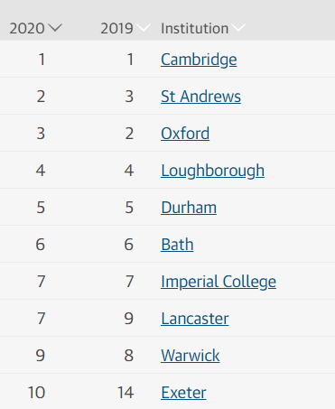
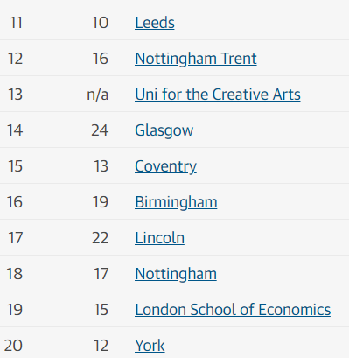
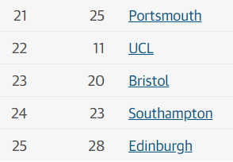
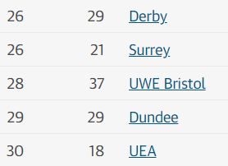
Notes:
Choosing a university course is one of the first and most important decisions a student makes. Your enjoyment of your course has a huge bearing on your overall university experience and performance.
There are 30,000 courses offered at UK university. While this vast array of choice means that the right course is out there for you, it can be challenging trying to find it. This section will walk you through the key steps in the decision-making process:
1. Choosing a subject
It’s important you choose a subject you enjoy and will help you reach your goals. Here are some things to help you choose the right subject for you:
Think about what you enjoy day-to-day – maybe this could be part of a future job role?
Explore different job sites and graduate career options to look for ideas on what you’d like to do once you've finished your studies.
Think about your career goals and the qualifications required as part of a person specification.
Take a look at our subject guides to get an idea of the types of subjects you could study, and the industries graduates go on to work in.
Search for courses by subject to see what's available.
UK degree courses tend to be very specialised from day one, allowing students to focus on their chosen subject. However, there are others that allow you more flexibility in what you study. Make sure you read the course descriptions carefully, and click through to university websites for further information.
Thinking about more than one course or subject?
To increase your chances of getting a place on a course we give you the option of applying to up to five courses at once, usually all in a similar subject so that your application is relevant to all of them.
Please note, there are a couple of restrictions though:
You can only apply maximum of four courses in any one of medicine, dentistry, veterinary medicine or veterinary science.
Usually you can only apply to one course at either the University of Oxford or the University of Cambridge. There are exceptions though – if you'll be a graduate at the start of the course, and you're applying for graduate medicine (course code A101) at the University of Cambridge, you could then also apply to medicine (course code A100) at Cambridge, as well as graduate medicine (course code A101) at the University of Oxford. (Some applicants will need to complete an additional application form to apply – visit the University of Oxford and the University of Cambridge websites for more information.)
2. Types of undergraduate course
After leaving school, most students going onto university or college study for an undergraduate degree. These are usually made up of modules (some compulsory and some optional) that add up to a full degree.
Here are some examples of the types of undergraduate courses you can do.
Bachelor degree courses
Bachelor degrees usually last either three or four years if studied full-time (although some courses are longer). You can concentrate on a single subject, combine two subjects in a single course (often called dual or joint honours courses), or choose several subjects (combined honours). Most courses have core modules which everyone studies, and many courses allow you to choose options or modules to make up a course that suits you.
Some bachelor degrees offer a sandwich year, involving an additional placement or year in industry, which forms part of the course. If you're an international student, you'll need to check you're eligible to work in the UK, or that your visa allows you to do a placement course. Most international students on a tier 4 visa will be eligible for a year in industry or work placements as part of their course, but there may be some conditions. Check with the university or college before making this choice in your application. You can find out more on the UKCISA website.
There are also courses which include postgraduate-level study, known as integrated master's. Integrated master's being at undergraduate level, then continue for an extra year (or more) so you're awarded a master's degree at the end. These are most common in engineering or science subjects. If you're interested in an integrated master's, you'll need to include the term 'master's' when using the UCAS search tool.
Foundation years
Some degrees offer a foundation or qualifying year as the first year, sometimes called ‘year zero’. They are generally one year, full-time courses delivered at a university or college, and can be offered as a 'standalone' course, or as part of a degree. You'll still be treated as a full-time undergraduate student.
Foundation years are designed to develop the skills and subject-specific knowledge required to undertake a degree course, and specialise in a subject area.
If your grades weren’t suitable, or you studied combinations of subjects at school or college that mean you don’t meet the entry requirements for your chosen course, a foundation year could be perfect. Not all universities and colleges offer foundation years.
Most students who take a foundation year choose to stay at the same university or college to complete their full degree, but it may be possible to apply for a full-time degree course elsewhere if you complete the course successfully. You will need to check this with the individual universities and colleges concerned. You will also pay tuition fees for your foundation year.
If you're interested in a foundation year, you'll need to include this in the undergraduate keyword field in the UCAS search tool.
Diploma in Foundation Studies (art and design)
This one-year qualification – often shortened to ‘Art Foundation’ – is widely recognised as a primary route to gain entry to some of the most prestigious art and design degree courses. The learning is tailored to a student’s specific area of art and design subject interest, so they can progress to study that area at degree level. For funding purposes, this course is classified as a further education course, so student loans (for tuition and living costs) are not available, even if you take the course at a university or college. However, UK/EU students under the age of 19 on 31 August of the year of entry will not be charged a tuition fee. As a result, many students choose to take this course straight after school or college, in their home town or city.
Foundation degrees
Foundation degrees are usually two-year courses (longer if part-time), that are equivalent to the first two years of an undergraduate degree. They are not the same as a foundation year.
These can be a good destination for school leavers at 18, as they offer a qualification that can help gain degree entry. This route is a good option for students who need a course with lower entry requirements and fewer examinations, would prefer a vocational degree/to study while they work, or are not yet ready to commit to three years at university.
Foundation degrees often combine academic skills and knowledge with workplace performance and productivity. They may have been designed in partnership with employers, and therefore focus on a particular job role or profession, enabling you to gain professional and technical skills to further your career. They can be used as a standalone qualification for employment, but are more commonly used as the basis for progression to a final ‘top-up’ year, leading to a full bachelors degree. The final year may be taken at a different university or college.
Degree or graduate level apprenticeship
This is a new type of higher level apprenticeship, which can lead to a bachelors degree as part of an apprenticeship. It is important to check the full details of a given job and apprenticeship with the employer and training provider. These courses are a good fit for students who want to gain work experience rather than studying full-time at university, but would like to achieve the same degree status.
Students need to be highly committed – competition can be fierce and entry qualifications can be high. If you’re considering this option, you may want to keep your options open by making an application to a full-time bachelors degree through UCAS at the same time.
If you need a visa to study in the UK, you need to check your visa status allows you to do a part-time course, and/or work in the UK. Check if you need a visa and find out if you’re eligible to work on UKCISA's ‘Can you work?’ website.
Looking to study performing arts?
As well as university and college courses, you can also choose to study at a UK conservatoire. Courses at conservatoires are more performance-based than you will find at a uni or college. Conservatoires offer courses in music, dance, drama, and musical theatre.
Find out more
3. Choosing how to study
Most students study undergraduate courses full-time, however this is not the only way. There are lots of different modes of study, designed to fit around your own circumstances.
Part-time
Many universities and colleges offer part-time degree courses, which are normally taken over a longer period, so you can learn at a more relaxed pace, or work (if eligible) alongside your studies.
There are some real benefits to studying part-time:
It might be a challenge to work or take care of your family at the same time as studying, but if you're committed, it can be very rewarding.
These may be delivered via evening and weekend classes, day release, or study breaks, helping you manage study around your other commitments.
Some contain a combination of online and offline work, with regular assignments and tutor support.
Some course deadlines can be altered to fit around your other responsibilities too.
Distance and blended learning
Distance learning means studying remotely, allowing you to learn in your own time. Blended learning combines face-to-face sessions with online learning, giving a good mix of learning from the experts and teaching yourself, with course materials available online.
Your course activities and assignments will be supported by a range of online learning resources, with regular support from your tutor, interacting with fellow students via email, online forums, phone, and virtual conferencing.
Courses often include day schools or residential weekends where you work with other students on a specific project, followed by continued contact with the team as you work together, resulting in another residential where results are presented and assessed.
You will find some distance and blended courses advertised in the UCAS search tool and some on university or college websites. UCAS does not provide a central admissions service for distance or blended learning – you will need to apply directly to the university or college to be considered for the programme.
Accelerated degrees
Accelerated degrees are offered by some universities and colleges, in some subject areas. Students on accelerated degrees undertake the same course content as students on typical degrees, but complete their degrees one year sooner. For example, accelerated degree students can complete the full content of a typical three-year degree, but graduate in two years.
Work-based learning
If you are employed in the UK, it is also possible to study in the workplace. Some course providers partner with official organisations to create customised programmes – right through from a Certificate to a doctorate-level qualification. For example, the Royal Institute of British Architects (RIBA) offers a flexible study programme for those already working in the industry who want to qualify officially.
Higher and degree apprenticeships could also be an option for work-based learning – find out more about apprenticeships.
4. Choosing where to study
Some students set their heart on a particular university, while others just want to choose the course they like the sound of best. Either way is fine, but make sure you do your research, as changing your university or college once you’ve started isn’t always easy.
You could choose to study at a UK higher education college instead of a university – find out more.
Here are five top tips to help you when choosing where to study:
Attend an open day or if you can't visit in person, you can go to an online open day – we cannot recommend this enough. It’s an opportunity for you to meet the course tutors, see the facilities, and explore the area.
If you can’t attend an open day, explore the campus with a virtual tour.
Check the application deadline – some universities and courses have a different application deadline, so make sure you know the deadline associated to your chosen course or uni.
Check the entry requirements – different courses and universities will have different entry requirements, which you can check on the course listing in our search tool. Some universities and colleges make contextual offers. This is where the university or college considers any barriers you may face, and will either reduce their grade requirements or give extra consideration when deciding whether to give you an offer. Check out this blog for more information.

Slide 22
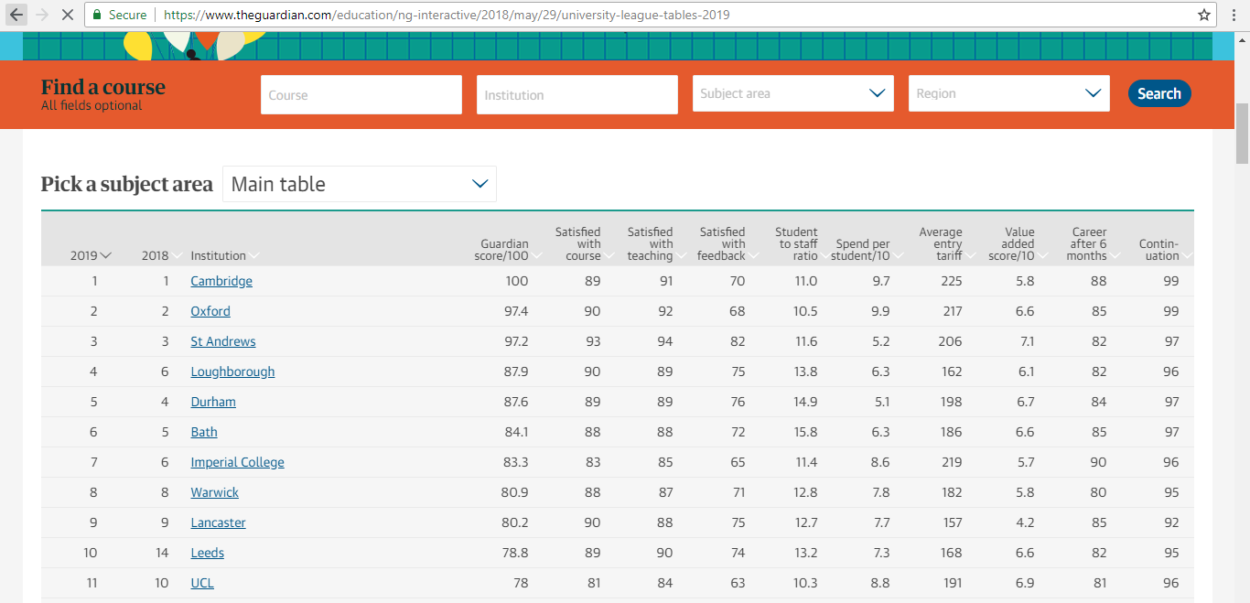
The Guardian University League Table (BBB = 120 pts)
Search for your course here and then find out:
Overall rankings
Rankings for different criteria
Rankings for subjects
Course information by university
https://www.theguardian.com/education/ng-interactive/2018/may/29/university-league-tables-2019

Slide 23
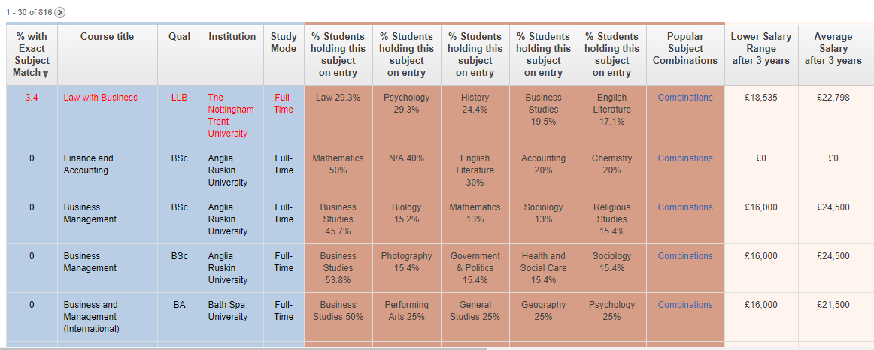
Match your subject to a university course
https://sacu-student.com/?page_id=5203
A great tool for looking at what university courses are linked to your A Level and BTEC courses - please refer to it when choosing.

Slide 24
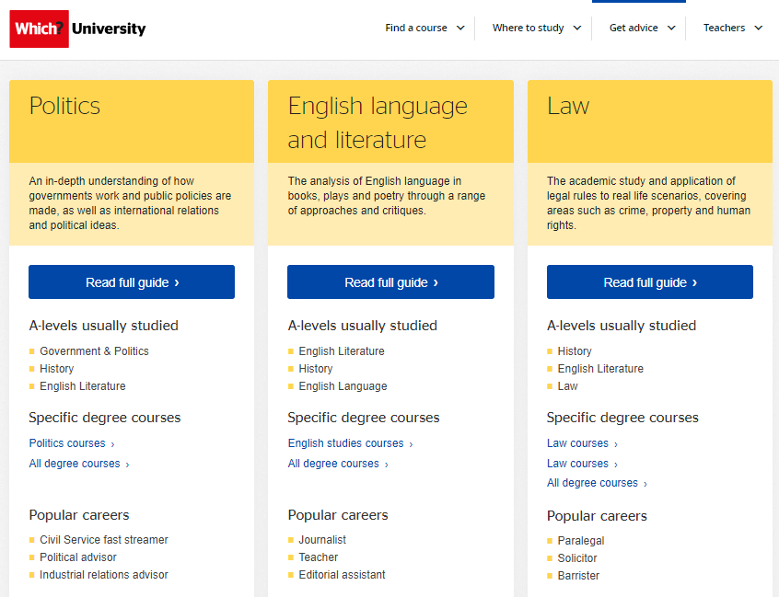
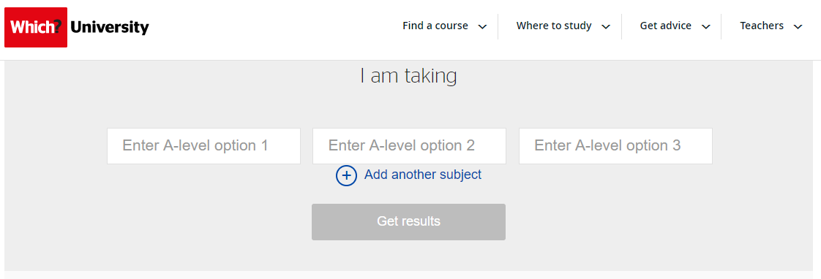
Match your subject to a university course
https://university.which.co.uk/a-level-explorer

Slide 25
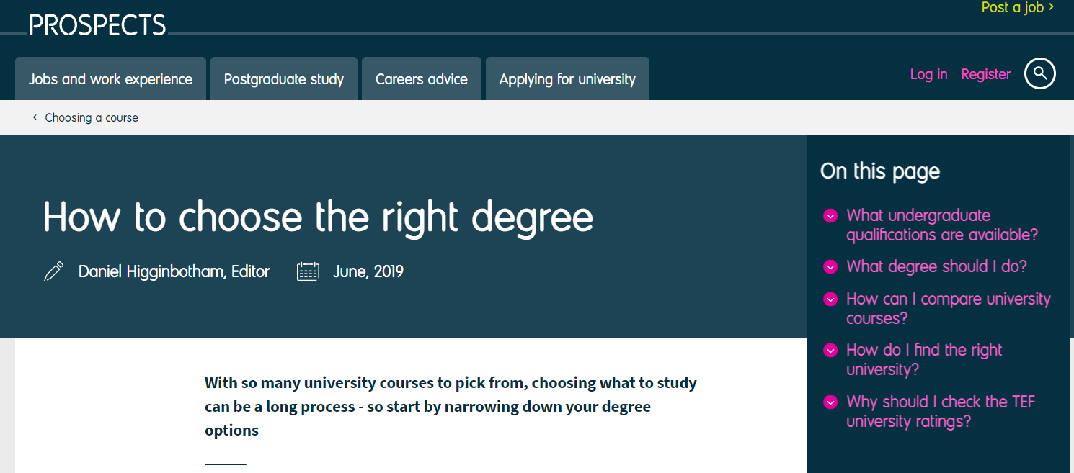
Work and careers after university to help you decide on the right course.
https://www.prospects.ac.uk/applying-for-university/choosing-a-course/how-to-choose-the-right-degree
You can Job profile or Job match to a university course - please refer to it when choosing.

Slide 26
Graduate Schemes (working backwards)
https://jobs.theguardian.com/jobs/graduate/direct-employer/?CMP=PPC_JOBS_GGL_&gclid=CjwKCAiAnIT9BRAmEiwANaoE1Xlk6d3aZx2cciEGImvQsrQ7dT2W7shgjY0qbkhpPRVCaLwFJEpjLBoCvFAQAvD_BwE
This website can help you decide your route post-university from which you could work backwards.
In short, often it is not so important the subject you study but rather the type of university and the standard that you achieve.

Slide 27
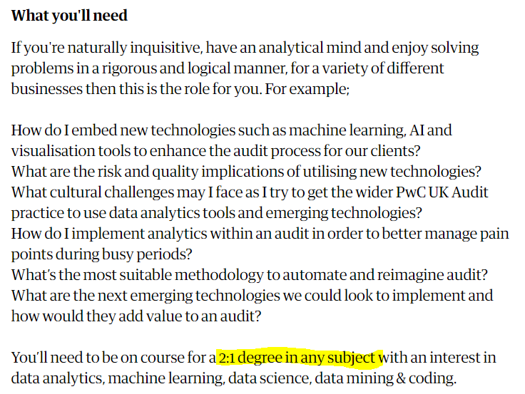

Slide 28
How to choose the right university course for you?
https://targetcareers.co.uk/careers-advice/choices-about-uni/48-how-to-choose-the-right-university-and-course-for-you
This website can help you decide depending on the type of career that you might be interested in – please refer to it when choosing.

Slide 29
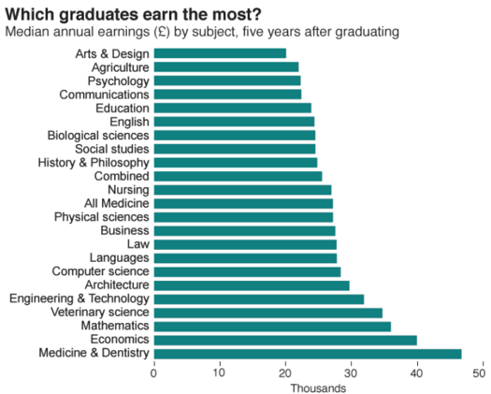

Slide 30
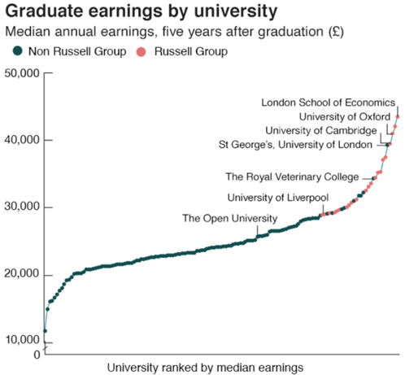
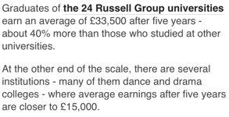

Slide 31
Conditional Offers
A conditional offers mean that students are offered a placed with a set of requirement, they could be:
A qualification (UCAS or Grade)
Interview
Performance

Slide 32
Unconditional Offers
Unconditional offers mean that students are offered a placed regardless of results:
Greatly impacts motivation.
Research shows that it impacts performance.
More likely to miss targets by 1 or 2 grades.
Importance of A Level grades in future CVs.
It is a journey – your A Level skills and knowledge will form the basis of your degree level study.

Slide 33
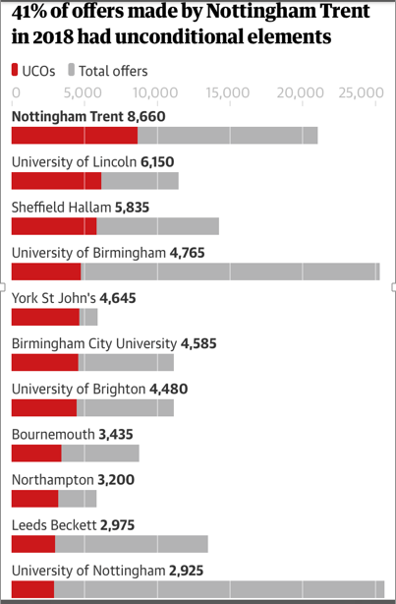
Earnings for those graduating from universities that offer the most = £21,890 on average
Those universities who offer the fewest = £30,180 on average
After the first sixth months of graduation.

Slide 34
Coming soon…
The Personal Statement (Tues 10th November p3)
Getting in to a top university (Tues 17th November p5)
Apprenticeships and the Hub (Tues 24th^{th} November p5)
Student Finance and Next Steps (Weds 2nd December p3)
Please remember to submit questions…

Slide 35
UCAS Virtual Workshops
UCAS workshop 1 – Choosing the right course: https://www.loom.com/share/3c7fefe13237494f83792bf1eb4546ee
UCAS workshop 2 – Writing a top personal statement: https://www.loom.com/share/aba9f8281aef4765997914fb81e33ea5
UCAS workshop 3 – Getting into your top choice university: https://www.loom.com/share/3181be795b6947bf930de72d4ae60c62
UCAS workshop 4 – Creating your account: https://www.loom.com/share/7e6f2887da21496cac0c12b6584d5981
UCAS workshop 5 – The Hub and the Admissions test: https://www.loom.com/share/0a0af3ff72bd44cab29f836b1b385911
UCAS workshop 6 – Apprenticeships:
Part 1: https://www.loom.com/share/65b275a2c52d4643b75ddbdbb88407f5
Part 2: https://www.loom.com/share/bc8fd9c3f04d49679a2a64d61ddd2852
You will find the supporting resources and PowerPoint presentations here: https://stjosephssloughsch.sharepoint.com/:f:/s/StudentResources/En5A_uzuJD9JuNOkwoNAvzYBinKiHFugmU1cgKDfeNe-Fg?e=8j80bB

Slide 36
Please come and see me any of the sixth form team if you need any other help.

