Slide 1
Today’s session –
Being Mindful
LO1 - Understand what mindfulness is
LO2 - Understand the benefits of being mindful
LO3 - Identify ways to be more mindful

Slide 2
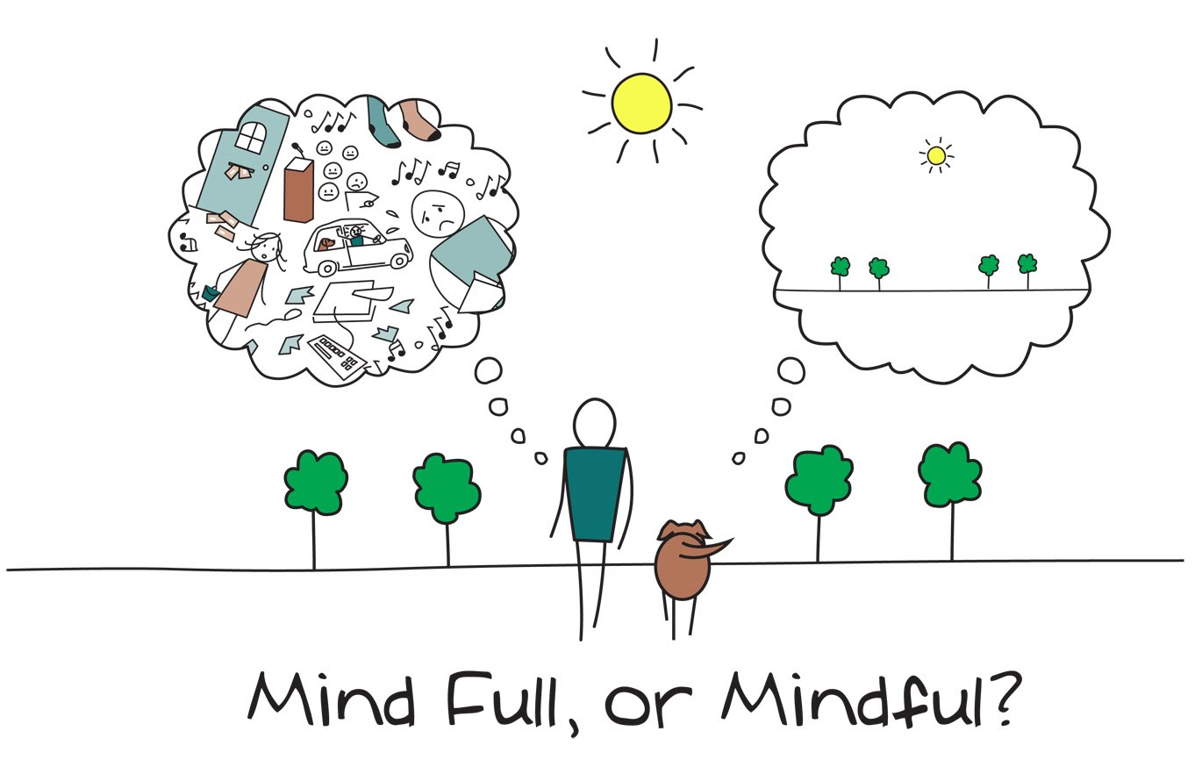
LO1 - Understand what mindfulness is.
LO2 - Understand the benefits of being mindful.
LO3 - Identify ways to be more mindful.
GROUP TASK: What is mindfulness?

Slide 3
LO1 - Understand what mindfulness is.
LO2 - Understand the benefits of being mindful.
LO3 - Identify ways to be more mindful.
What is mindfulness?
Mindfulness is…
Being in the present moment
Being aware
On purpose
Without judgment
We can be mindful of our senses, and of our inner world of thoughts and emotions.
It helps us to respond, not react.
It is simple. But it is not often easy.

Slide 4
LO1 - Understand what mindfulness is.
LO2 - Understand the benefits of being mindful.
LO3 - Identify ways to be more mindful.
DISCUSSION: Have you ever…?
Said something you later regretted?
Been so nervous for a presentation or an event that you couldn’t sleep the night before?
Walked into a room to get something, and then forgot what you were looking for?
Been really sad or upset but you didn’t know exactly why?
Been so engrossed in a project or hobby that everything else fell away because that activity commanded your full focus and attention?

Slide 5
What is mindfulness?
LO1 - Understand what mindfulness is.
LO2 - Understand the benefits of being mindful.
LO3 - Identify ways to be more mindful.
Many of us live our lives on automatic pilot
We go through the motions of our daily routines, we worry about the future or we spend time going over yesterday’s argument with a friend.
Many of us do not live in the present – we don’t pay attention to what is happening in our lives now, at this very moment.

Slide 6
LO1 - Understand what mindfulness is.
LO2 - Understand the benefits of being mindful.
LO3 - Identify ways to be more mindful.
Without mindfulness
“Between stimulus and response there is a space. In that space is our power to choose our response. In our response lies our growth and our freedom.”
Victor Frankl
Stimulus
Reaction
With Mindfulness
Stimulus
Mindfulness
Choice
Response

Slide 7
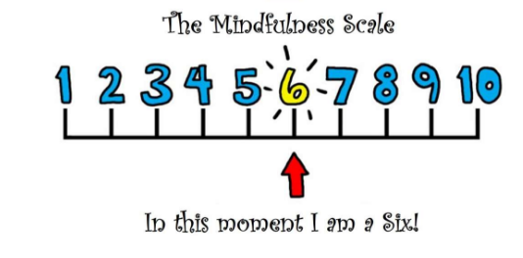
LO1 - Understand what mindfulness is.
LO2 - Understand the benefits of being mindful.
LO3 - Identify ways to be more mindful.
TASK: How mindful are you?
Complete the ‘Mindful Attention Awareness Scale’,
Complete the collection of statements about your everyday experiences. Using the 1-6 scale below, indicate how frequently or infrequently you currently have each experience. Answer according to what really reflects your experience rather than what you think your experience should be.

Slide 8
TASK: How mindful are you?
Scoring information:
Add all your scores together and divide by 15 to work out your mean score
Higher scores reflect higher levels of mindfulness.
LO1 - Understand what mindfulness is.
LO2 - Understand the benefits of being mindful.
LO3 - Identify ways to be more mindful.

Slide 9
LO1 - Understand what mindfulness is.
LO2 - Understand the benefits of being mindful.
LO3 - Identify ways to be more mindful.
Does your mind constantly jump around from branch to branch and thought to thought?
Do you sometimes have a worry brain?
Do you get distracted easily?
You may think… “I'm going to fail my exams and my parents will be furious with me! I'll never get good grades and I'll never find a job!”

Slide 10
TASK: How do you think mindfulness can help you?
Studies show that students who meditate before an exam perform better than students who do not.
Mindfulness practice can improve concentration.
Mindfulness-based interventions have been demonstrated to reduce the symptoms of anxiety, stress and depression.
LO1 - Understand what mindfulness is.
LO2 - Understand the benefits of being mindful.
LO3 - Identify ways to be more mindful.

Slide 11
Mindfulness helps de-clutter
LO1 - Understand what mindfulness is.
LO2 - Understand the benefits of being mindful.
LO3 - Identify ways to be more mindful.
The chatter of the mind is just that: chatter. It's not reality; it's worry, it's anxiety…
Being mindful will help you to be aware of your thoughts and feelings at any given time.
By acknowledging unwanted feelings, without getting caught up in the negative thoughts they generate, we can begin to de-clutter our minds.

Slide 12
TASK: Can you think of any examples of daily mindfulness
LO1 - Understand what mindfulness is.
LO2 - Understand the benefits of being mindful.
LO3 - Identify ways to be more mindful.
Enjoying the taste of a hot chocolate
Listening to the sound of birds singing
Feeling the sensation of rain on our face
Feeling anger or joy in our body
Being aware of good things in your life
Brushing your teeth
Walking to class
Getting dressed in the morning
Walking your dog
Cleaning your room
Answering your phone
Exercising or playing sports
Playing a musical instrument
Drawing or painting
Pick a few of these examples to work on over the next week.

Slide 13
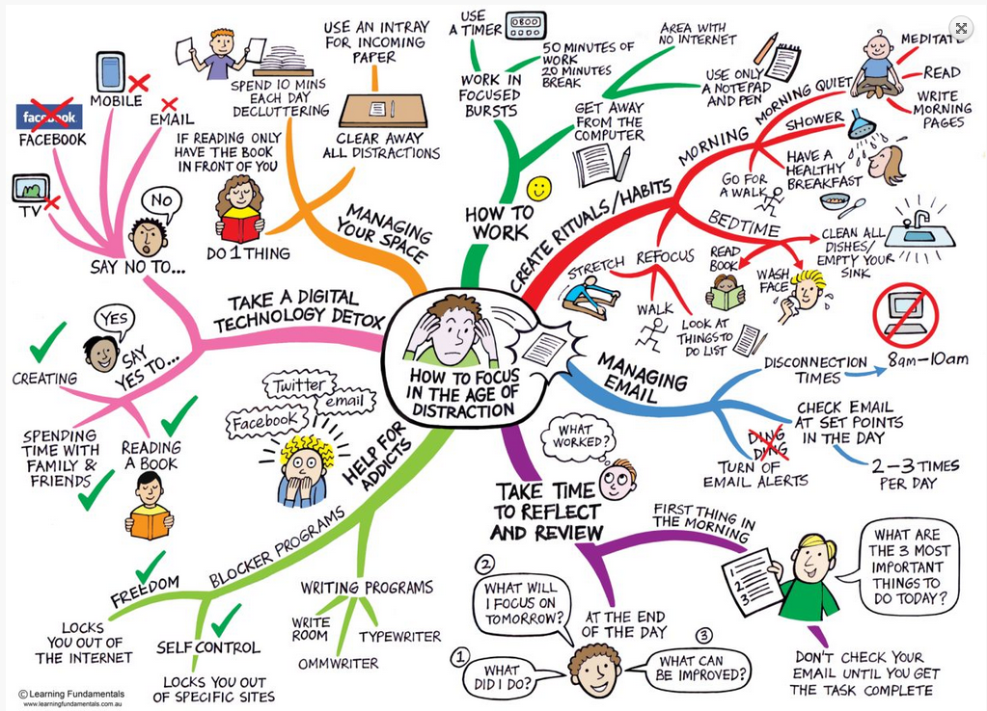
LO1 - Understand what mindfulness is.
LO2 - Understand the benefits of being mindful.
LO3 - Identify ways to be more mindful.
We’re living in the age of distraction
This means we can get stressed easily

Slide 14
LO1 - Understand what mindfulness is.
LO2 - Understand the benefits of being mindful.
LO3 - Identify ways to be more mindful.
VIDEO - Mindful techniques

Slide 15
LO1 - Understand what mindfulness is.
LO2 - Understand the benefits of being mindful.
LO3 - Identify ways to be more mindful.
Slow down to speed up
There are three ‘Mental Muscles’we don’t usually hear about:
Mindful Awareness
Concentration of Mind
Mental Energy, Effort, and Stamina
Like muscles in the body, these three ‘Mental Muscles’ respond to training, practice and development – they become stronger and stronger the more we exercise and use them!

Slide 16
LO1 - Understand what mindfulness is.
LO2 - Understand the benefits of being mindful.
LO3 - Identify ways to be more mindful.
Mindfulness techniques – the breath
Short Practice:
3 mins A-G-E
Minute 1
Attention to what’s here now
Minute 2
Gathering the attention to the breath
Minute 3
Expanding the attention to the breath and other sensations in the body
Activating the Relaxation Response
Slowing the Stress Response
Calming the anxious mind
Increasing focus - paying attention
Developing Stress Hardiness

Slide 17
LO1 - Understand what mindfulness is.
LO2 - Understand the benefits of being mindful.
LO3 - Identify ways to be more mindful.
Three-part breath
Find a place where it's quiet.
Sit in a straight back chair with both feet on the floor or lie on the floor with a straight spine.
Begin inhaling by expanding the abdomen (let it inflate like a balloon), then move the breath into your rib cage and, finally, all the way into your upper chest.
Exhale by reversing this action; begin at your collarbones and exhale down through your rib cage and into your abdomen. Contract your abdominal muscles as you finish exhaling.
You might find it helpful to lightly place your right hand on your abdomen and your left hand on your rib cage to help direct the breath on its journey.
Begin by practicing for one minute and then gradually lengthen the practice to five minutes.
This technique helps to eliminate shallow chest breathing and encourages full exhalation and inhalation.
Mindfulness training will give you tools to help you remain calm, sustain your attention and be able to focus

Slide 18
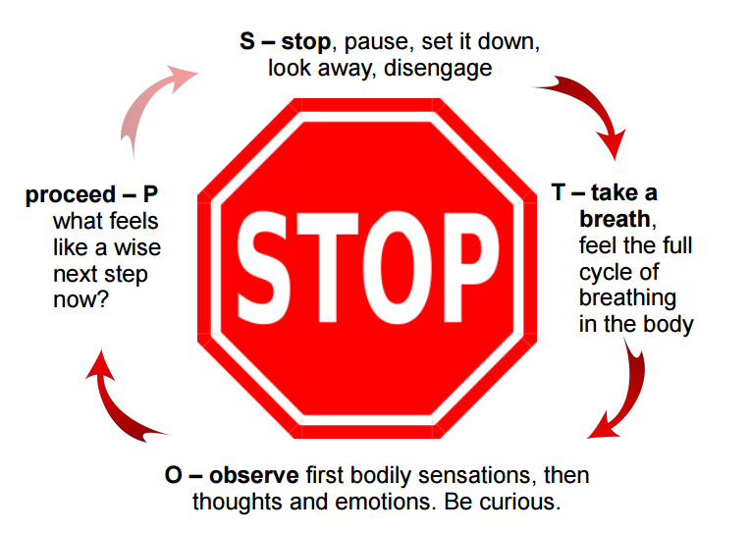
LO1 - Understand what mindfulness is.
LO2 - Understand the benefits of being mindful.
LO3 - Identify ways to be more mindful.
The STOP practice
Stop.
Take a breath.
Observe your thoughts and feelings.
Pause. Proceed mindfully.

Slide 19
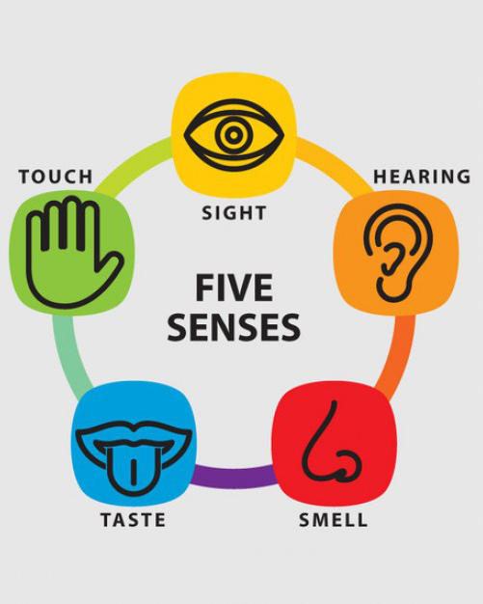
LO1 - Understand what mindfulness is.
LO2 - Understand the benefits of being mindful.
LO3 - Identify ways to be more mindful.
5 senses drill - 2 minute stress buster
Pause what you are doing for a moment and take one or two deep breaths to help bring you into the present moment.
1. Look around you, and silently name three things that you see in your immediate vicinity. 2. Now open up to the sounds around you and silently name three things that you can hear right now 3. Bringing your attention to your body, silently name three sensations that you can feel in this moment (e.g. maybe warmth, tingling, coolness…) 4. Bringing your attention to smell and taste, what do you notice in your immediate awareness when you bring your attention to these senses - name what you experience. 5. Take one or two breaths to finish this mindfulness exercise.

Slide 20
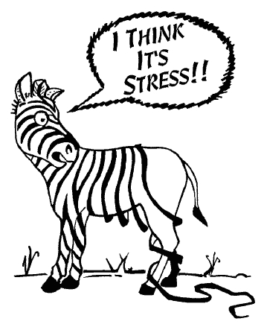
LO1 - Understand what mindfulness is.
LO2 - Understand the benefits of being mindful.
LO3 - Identify ways to be more mindful.
5 senses drill - 2 minute stress buster
Repeat the 5 senses drill exercise every now and then to deliberately bring your awareness in line with what is happening in the present moment.
It will help you build your resilience and to deal with exam anxiety or general pressures.

Slide 21
The mindful unplug
LO1 - Understand what mindfulness is.
LO2 - Understand the benefits of being mindful.
LO3 - Identify ways to be more mindful.
Try to unplug from technology everyday
Switch off from technology at least 30 mins- 1 hr before going to sleep
Appreciate the world around you and what you are doing rather than being governed by your phone
Put your phone away and on silent while you are concentrating on tasks / revision / homework
Learn to have the control to not be obsessed with your phone!
Choose some time each day and week to switch off and unplug from technology

Slide 22
Make a practice that works for you
LO1 - Understand what mindfulness is.
LO2 - Understand the benefits of being mindful.
LO3 - Identify ways to be more mindful.
Make a practice that works for you
Try sitting for 5 minutes each day this week
Plan out when you are going to relax during your weekly schedule
Identify your mood triggers and have some coping strategies ready
Throughout the day
Try paying attention to taking a shower, washing the dishes, eating or going for a walk
Try pausing when the phone rings or try taking a breath at a red light when crossing the road
Try taking more breaks during revision
A small thing routinely repeated adds up over time to produce big results.
‘Just One Thing’ could change your life!

Slide 23
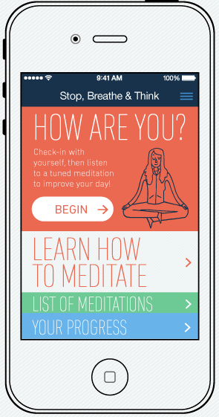
LO1 - Understand what mindfulness is.
LO2 - Understand the benefits of being mindful.
LO3 - Identify ways to be more mindful.
There’s an App for that…
Stop, Breathe, and Think - It opens with a short “interview” where the user selects several words to describe how they are feeling. Then the app recommends guided meditations for their current state.
Take a Break! This provides short guided meditations for stress relief.
Smiling Mind - This app was designed for students.

Slide 24
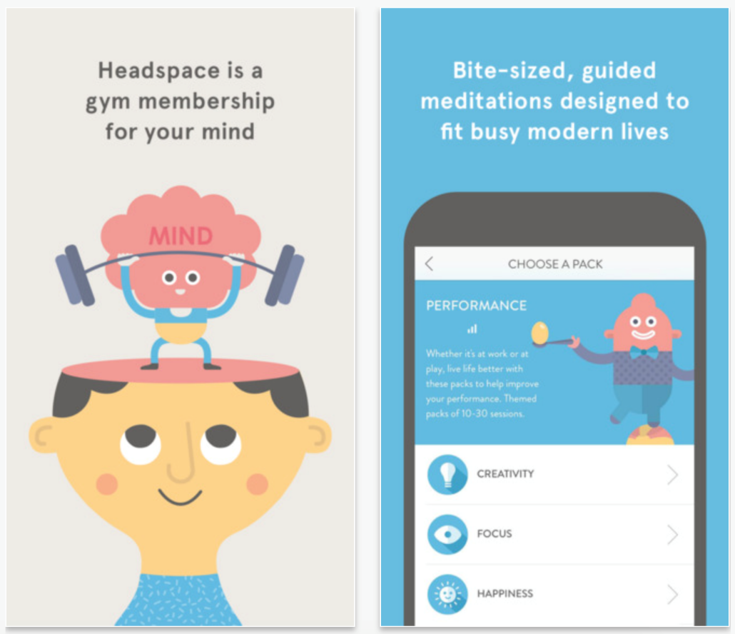
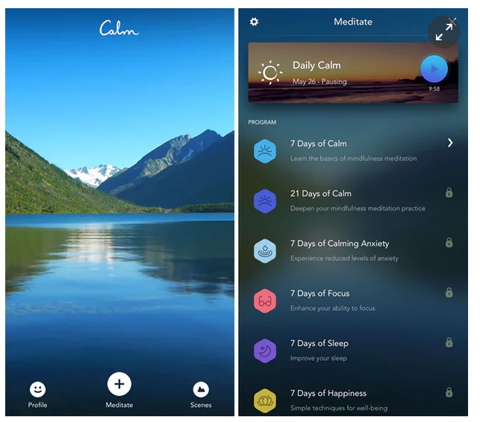
LO1 - Understand what mindfulness is.
LO2 - Understand the benefits of being mindful.
LO3 - Identify ways to be more mindful.
There’s an App for that…
Headspace – is the most popular and well-known mindfulness app. Exercises are designed to be used for around 10 minutes a day, starting with a 10-session pack that comes free with the initial download. It is £9.99 a month or £74.99 a year.
Calm - is similar to Headspace in its setup: the free element is a seven-day course of guided-meditation exercises, while the monthly subscription costs £7.99 and the yearly option costs £29.99

Slide 25
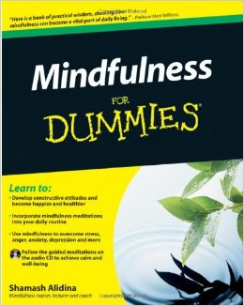
LO1 - Understand what mindfulness is.
LO2 - Understand the benefits of being mindful.
LO3 - Identify ways to be more mindful.
Mindfulness reading

Slide 26
LO1 - Understand what mindfulness is.
LO2 - Understand the benefits of being mindful.
LO3 - Identify ways to be more mindful.
Mindfulness YouTube
https://www.youtube.com/playlist?list=PLbTuZkZyHw9I7-YcOp27YgOVuo1tCJUFE
A playlist of mindful meditation from Mark Williams, author of:

Slide 27
LO1 - Understand what mindfulness is.
LO2 - Understand the benefits of being mindful.
LO3 - Identify ways to be more mindful.
Plenary: Plan out how you will be more mindful everyday or week.
The goal of mindfulness is to be aware of the present moment, without distraction, by acknowledging and accepting our feelings and thoughts
Which learning objectives have you met by completing this task?

