Slide 1

TODAY’S SESSION –
My Mind Introduction
LO1 - Identify the types of things that affect our mind.
LO2 - Understand the positive and negative effects of our minds.
LO3 - Know the essential activities which contribute to a having healthy mind.
LO1 - Identify the types of things that affect our mind.
LO2 - Understand the positive and negative effects of our minds.
LO3 - Know the essential activities which contribute to a having healthy mind.

Slide 2
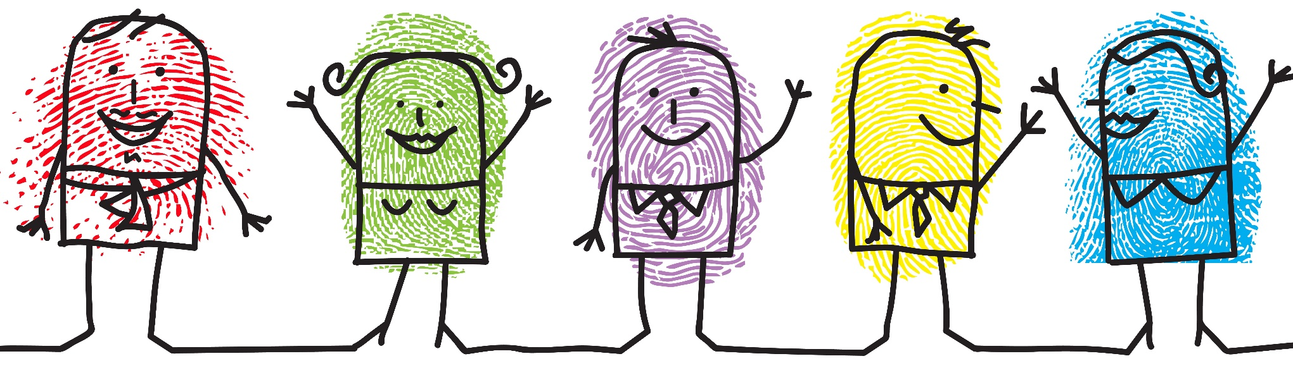
LO1 - Identify the types of things that affect our mind.
LO2 - Understand the positive and negative effects of our minds.
LO3 - Know the essential activities which contribute to a having healthy mind.
What is mental wellbeing?
Each person has a state of mental health, just as everyone has a state of physical health.
A ‘Healthy Mind’ describes emotional wellbeing, the capacity to live a full and creative life, and the flexibility to deal with life’s inevitable challenges. A healthy mind helps us respond to, and cope with, the demands of life.

Slide 3

LO1 - Identify the types of things that affect our mind.
LO2 - Understand the positive and negative effects of our minds.
LO3 - Know the essential activities which contribute to a having healthy mind.
Key Definitions
Definition – The Mind
‘The element of a person that enables them to be aware of the world and their experiences, to think, and to feel.’
‘A person's ability to think and reason’
Definition – Mindset
The way we think, feel and reach conclusions
Our attitudes, moods and beliefs
An inclination or a habit
A mental attitude that determines how you will interpret and respond to situations
The thought processes of an individual

Slide 4
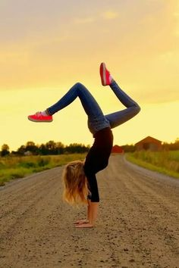
LO1 - Identify the types of things that affect our mind.
LO2 - Understand the positive and negative effects of our minds.
LO3 - Know the essential activities which contribute to a having healthy mind.
Why do we need to be mentally
healthy?
  Improved learning and academic achievement
  Reduced absence from work or school due to sickness
  Reductions in risk-taking behaviours like smoking or drinking
  Improved physical health
  Reduced mortality
  Increased community involvement

Slide 5

LO1 - Identify the types of things that affect our mind.
LO2 - Understand the positive and negative effects of our minds.
LO3 - Know the essential activities which contribute to a having healthy mind.
GROUP TASK:
Wellbeing is made up of two key elements:
Feeling good
Functioning well
What do we mean by each of these?

Slide 6

LO1 - Identify the types of things that affect our mind.
LO2 - Understand the positive and negative effects of our minds.
LO3 - Know the essential activities which contribute to a having healthy mind.
GROUP TASK:
1. Feeling good means…
Experiencing positive emotions like happiness, contentment and enjoyment.
It also includes feelings of things like curiosity, engagement and safety.
Feeling happy about life
Being positive
Having confidence
2. Functioning well means…
How a person is able to function in the world
Having positive relationships and social connections
Feeling in control of your life
Having a sense of purpose
Coping with life's ups and downs

Slide 7

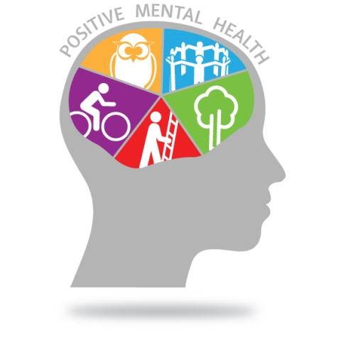
LO1 - Identify the types of things that affect our mind.
LO2 - Understand the positive and negative effects of our minds.
LO3 - Know the essential activities which contribute to a having healthy mind.
TASK: How do you keep a
healthy mind?

Slide 8
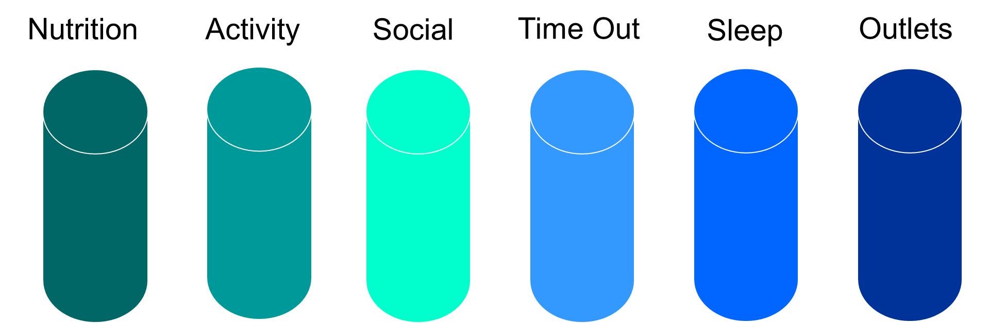
LO1 - Identify the types of things that affect our mind.
LO2 - Understand the positive and negative effects of our minds.
LO3 - Know the essential activities which contribute to a having healthy mind.
Cylinders of Wellness
Social
We’re happier when we’re connected to others, and more depressed if we’re isolated. Social withdrawal can be an early warning sign that stress is having an impact.
Activity
Nutrition
Being ACTIVE is the key, whether it’s walking, swimming, going to the gym, dancing or team sports. We are designed for motion, which provides our brain and our body with the blood flow that they need to work well.
Fuel your body with what it needs. If your body is starved of nutrients, you’ll be operating at a fraction of your capability.

Slide 9
LO1 - Identify the types of things that affect our mind.
LO2 - Understand the positive and negative effects of our minds.
LO3 - Know the essential activities which contribute to a having healthy mind.
RECAP: Cylinders of Wellness
Sleep
Outlets
Time Out
Taking a break makes a big difference to our day-to-day stress management. Always have something in the diary to look forward to, as having something booked in helps boosts our ability to deal with our immediate stress triggers.
.
We all have different sleep needs. What’s important is to get consistent and regular sleep. Getting to bed when you’re tired and getting up at the same time every morning gives your body the most restful and rejuvenating sleep.
We all need something to take our minds off the day to day. Good outlets are activities that completely engage our bodies and minds. Yoga and meditation are popular examples, as are hobbies like reading, gardening or cooking.

Slide 10
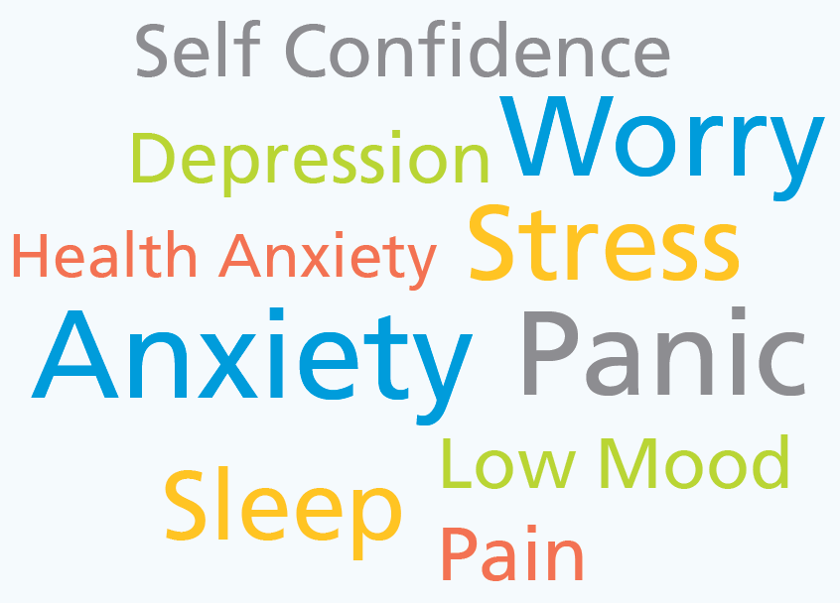
LO1 - Identify the types of things that affect our mind.
LO2 - Understand the positive and negative effects of our minds.
LO3 - Know the essential activities which contribute to a having healthy mind.
TASK: In pairs, write down all the things that
contribute to your mental wellbeing day to day.
Mind-set can affect our responses to situations
How we approach tasks and challenges
Social media
Interactions with friends or family
Our moods and emotions
Daily life choices e.g. a walk, a bath
The food we eat or exercise we complete
Our self esteem and confidence

Slide 11
LO1 - Identify the types of things that affect our mind.
LO2 - Understand the positive and negative effects of our minds.
LO3 - Know the essential activities which contribute to a having healthy mind.
We are what we think
Thoughts
Your attitude and mindset are a choice. You can choose to look at your life positively and maintain an optimistic mindset, or you can choose to have a negative, self-pitying attitude.
What we think, determines what we believe
Actions
Beliefs
The mind and positive thinking
Feelings
What we believe, determines how we feel
The way we feel, influences how we are going to act

Slide 12
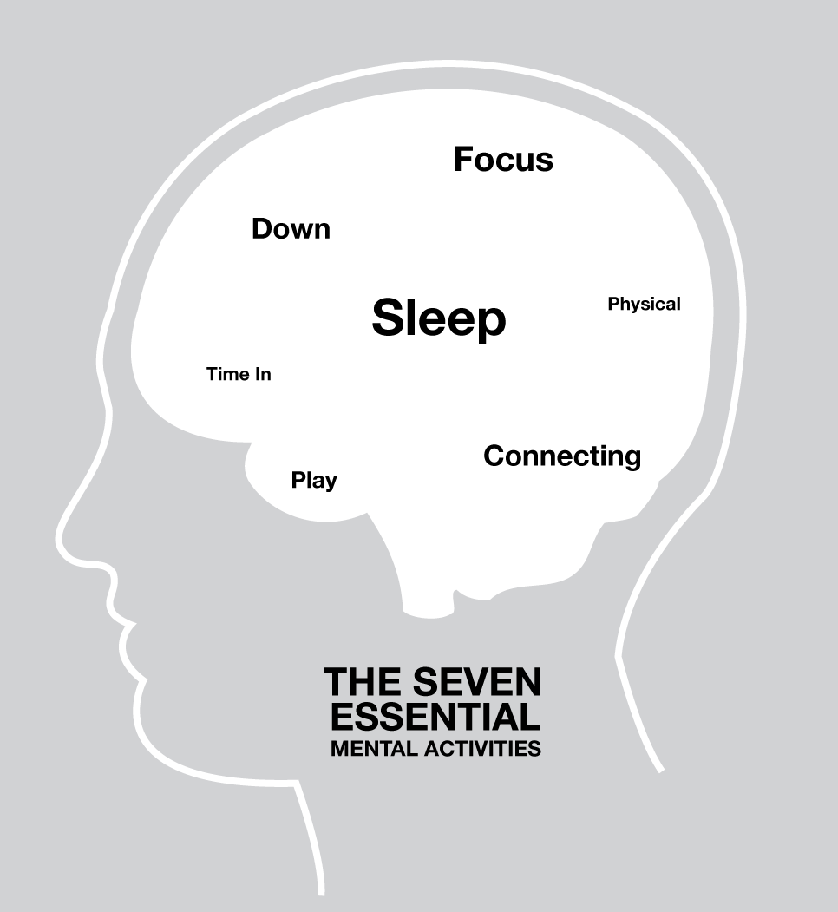
LO1 - Identify the types of things that affect our mind.
LO2 - Understand the positive and negative effects of our minds.
LO3 - Know the essential activities which contribute to a having healthy mind.
The Healthy Mind Platter
The Healthy Mind Platter has seven
daily essential mental activities
necessary for optimum mental health.
These seven daily activities make up
the full set of ‘mental nutrients’ that
your brain and mind need to function at their best.
Created in the US by David Rock and Daniel J Siegel

Slide 13
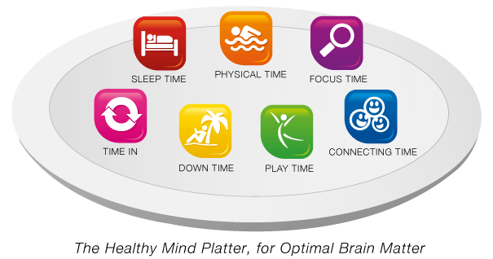
LO1 - Identify the types of things that affect our mind.
LO2 - Understand the positive and negative effects of our minds.
LO3 - Know the essential activities which contribute to a having healthy mind.
Healthy Mind Platter
The seven essential daily mental activities are:
Created in the US by David Rock and Daniel J Siegel

Slide 14



LO1 - Identify the types of things that affect our mind.
LO2 - Understand the positive and negative effects of our minds.
LO3 - Know the essential activities which contribute to a having healthy mind.
Healthy Mind Platter
Focus Time When we closely focus on tasks in a goal-oriented way, taking on challenges that make deep connections in the brain.
Play Time When we allow ourselves to be spontaneous or creative, playfully enjoying random or new experiences, which helps make new connections in the brain.
Connecting Time When we connect with other people, ideally in person, or take time to appreciate our connection to the world around us, richly activating the brain's relational circuit.

Slide 15




LO1 - Identify the types of things that affect our mind.
LO2 - Understand the positive and negative effects of our minds.
LO3 - Know the essential activities which contribute to a having healthy mind.
Healthy Mind Platter
Physical Time When we actively move our bodies and carry out exercise. This helps to strengthen the brain in many ways.
Time In When we quietly reflect internally, focusing on sensations, images, feelings and thoughts, helping you to become more mindful
Down Time When we are non-focused, without any specific goal, and let our mind wander or simply relax, which helps our brain recharge.
Sleep Time When we give the brain the rest it needs to consolidate learning and recover from the experiences of the day.

Slide 16
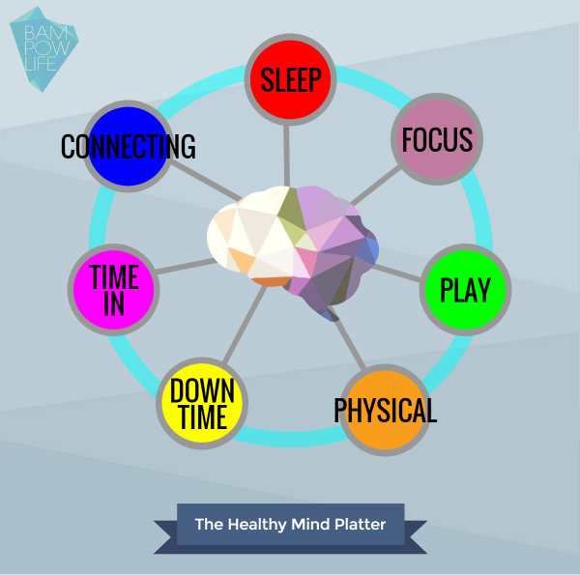
LO1 - Identify the types of things that affect our mind.
LO2 - Understand the positive and negative effects of our minds.
LO3 - Know the essential activities which contribute to a having healthy mind.
TASK: How many activities do you
do on the Healthy Mind Platter?
Use the worksheet to map out an average day and see what percentage of your time you spend in each area.
With a partner, share the areas which you need to improve on.

Slide 17

LO1 - Identify the types of things that affect our mind.
LO2 - Understand the positive and negative effects of our minds.
LO3 - Know the essential activities which contribute to a having healthy mind.
Summary
Think, Pair & Share – think about the statement on the right hand side. Discuss with your partner. To what extent do you agree with this statement?
If you both agree, play the Devil’s Advocate by trying to form a counter argument to present to the class. Consider what other factors exist.
Our ability to influence our physical state with our mental attitude, thoughts and emotions, play a powerful and direct role in shaping our body’s health

Slide 18
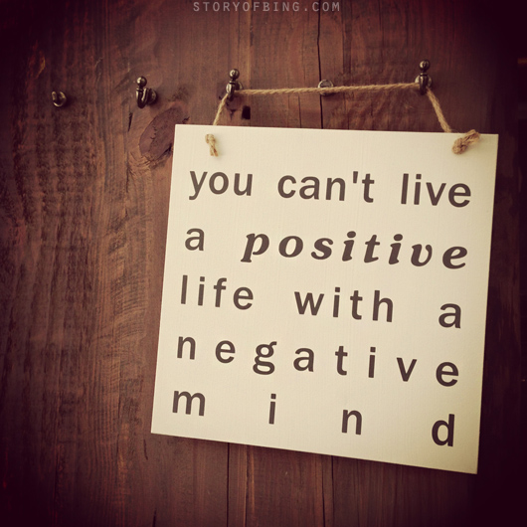
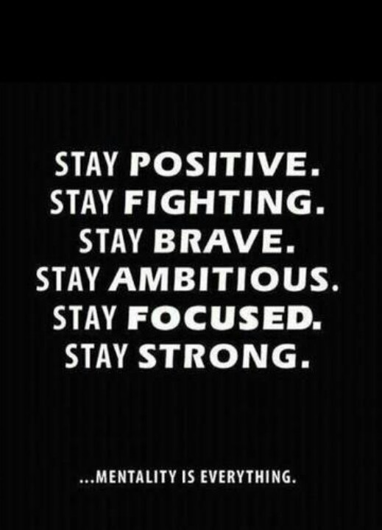
LO1 - Identify the types of things that affect our mind.
LO2 - Understand the positive and negative effects of our minds.
LO3 - Know the essential activities which contribute to a having healthy mind.
Summary

