Slide 1
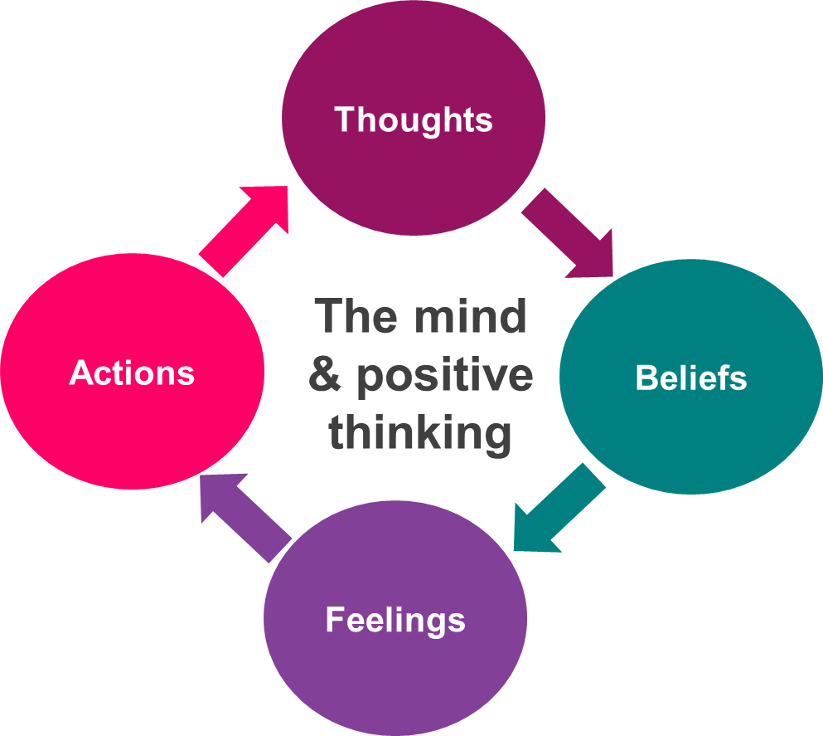
LAST SESSION – My Mind Introduction
Have you been working on any areas to improve your mental wellbeing?

Slide 2
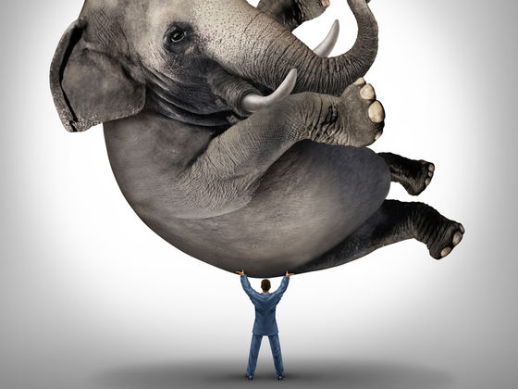
LO1 - Understand the link between a healthy body and a healthy mind.
LO2 - Understand how to maintain good mental wellbeing and physical health.
LO3 - Increase your life expectancy by creating a Five Ways of Wellbeing plan.
TODAY’S SESSION –
Healthy Body, Healthy Mind
LO1 - Understand the link between a healthy body and a healthy mind.
LO2 - Understand how to maintain good mental wellbeing and physical health.
LO3 - Increase your life expectancy by creating a Five Ways of Wellbeing plan.

Slide 3
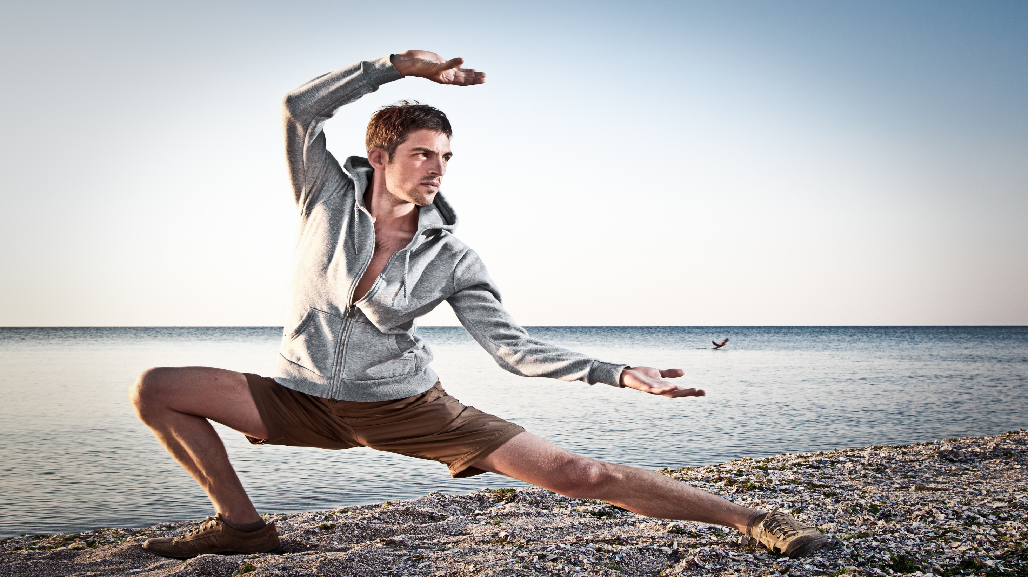
LO1 - Understand the link between a healthy body and a healthy mind.
LO2 - Understand how to maintain good mental wellbeing and physical health.
LO3 - Increase your life expectancy by creating a Five Ways of Wellbeing plan.
Physical Health
Physical health is defined as the condition of your body.
Good physical health is when your body is functioning as it was designed to function.
Health is a state of complete physical, mental and social well-being. Is it not merely the absence of disease.

Slide 4
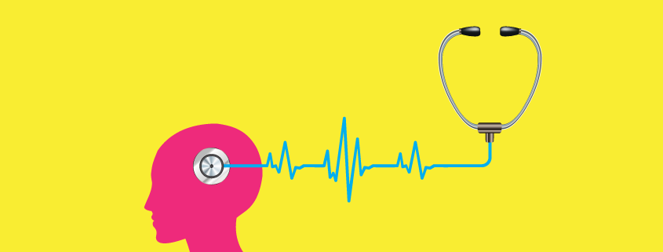
LO1 - Understand the link between a healthy body and a healthy mind.
LO2 - Understand how to maintain good mental wellbeing and physical health.
LO3 - Increase your life expectancy by creating a Five Ways of Wellbeing plan.
RECAP: Mental Wellbeing
The feeling of connection to our community
and surroundings
Having a sense of purpose and feeling valued
The sense of feeling good about ourselves and being happy
Being able to function well individually or in relationships
Coping with challenges and making the most of opportunities
The ability to deal with the ups and downs
Feeling supported by family and friends
Having control and freedom over our lives

Slide 5
LO1 - Understand the link between a healthy body and a healthy mind.
LO2 - Understand how to maintain good mental wellbeing and physical health.
LO3 - Increase your life expectancy by creating a Five Ways of Wellbeing plan.
DISCUSS: How do you feel when…?
You have just eaten a huge pizza, and dessert, and drunk a bottle of coke
You have taken part in a fun sporting activity
You have carried out some exercise
You have eaten healthy food all week
You have had regular sleep patterns
You have taken some time out for you
You haven’t exercised in months
You have had a bad day
You have no energy or motivation

Slide 6
LO1 - Understand the link between a healthy body and a healthy mind.
LO2 - Understand how to maintain good mental wellbeing and physical health.
LO3 - Increase your life expectancy by creating a Five Ways of Wellbeing plan.
TASK: What is the link between physical health and your mental wellbeing?
Think of both positive and negative examples
Physical Health
Mental Wellbeing

Slide 7
“
LO1 - Understand the link between a healthy body and a healthy mind.
LO2 - Understand how to maintain good mental wellbeing and physical health.
LO3 - Increase your life expectancy by creating a Five Ways of Wellbeing plan.
Good physical health can improve our state of mind. A strong and healthy mind can greatly improve our ability to cope with physical ailments.
“
”
“
Poor mental health can affect our physical health leading to an increased risk of some conditions
If you are physically fit then you are more likely to be mentally fit.
”
”

Slide 8
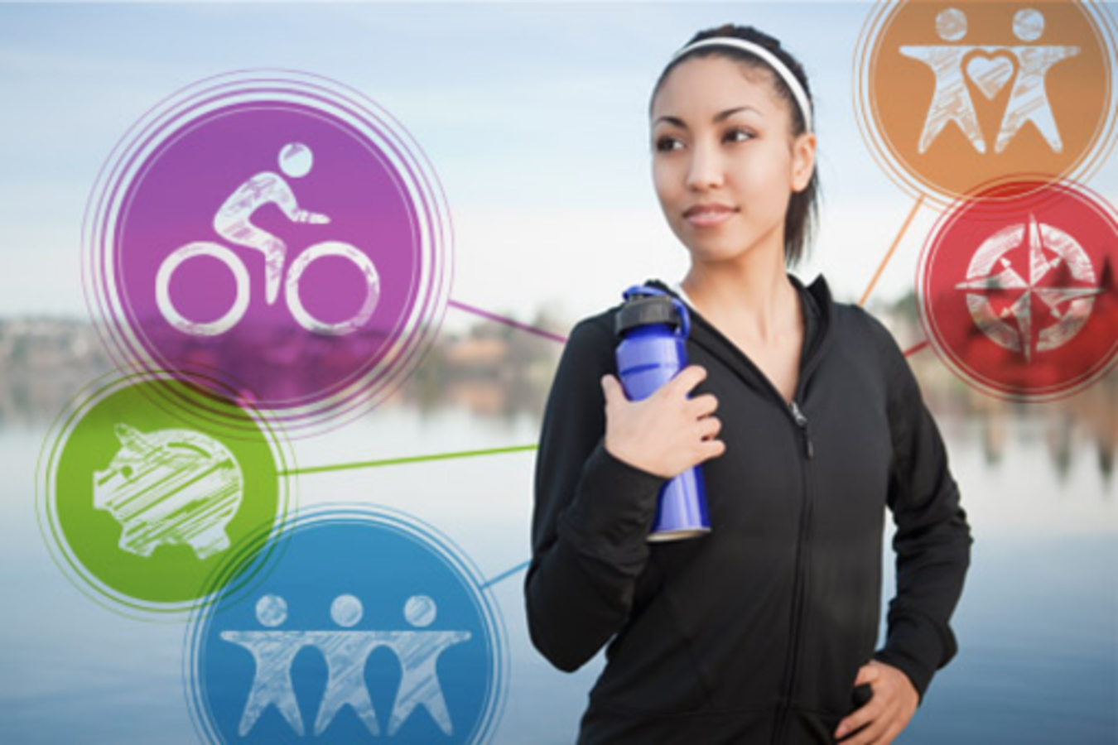
LO1 - Understand the link between a healthy body and a healthy mind.
LO2 - Understand how to maintain good mental wellbeing and physical health.
LO3 - Increase your life expectancy by creating a Five Ways of Wellbeing plan.
TASK: If we are stressed and
under pressure, how can it
impact our physical health?

Slide 9
LO1 - Understand the link between a healthy body and a healthy mind.
LO2 - Understand how to maintain good mental wellbeing and physical health.
LO3 - Increase your life expectancy by creating a Five Ways of Wellbeing plan.
Negative impacts of our mental wellbeing on our physical health
The immune system may be less effective when stress hormones are released regularly. This is because the body focuses on the task it sees as most important, avoiding the threat, rather than using energy to detect infections, for example, and keep them under control.
Healing is slowed down. Like the immune system, when the body believes it is under attack it puts tasks that are not immediately essential, like repairing damaged cells, on the back-burner. While this is OK in the short-term, in the long term it can cause physical problems by slowing down recovery.

Slide 10
LO1 - Understand the link between a healthy body and a healthy mind.
LO2 - Understand how to maintain good mental wellbeing and physical health.
LO3 - Increase your life expectancy by creating a Five Ways of Wellbeing plan.
Negative impacts of our mental wellbeing on our physical health
Digestion is also put on the back burner during times of stress which can lead to digestive discomfort such as abdominal pain, nausea, constipation, diarrhoea and bloating.
Thinking styles can affect how you feel emotionally and physically. This can lead to us feeling worried, sad or upset regardless of whether the thought is true or not.

Slide 11
TASK: If we take care of our physical
health, how can it positively impact our
mental wellbeing?
LO1 - Understand the link between a healthy body and a healthy mind.
LO2 - Understand how to maintain good mental wellbeing and physical health.
LO3 - Increase your life expectancy by creating a Five Ways of Wellbeing plan.

Slide 12
LO1 - Understand the link between a healthy body and a healthy mind.
LO2 - Understand how to maintain good mental wellbeing and physical health.
LO3 - Increase your life expectancy by creating a Five Ways of Wellbeing plan.
Positive impacts of our physical health
on our mental wellbeing
Feeling Good – Exercise sets off complicated physical processes that affect nearly every organ system. When you exercise several times a week or more, your body adapts so you’re able to do so more efficiently.
Relaxation - When you relax, you may notice changes in your emotional state such as feeling less tense and more at ease. Your heart will also beat slower, your breathing will slow down and your blood pressure will go down too.
Immune system - Moderate exercise reduces levels of stress hormones and other chemicals that suppress immune system functioning and increase inflammatory activity.

Slide 13
LO1 - Understand the link between a healthy body and a healthy mind.
LO2 - Understand how to maintain good mental wellbeing and physical health.
LO3 - Increase your life expectancy by creating a Five Ways of Wellbeing plan.
Positive impacts of our physical health
on our mental wellbeing
Hormones - Exercise affects nearly all of the dozens of hormones your body produces. Two of these substances, epinephrine and norepinephrine, are key players in promoting physical changes while you are exercising.
Endorphins – These are natural feel good chemicals that help block pain perception and can improve mood. These rise after 30 minutes or more of exercise.

Slide 14
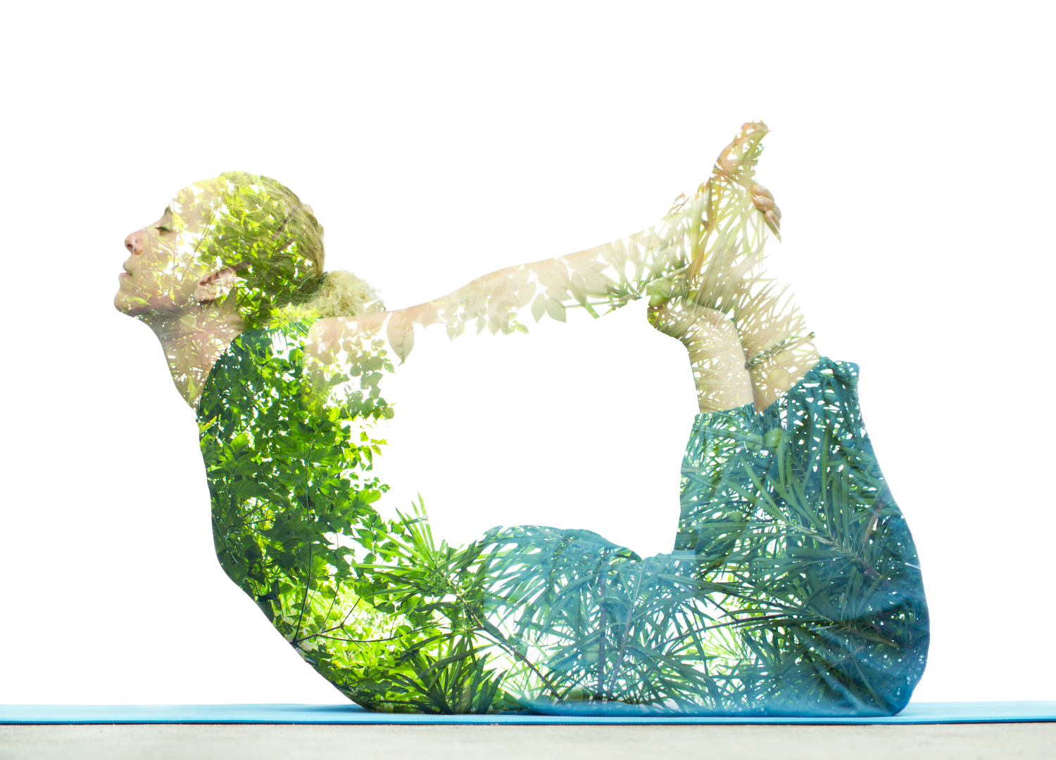
LO1 - Understand the link between a healthy body and a healthy mind.
LO2 - Understand how to maintain good mental wellbeing and physical health.
LO3 - Increase your life expectancy by creating a Five Ways of Wellbeing plan.
Mental strength is an attribute to be developed in life, just like physical strength
Mind control is essential for a healthy body.
Disciplining of daily routines is a must!

Slide 15
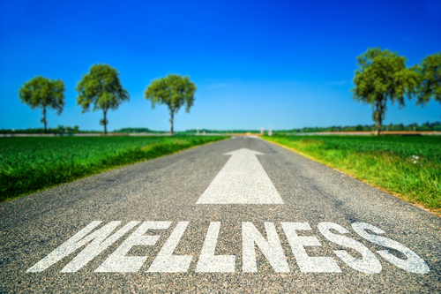
LO1 - Understand the link between a healthy body and a healthy mind.
LO2 - Understand how to maintain good mental wellbeing and physical health.
LO3 - Increase your life expectancy by creating a Five Ways of Wellbeing plan.
Top Healthy Body, Healthy Mind Tips
Look after yourself physically
Try to eat a well-balanced diet
Allow yourself enough time for sleep and rest
Learn to relax
Balance your awareness - being aware of your body can help you to make wise choices
Do things that matter to you the most
Talk to someone
Understand your thinking
Do things you enjoy

Slide 16
Advocates for Healthy Body, Healthy Mind
These people have been affected by Mental Health issues and have found that physical exercise has had a positive effect on their Mental Health.
Bella Mackie
When Bella Mackie’s first marriage broke up, her mental health hit rock bottom. Desperate as her world closed in, she took up jogging which she believes, saved her life.
https://www.youtube.com/watch?v=Bu04PX3U9bM
Tommy Caldwell
After being held hostage and having to make life changing decisions, going through a divorce and struggling with depression, Tommy Caldwell decided to do the impossible. In this documentary he shows how incredible physical feats helped to get his life back on track.
https://www.youtube.com/watch?v=edfw9ip9sCQ
LO1 - Understand the link between a healthy body and a healthy mind.
LO2 - Understand how to maintain good mental wellbeing and physical health.
LO3 - Increase your life expectancy by creating a Five Ways of Wellbeing plan.

Slide 17
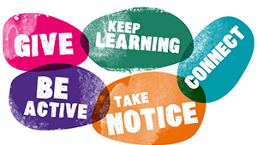
LO1 - Understand the link between a healthy body and a healthy mind.
LO2 - Understand how to maintain good mental wellbeing and physical health.
LO3 - Increase your life expectancy by creating a Five Ways of Wellbeing plan.
Healthy Body, Healthy Mind
The Five Ways to Wellbeing are a set of evidence-based actions which promote people’s wellbeing. They were created by The New Economics Foundation in association with the government.
“
You are what you repeatedly do. Excellence, then, is not an act, but a habit Aristotle
”

Slide 18
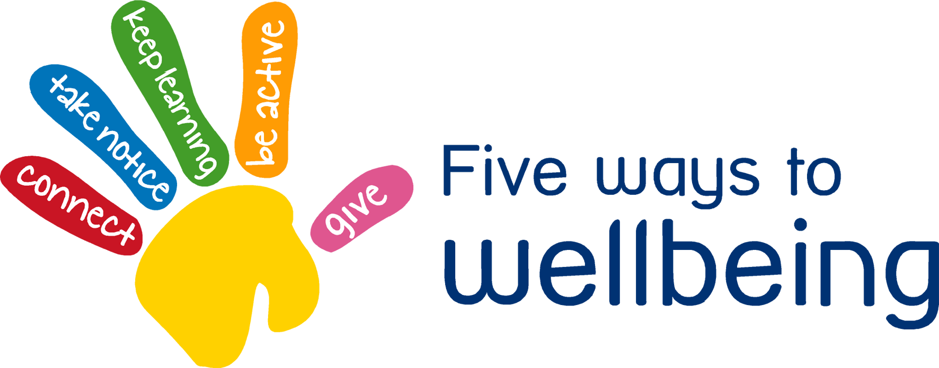
LO1 - Understand the link between a healthy body and a healthy mind.
LO2 - Understand how to maintain good mental wellbeing and physical health.
LO3 - Increase your life expectancy by creating a Five Ways of Wellbeing plan.
5 Ways of Wellbeing
By adopting the Five Ways to Wellbeing you can increase your life expectancy by up to 7.5 years!

Slide 19
LO1 - Understand the link between a healthy body and a healthy mind.
LO2 - Understand how to maintain good mental wellbeing and physical health.
LO3 - Increase your life expectancy by creating a Five Ways of Wellbeing plan.
5 Ways of Wellbeing
Connect with the people around you. With family, friends, colleagues and neighbours. At home, work, school or in your local community. Think of these as the cornerstones of your life and invest time in developing them. Building these connections with support and enrich yourself every day. Spend time doing things with your friends and family and talking to people.
WORKSHEET TASK: Talk to a partner about what networks and supportive relationships you have. Who are the people you can rely on? Think about who you can go to for support in different areas of your life – for example, parents, teachers and peer groups.
Fill in the ‘Connect’ box on your worksheet.

Slide 20
LO1 - Understand the link between a healthy body and a healthy mind.
LO2 - Understand how to maintain good mental wellbeing and physical health.
LO3 - Increase your life expectancy by creating a Five Ways of Wellbeing plan.
5 Ways of Wellbeing
Go for a walk or run. Step outside. Cycle. Play a game. Garden. Dance. Exercising makes you feel good. Most importantly, discover a physical activity that you enjoy; one that suits your level of mobility and fitness.
WORKSHEET TASK: Talk to a partner about what you can do every day to be more active. Remember that just ten minutes of exercise each day makes you more alert, can help with your mental wellbeing and it lowers your stress levels.
Fill in the ‘Be Active’ box on your worksheet.

Slide 21
LO1 - Understand the link between a healthy body and a healthy mind.
LO2 - Understand how to maintain good mental wellbeing and physical health.
LO3 - Increase your life expectancy by creating a Five Ways of Wellbeing plan.
5 Ways of Wellbeing
Be curious. Catch sight of the beautiful. Remark on the unusual. Notice the changing seasons. Savour the moment, whether you are on a train, eating lunch or talking to friends. Be aware of the world around you and what you are feeling. Reflecting on your experiences will help you appreciate what matters to you. Take notice of people and talk to a trusted person if you, or they, are sad. Recognise that there are times when people may feel low - for example, during times of change, during exams, during an argument or family troubles. It is OK to feel sad and it is important that we can share this with someone who will understand.
WORKSHEET TASK: Talk about the importance of taking more notice of yourself (some people call this mindfulness). What happens when you feel stressed – not just physically, but how does it make you feel? Come up with some strategies for dealing with stress and Fill in the ‘Take Notice’ box on your worksheet.

Slide 22
LO1 - Understand the link between a healthy body and a healthy mind.
LO2 - Understand how to maintain good mental wellbeing and physical health.
LO3 - Increase your life expectancy by creating a Five Ways of Wellbeing plan.
5 Ways of Wellbeing
Try something new. Rediscover an old interest. Sign up for a course. Take on a different responsibility at school or in a job. Fix a bike. Learn to play an instrument or how to cook your favourite food. Set a challenge you will enjoy achieving. As well as being fun to do, learning new things will make you more confident. Think creatively and do something different. Learning makes you more aware of your surroundings, it builds confidence, and so improves mental health.
WORKSHEET TASK: Talk to a partner about what you would like to learn about and how you can go about achieving it.
Fill in the ‘Keep Learning’ box on your worksheet.

Slide 23
LO1 - Understand the link between a healthy body and a healthy mind.
LO2 - Understand how to maintain good mental wellbeing and physical health.
LO3 - Increase your life expectancy by creating a Five Ways of Wellbeing plan.
5 Ways of Wellbeing
Do something nice for a friend, or a stranger. Thank someone. Smile. Volunteer your time. Join a community group. Look out, as well as in. Seeing yourself, and your happiness, linked to the wider community can be incredibly rewarding and will create connections with the people around you. Evidence says that doing something for someone else, with no expectation of anything in return, impacts on the parts of the brain that release “happy” chemicals. Do a good turn to help someone at home, school or in your community.
WORKSHEET TASK: Talk with a partner about how you could do something for someone else and improve their wellbeing? How have you given your time to others recently? Think about what you could do.
Fill in the ‘Give’ box on your worksheet.

Slide 24
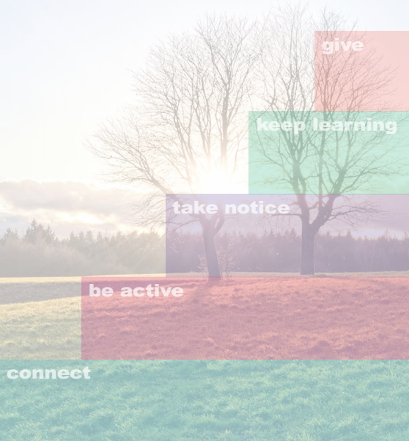
LO1 - Understand the link between a healthy body and a healthy mind.
LO2 - Understand how to maintain good mental wellbeing and physical health.
LO3 - Increase your life expectancy by creating a Five Ways of Wellbeing plan.
Building Resilience
Try to integrate the 5 ways of wellbeing into your daily life – think of them as your “5 a day” for mental wellbeing
As we develop our strengths and resources we will also be more resilient and be more able to deal with challenges as and when they arise.

Slide 25
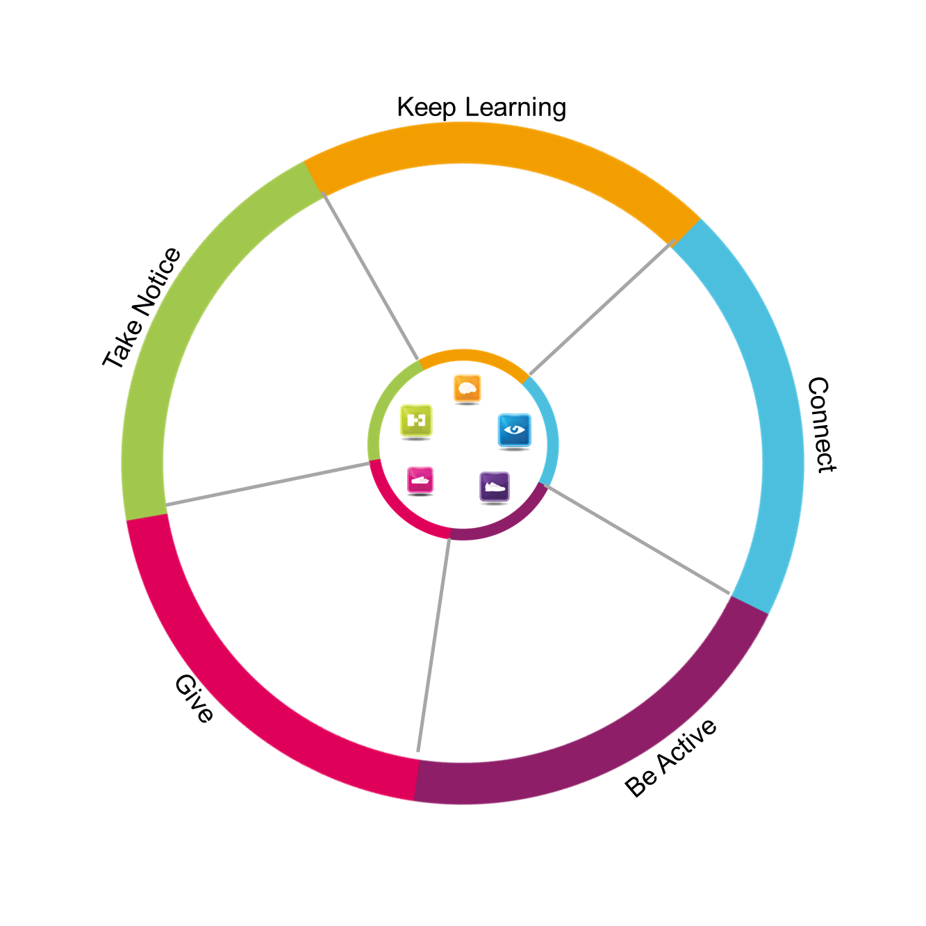
LO1 - Understand the link between a healthy body and a healthy mind.
LO2 - Understand how to maintain good mental wellbeing and physical health.
LO3 - Increase your life expectancy by creating a Five Ways of Wellbeing plan.
TASK: My
Talk about what you do on a weekly basis under each category and write them down.
Do you do some of the five ways more than others?
Write down some key actions that you are going to work on for next week

Slide 26
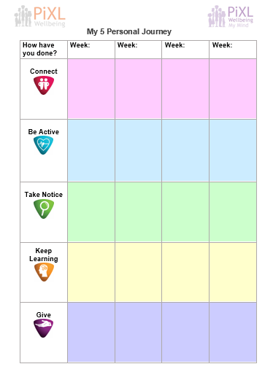
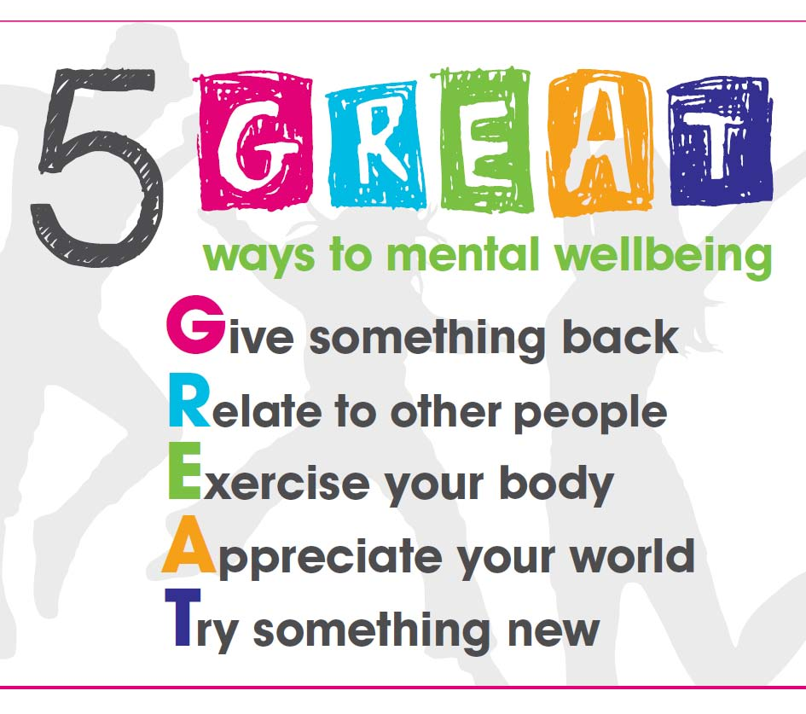
Personal Journey
LO1 - Understand the link between a healthy body and a healthy mind.
LO2 - Understand how to maintain good mental wellbeing and physical health.
LO3 - Increase your life expectancy by creating a Five Ways of Wellbeing plan.
You can keep track of your progress by using the My 5 Personal Journey

Slide 27
Plenary
LO1 - Understand the link between a healthy body and a healthy mind.
LO2 - Understand how to maintain good mental wellbeing and physical health.
LO3 - Increase your life expectancy by creating a Five Ways of Wellbeing plan.
Think, Pair & Share
Think about what the single most important element of maintaining a healthy body and mind is.
Justify your answer to your partner.
Tell them one change, for yourself, that you will put in place next week.

