Slide 1
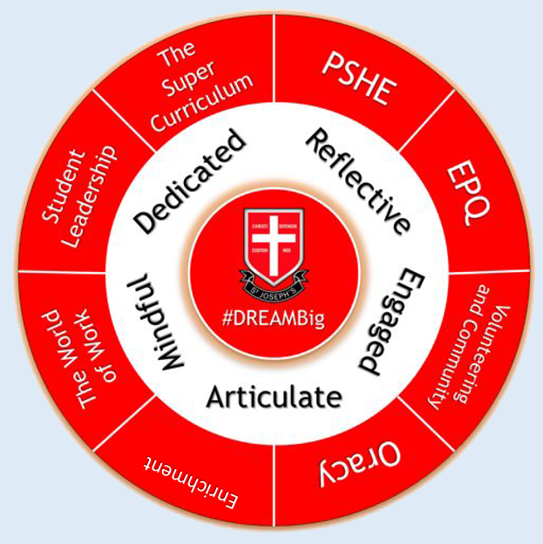
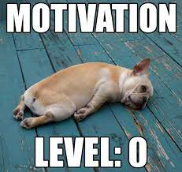
How Self-Motivated Are You?
#DREAMBig

Slide 2
LO1 – to understand our own levels of motivation.
LO2 – to demonstrating our understanding of the power of habit.
LO3 – to apply new organisational skills learnt.
Think, Pair & Share:
What is your worst habit? Have you broken it? If so, how? How difficult was it?
Share your thoughts with your partner and then share with the class.

Slide 3
LO1 – to understand our own levels of motivation.
LO2 – to demonstrating our understanding of the power of habit.
LO3 – to apply new organisational skills learnt.
Are you motivated to achieve what you really want in life?
And how hard do you push yourself to get things done?
What's the difference between those who never reach their goals, year after year, and those who achieve one goal after another?
Often, it's their self-motivation.

Slide 4
LO1 – to understand our own levels of motivation.
LO2 – to demonstrating our understanding of the power of habit.
LO3 – to apply new organisational skills learnt.
Self-motivation is the force that keeps pushing us to go on – it's our internal drive to achieve, produce, develop, and keep moving forward. When you think you're ready to quit something, or you just don't know how to start, your self-motivation is what pushes you to go on.
With self-motivation, you'll learn and grow – regardless of the specific situation. That's why it's such a fundamental tool for reaching your goals, achieving your dreams.
How hard do you push yourself to get things done?

Slide 5
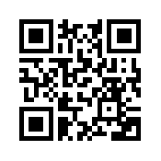
LO1 – to understand our own levels of motivation.
LO2 – to demonstrating our understanding of the power of habit.
LO3 – to apply new organisational skills learnt.
Task) Complete the Self-Motivation Quiz. Click on the link or scan the QR code:
https://www.mindtools.com/pages/article/newLDR_57.htm
When complete, read your score interpretation underneath the quiz.
Think, Pair & Share: discuss your results with your partner. What factors impact your motivation and how have you overcome this in the past?
Share your answers as a group.
Scan with your iPad/Phone camera to access.

Slide 6
LO1 – to understand our own levels of motivation.
LO2 – to demonstrating our understanding of the power of habit.
LO3 – to apply new organisational skills learnt.
Effort, motivation and habit are all intrinsically linked.
If you can stick to new (and difficult) behaviours for 30 days, the research shows that this will become a habit, feeling like less of an imposition.
But how does habit work?

Slide 7
LO1 – to understand our own levels of motivation.
LO2 – to demonstrating our understanding of the power of habit.
LO3 – to apply new organisational skills learnt.
Research shows that we can ‘hack’ our brains with a reward system to change our habits. We can therefore create new habits to become more motivated and organised, helping us to achieve our goals.
Today, we will look at:
Hacking Your Brain’s Reward System to Change Habits
The Three ‘R’s of Habit
The Energy Line
The Eisenhower Matrix

Slide 8
Learning Objectives:
LO1 – to understand our own levels of motivation.
LO2 – to demonstrating our understanding of the power of habit.
LO3 – to apply new organisational skills learnt.

Slide 9
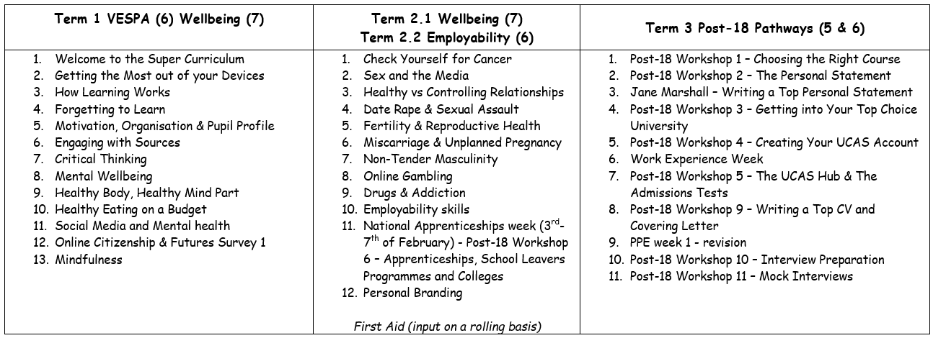
The Year 12 PSHE Learning Journey

Slide 10
Key Vocabulary:
LO1 – to understand our own levels of motivation.
LO2 – to demonstrating our understanding of the power of habit.
LO3 – to apply new organisational skills learnt.
Intrinsic - being an extremely important and basic characteristic of a person or thing.
Cue – a signal for someone to do something.
Neuron - being an extremely important and basic characteristic of a person or thing.
Matrix – a rectangular array of numbers, symbols, or expressions, arranged in rows and columns

Slide 11
Hacking Your Brain’s “Reward System” to Change Habits
LO1 – to understand our own levels of motivation.
LO2 – to demonstrating our understanding of the power of habit.
LO3 – to apply new organisational skills learnt.

Slide 12
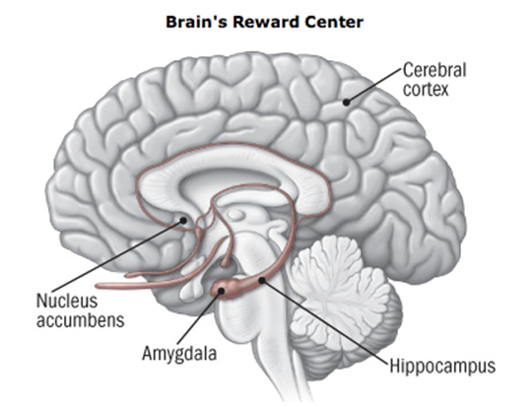
How Habit Works
https://www.youtube.com/watch?v=vN1aRN5bQQ0
Got a bad habit you just can’t seem to break? That’s because it’s literally wired into your brain.
Every single thought, action, and feeling changes your brain. When repeated enough times, a habit is formed.
We can use this to our advantage.
LO1 – to understand our own levels of motivation.
LO2 – to demonstrating our understanding of the power of habit.
LO3 – to apply new organisational skills learnt.

Slide 13
Answers (green pen marking and stick in your books):
True
New neural pathways (habits) are formed by consciously repeating a behaviour.
Cue, behaviour & reward
Rewarding a behaviour can help create a craving and this is what makes a habit so strong. The action of concentrating the eyes directly on something.
You get cravings because the link between behaviour and reward becomes so strong that the neurones start firing at the thought of the behaviour.
When a behaviour is repeated often enough, a habit is formed.
LO1 – to understand our own levels of motivation.
LO2 – to demonstrating our understanding of the power of habit.
LO3 – to apply new organisational skills learnt.

Slide 14
We use the ‘Three R’s to tap into the power of habit to motivate ourselves.
LO1 – to understand our own levels of motivation.
LO2 – to demonstrating our understanding of the power of habit.
LO3 – to apply new organisational skills learnt.

Slide 15
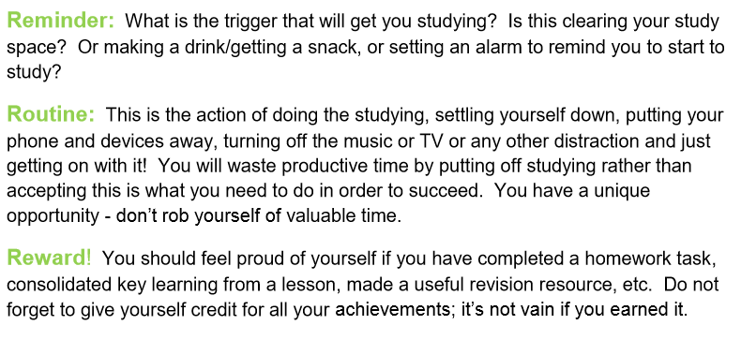
Reminder (Cue), Routine (Behaviour) & Reward - Explained
Use the Three Rs to create a new habit around studying. Read through the example on the right hand side.

Slide 16
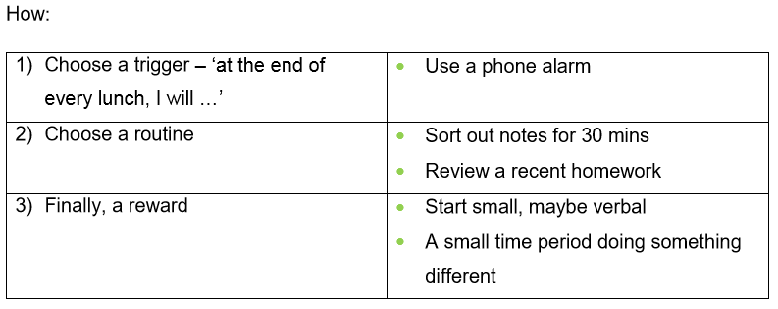
Task) think about a habit you would like to form and plan this out in your books. Use the template below and then share with the class.
Trigger:
Routine:
Reward:
Here is an example
Bonus! What makes the most powerful type of reward and how can you tap into this information to improve your motivation? Share you findings with the class.
LO1 – to understand our own levels of motivation.
LO2 – to demonstrating our understanding of the power of habit.
LO3 – to apply new organisational skills learnt.

Slide 17
Motivation is key to Organisation. Both are key to success.
LO1 – to understand our own levels of motivation.
LO2 – to demonstrating our understanding of the power of habit.
LO3 – to apply new organisational skills learnt.

Slide 18
Often, poor organization can impact motivation. Here are some tips for staying organised.
LO1 – to understand our own levels of motivation.
LO2 – to demonstrating our understanding of the power of habit.
LO3 – to apply new organisational skills learnt.

Slide 19
The Energy Line – rank your tasks by the energy they use up.
LO1 – to understand our own levels of motivation.
LO2 – to demonstrating our understanding of the power of habit.
LO3 – to apply new organisational skills learnt.

Slide 20
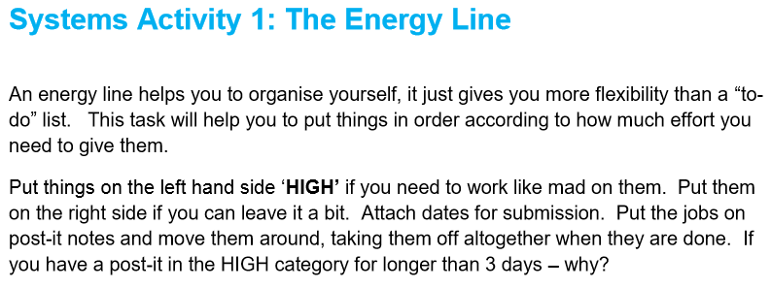
Task 2) on your sheet, complete ‘The Energy Line’ below for everything you have to do this week including school life, work life and your personal life.
Reflect upon those tasks that are high energy and justify their importance. Is their effort worth their reward? Is there anything you would remove from your list? Discuss with your partner.
LO1 – to understand our own levels of motivation.
LO2 – to demonstrating our understanding of the power of habit.
LO3 – to apply new organisational skills learnt.

Slide 21
The Eisenhower Matrix – boost your productivity by prioritising your tasks by urgency and importance.
LO1 – to understand how we comprehend information through reading.
LO2 – to understand how we effectively engage with sources in order to comprehend information.
LO3 – to demonstrate use of a strategy for effective reading.

Slide 22
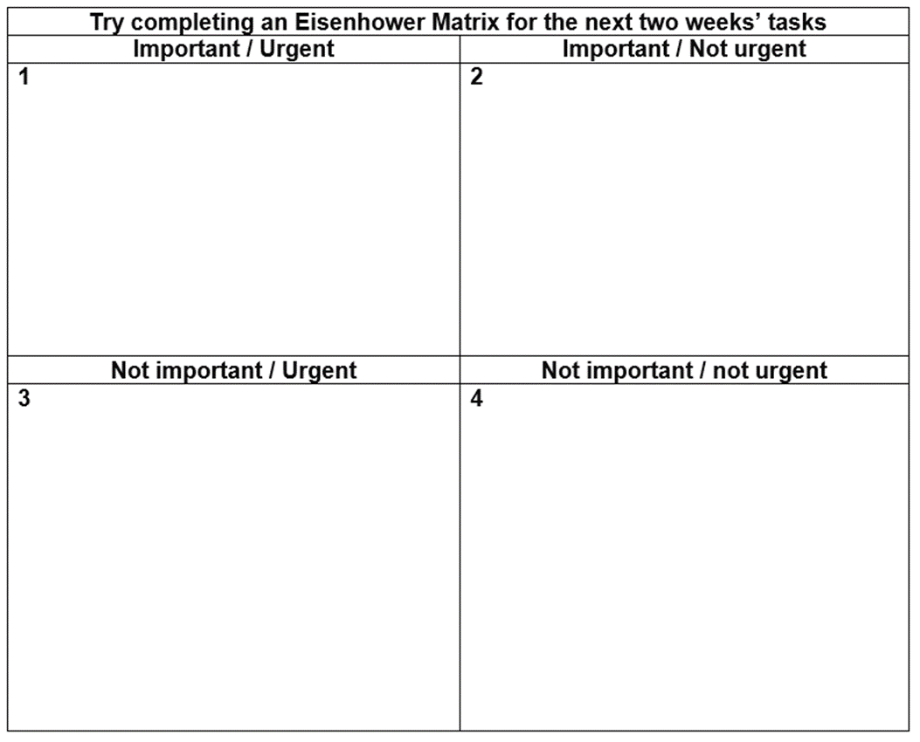
The Eisenhower Matrix
https://www.youtube.com/watch?v=tT89OZ7TNwc
A long to do list can often impact motivation. Sometimes, you just don’t know where to start.
Watch the video and then complete the Eisenhower Matrix for all of the tasks you need to do this week.
Discussion – what does it show you about your priorities?
LO1 – to understand our own levels of motivation.
LO2 – to demonstrating our understanding of the power of habit.
LO3 – to apply new organisational skills learnt.

Slide 23
Plenary:
LO1 – to understand our own levels of motivation.
LO2 – to demonstrating our understanding of the power of habit.
LO3 – to apply new organisational skills learnt.
Task) you are asked to contribute to the Sixth Form prospectus. This will be read by the current Year 11. Write an article explaining how to study effectively. Refer to:
How the brain works and how to reduce Cognitive Load.
The importance of Interleaving and Spaced Learning.
How to engage with sources using Academic Reading strategies and Cornell Notes.
Give your opinion on the most and least effective strategies that you have learnt this term.

