Slide 1
Engaging With Sources.
#DREAMBig
Notes:
How to analyse a text
Create a super curricular plan

Slide 2
Task) discuss the questions with a partner and make an educated guess to the correct answers.
LO1 – to understand how we comprehend information through reading.
LO2 – to understand how we effectively engage with sources in order to comprehend information.
LO3 – to demonstrate use of a strategy for effective reading.
1. How many words should you know after having finished GCSE?
2. How many words does the average student arrive at university with?
3. What percentage of employers rate literacy skills as in the top three most important considerations?
4. How much reading/study should you do per week, per subject, outside of the classroom? (open answer).
A) 10,000
B) 25,000
C) 50,000
D) 100,000
A) 10,000
B) 50,000
C) 75,000
D) 150,000
A) 33%
B) 50%
C) 60%
D) 70%

Slide 3
LO1 – to understand how we comprehend information through reading.
LO2 – to understand how we effectively engage with sources in order to comprehend information.
LO3 – to demonstrate use of a strategy for effective reading.
1. How many words should you know after having finished GCSE?
2. How many words does the average student arrive at university with?
3. What percentage of employers rate literacy skills as in the top three most important considerations?
4. How much reading/study should you do per week, per subject, outside of the classroom? (open answer).
C) 50,000
A) 10,000
D) 70%
One hour extra per hour of study.

Slide 4
Engaging with Sources
From the questions, we can deduce that effective reading skills are critical for success at sixth form and university.
Reading practice and acquisition of vocabulary is central to effective reading skills.
LO1 – to understand how we comprehend information through reading.
LO2 – to understand how we effectively engage with sources in order to comprehend information.
LO3 – to demonstrate use of a strategy for effective reading.

Slide 5
Engaging with Sources
It is assumed that you are reading independently, and beyond what you are being taught in class, in order reach the top grades.
Therefore, it is important to understand how to engage with the sources (i.e. books, textbooks, journals etc.) in order to learn most effectively.
LO1 – to understand how we comprehend information through reading.
LO2 – to understand how we effectively engage with sources in order to comprehend information.
LO3 – to demonstrate use of a strategy for effective reading.

Slide 6
Therefore, today we will look at:
Strategies to Develop Academic Reading Skills.
Strategies for Effective Note Taking.
Why Vocabulary is a Great Thing to Study.
LO1 – to understand how we comprehend information through reading.
LO2 – to understand how we effectively engage with sources in order to comprehend information.
LO3 – to demonstrate use of a strategy for effective reading.

Slide 7
Learning Objectives:
LO1 – to understand how we comprehend information through reading.
LO2 – to understand how we effectively engage with sources in order to comprehend information.
LO3 – to demonstrate use of a strategy for effective reading.

Slide 8
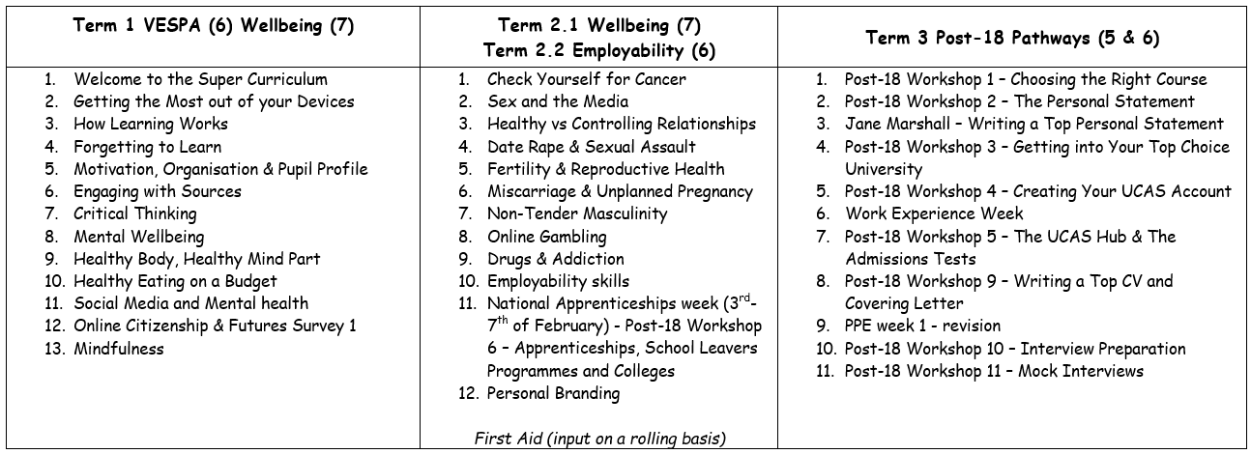
The Year 12 PSHE Learning Journey

Slide 9
Key Vocabulary:
LO1 – to understand how we comprehend information through reading.
LO2 – to understand how we effectively engage with sources in order to comprehend information.
LO3 – to demonstrate use of a strategy for effective reading.
Vocabulary acquisition - the process of learning the words of a language.
Context – the circumstances that form the setting for an event, statement, or idea, and in terms of which it can be fully understood.
Fluency - the ability to express oneself, and understand language, easily and articulately.
To recognise – identify (someone or something) from having encountered them before (this is different to having memorised it).

Slide 10
Academic Reading Strategies
LO1 – to understand how we comprehend information through reading.
LO2 – to understand how we effectively engage with sources in order to comprehend information.
LO3 – to demonstrate use of a strategy for effective reading.

Slide 11
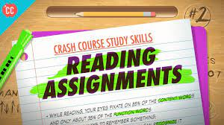
Reading Assignments
How to Read Faster and Remember More!
https://www.youtube.com/watch?app=desktop&v=WAIUkjsZ5xQ&feature=youtu.be
Watch the Crash Course Study Skills video and answer the questions about the Reading Theory and Reading Techniques (9 min 53 secs).
LO1 – to understand how we comprehend information through reading.
LO2 – to understand how we effectively engage with sources in order to comprehend information.
LO3 – to demonstrate use of a strategy for effective reading.

Slide 12
Answers (green pen marking and stick in your books):
2, 3 & 1
Pause frequently
Three
A rapid movement of the eye between fixation points.
The action of concentrating the eyes directly on something.
Regression is the process of re-reading text that you've already read.
You can online take in (comprehend) so much information in one pause.
LO1 – to understand how we comprehend information through reading.
LO2 – to understand how we effectively engage with sources in order to comprehend information.
LO3 – to demonstrate use of a strategy for effective reading.

Slide 13
Answers (green pen marking and stick in your books):
8) By practicing reading, widely and often.
9) Setting a time limit for each chapter.
10) Highlighting too much as everything is important when you first read it. When re reading, you ‘recognize’ the information highlighted when causes you to think that you have ‘recalled’ it, falsely.
11) If you come across a sentence that seems to be laying out a big, interesting idea: draw a quick dot next to it in the margin.
If you come across an example or explanation that supports the previous big idea: draw a quick dash next to it in the margin.
12) Survey, Question, Read, Retrieve and Review.
LO1 – to understand how we comprehend information through reading.
LO2 – to understand how we effectively engage with sources in order to comprehend information.
LO3 – to demonstrate use of a strategy for effective reading.

Slide 14
Think, Pair & Share:
Which reading strategy are you most likely to use and why?
Genius Task – deepen your discussion by debating the following:
One of your friends says they struggle with reading. They don’t like it but want to do well academically. What advice could you give them?
LO1 – to understand how we comprehend information through reading.
LO2 – to understand how we effectively engage with sources in order to comprehend information.
LO3 – to demonstrate use of a strategy for effective reading.

Slide 15
Note Taking – Study Skills
Sounds simple, right? WRONG!
There is a science behind taking effective notes.
It is a skill that will serve you well at sixth form, university and in your career.
There is a way that means that you remember more and it is most definitely not using your iPad.
Using a device for taking notes is actually detrimental for encoding to your long term memory AND will weaken your hand muscles…think of those 3 hour exams…)
LO1 – to understand how we comprehend information through reading.
LO2 – to understand how we effectively engage with sources in order to comprehend information.
LO3 – to demonstrate use of a strategy for effective reading.

Slide 16
Note Taking – Study Skills
The first step in honing your new study skills is to take better notes. This week Thomas will tell you everything you need to know to come to class prepared and find a note-taking system that will help you retain and review like a champ.
Task) watch the video and take notes on it using the template provided:
https://www.youtube.com/watch?app=desktop&v=E7CwqNHn_Ns&feature=youtu.be
LO1 – to understand how we comprehend information through reading.
LO2 – to understand how we effectively engage with sources in order to comprehend information.
LO3 – to demonstrate use of a strategy for effective reading.

Slide 17
Think, Pair & Share:
Compare the notes that you made from the Note Taking video. Does your partner have anything missing?
Help each other by sharing notes and filling in the gaps in your learning.
Genius Task – deepen your discussion by debating the following:
Think about one way you could organise your notes/books and/or folders more effectively. Share this with your partner.
LO1 – to understand how we comprehend information through reading.
LO2 – to understand how we effectively engage with sources in order to comprehend information.
LO3 – to demonstrate use of a strategy for effective reading.

Slide 18
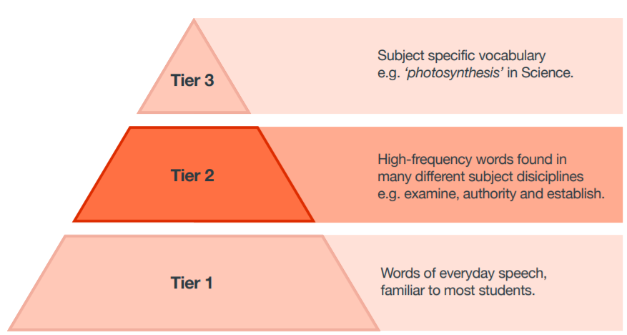
Tier Three Vocabulary
Tier three vocabulary is that which is specific to your subject.
Memorising the vocabulary in your study periods will really help your fluency within the subjects.
LO1 – to understand how we comprehend information through reading.
LO2 – to understand how we effectively engage with sources in order to comprehend information.
LO3 – to demonstrate use of a strategy for effective reading.
Notes:
Allow 20 mins for this.

Slide 19
Often you can find the Tier Three vocabulary lists in your specification but we have provided the Quizlet links here.
Art, Craft & Design - https://quizlet.com/_8dfxwm?x=1jqt&i=19uc6c
Science – https://quizlet.com/_55247u
English – https://quizlet.com/_313tje
Media – https://quizlet.com/_51wsbf
Economics - https://quizlet.com/_3gk87r?x=1jqt&i=19uc6c
Geography – https://quizlet.com/_4m188r
Computer Science – https://quizlet.com/_4qi4x8
Psychology – https://quizlet.com/_3akhnq
Maths subject vocabulary - https://quizlet.com/_8dg0oa?x=1qqt&i=19uc6c
Maths exam command words - https://quizlet.com/_8dg0to?x=1qqt&i=19uc6c
Business Studies – https://quizlet.com/_3l6674
BTEC Travel & Tourism – https://quizlet.com/_4465qh
BTEC Vocational Business - https://quizlet.com/_7rxvpi?x=1jqt&i=19uc6c
BTEC Health & Social Care - https://quizlet.com/_2qjeup?x=1jqt&i=19uc6c
Sociology – https://quizlet.com/_31qier
Level 3 Core Maths - https://quizlet.com/_6lfa51?x=1jqt&i=19uc6c
BTEC Sports studies – https://quizlet.com/_5nfdp1
Philosophy & ethics – https://quizlet.com/_4r8u2f
BTEC Performing arts – https://quizlet.com/_2o0byx?x=1jqt&i=19uc6c
Law – https://quizlet.com/_2ulbg3
Languages – search unit names for flashcards
History – search topic name + vocabulary
Product Design - https://quizlet.com/_2yskup?x=1jqt&i=19uc6c
General exam command words – https://quizlet.com/_5nfxcv
Notes:
Allow 20 mins for this.

Slide 20
Plenary:
LO1 – to understand how we comprehend information through reading.
LO2 – to understand how we effectively engage with sources in order to comprehend information.
LO3 – to demonstrate use of a strategy for effective reading.
Task) in order to demonstrate your learning today, complete the following tasks in any order of choice:
Use the Morse Code method to read a text from one of your subjects.
Use the SQ3R method to read a text from one of your subjects.
Use Cornell Note taking to take notes from a video linked specifically to your subjects.
Complete the ‘Learn’ task on a Quizlet vocabulary link for your subjects.

