Slide 1
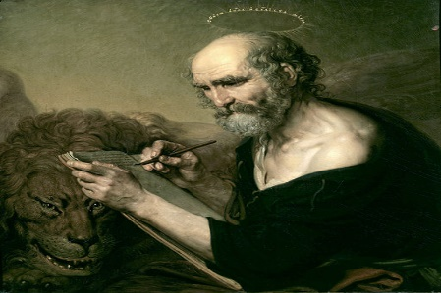
The Good Shepherd
Weekly Reflections
21st April 2024
Saint of the week Saint of the week – Mark the Evangelist – 25 April John Mark was born in Cyrene and his family moved to Palestine shortly after his birth. His mother, Mary, became an admirer of Jesus. She even offered her house as a place where the first Apostles could meet. Mark is often identified as the young man who accompanied Christ after His arrest in the Garden of Gethsemane. He travelled with Paul and Barnabas (Mark’s cousin) back to Antioch; Barnabas and Mark then both accompanied Paul of his first missionary journey. John Mark (St Mark is who is ascribed to being the author of the Gospel of Mark Mark was: Learned and Wise
A reading from the Gospel of St John (10:11-18)
Jesus said: ‘I am the good shepherd: the good shepherd is one who lays down his life for his sheep. The hired man, since he is not the shepherd and the sheep do not belong to him, abandons the sheep and runs away as soon as he sees a wolf coming, and then the wolf attacks and scatters the sheep; this is because he is only a hired man and has no concern for the sheep. ‘I am the good shepherd; I know my own and my own know me, just as the Father knows me and I know the Father; and I lay down my life for my sheep. And there are other sheep I have that are not of this fold, and these I have to lead as well. They too will listen to my voice, and there will be only one flock, and one shepherd. ‘The Father loves me, because I lay down my life in order to take it up again. No one takes it from me; I lay it down of my own free will, and as it is in my power to lay it down, so it is in my power to take it up again; and this is the command I have been given by my Father.’
PRAYER FOR THE WEEK Lord Jesus Christ, You call each one of us to be witnesses – to tell others what we have experienced of your love; to make known what you have done for us and to testify the way you have changed our lives. You have given us the good news, teach us to share it, in your glory. Amen
Day 1
The image of sheep and shepherds are seen throughout the bible. Why do you think this is? What love does a shepherd have for his flock and why does he have this love?
Day 2
Jesus, as the shepherd, has a love for his sheep. How did Jesus demonstrate his love for his flock?
Why do you think Jesus’s leadership is one of doing and self-sacrifice?
Day 3 Why does Jesus care for all of his sheep and go out in search for even a single lost one? Why does Jesus care for the lost, the least and the last? How can you ensure others around you do not feel lost?

Slide 2
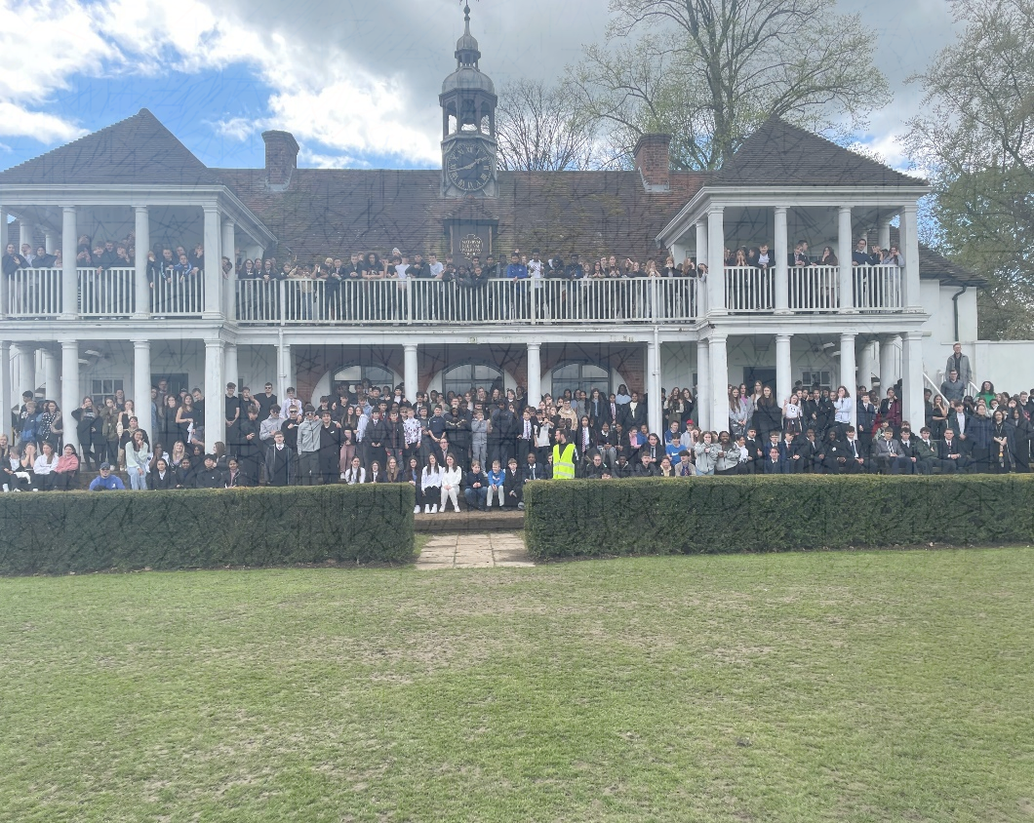
St Joseph’s Faith Walk and picnic 2024
When – Wednesday 1st May 2024
Where to – Walking to Eton fields and back.
Outline of day:
Time | Event
8.25am | Line up and St Joseph’s Day prayer recited by all students
8.30am- 9.15am | Students to follow plan to come to celebrate Mass
10.15am – 11am | Students return to form and then each year group comes to the changing room to get changed. Extended break (like electives for changing)
11am | Each year group goes to the playground, registered and then head on Faith Walk
12.30pm | Reach venue of Eton and then have a school picnic with events, music etc
1.30pm | Walk back to school from faith walk
3.15pm | BBQ and football match
Unlocking Belief In All

Slide 3
St Joseph’s Faith Walk and picnic 2024
Why a Faith Walk?
A Faith Walk is designed to strengthen our faith and bring us together with others in our school community. It is best described as a planned walk to encourage continued spiritual growth in your personal relationship with Christ by seeing and living it through your relationship with others.
Unlocking Belief In All

Slide 4
St Joseph’s Faith Walk and picnic 2024
When we arrive to Eton all students will have the opportunity to have a picnic with their friends. We encourage all students to arrange with their friends a picnic to enjoy together. Arrange sandwiches, cakes, soft drinks and sweets to enjoy in Eton.
Unlocking Belief In All

